Slide 1
ClarifAI
User-Centred Explainable AI (XAI) Methods for Scientists

Slide 2
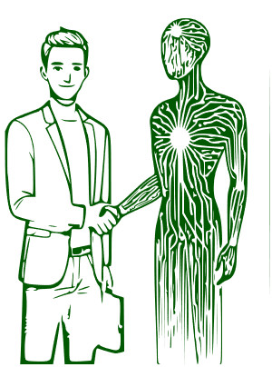
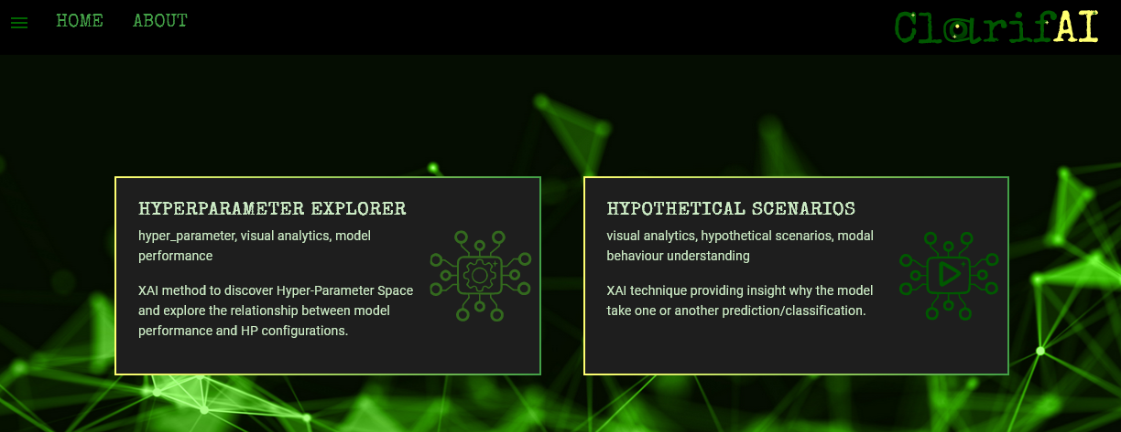
ClarifAI Project
Challenges of Using XAI Methods:
is web platform that provides a suite of XAI methods to help scientists and practitioners better understand the inner workings and development process of ML algorithms.
Oriented for ML Specialists
Lack of User-Friendly Explanation Formats

Slide 3
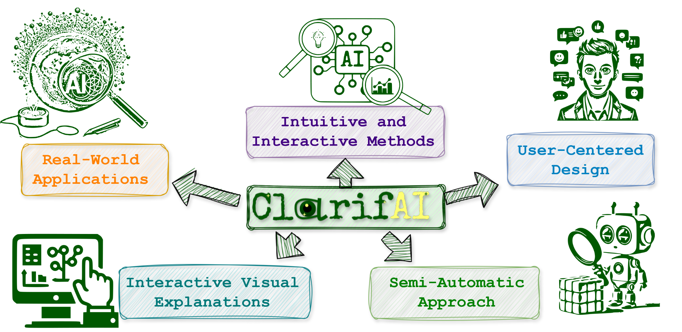
Our Approach

Slide 4
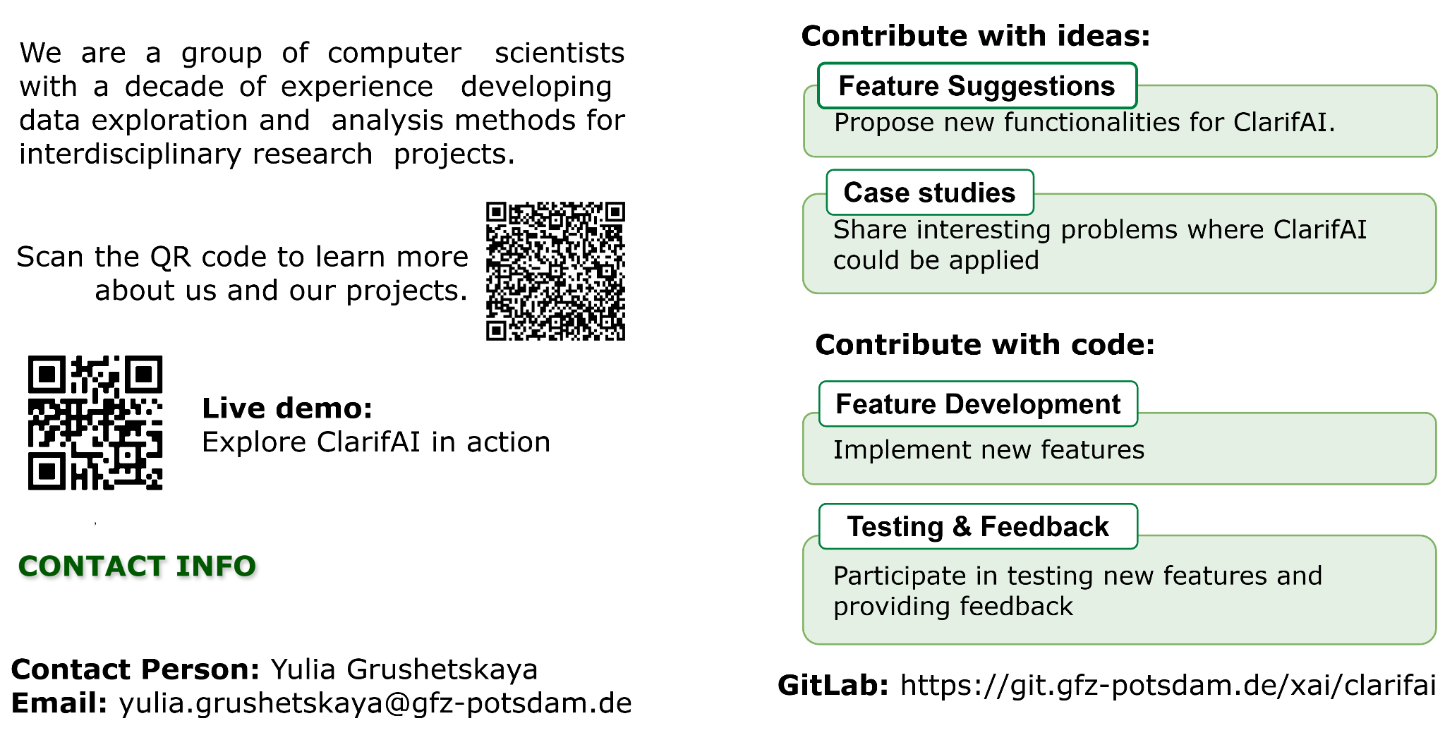
Join Us

