Slide 1
Uncovering Inductive Biases ​
in Material Text Representation for Improved Language Modeling
N. Alampara¹, R. Aliakbari¹, S. Miret³, K. M. Jablonka^{1, 2}
1 Friedrich Schiller University Jena, Laboratory of Organic and Macromolecular Chemistry, Jena, Thuringia, Germany 2 Helmholtz Institute for Polymers in Energy Applications Jena, Jena, Thuringia, Germany 3 Intel Labs, Hillsboro, Oregon, United States of America
composition geometry bonding periodicity symmetry coarse graining

Slide 2
Composition
Atom Sequences
Atom Sequences++
SLICES
SrTiO3
Sr Ti O O O
Mg Ta Pt 4.32 4.32 4.32 60 60 60
Mg Ta Pt 0 2 - - o 0 2 - o - 0 2 -o o 0 2 o - - 0 2 o - o 0 2o o - 0 1- - o01- o - 01o - - 12o oo
Crystal-text-LLM
Z-matrix​
Local-Env
CIF P₁
3.5 4.2 4.4​ 90 90 90​ Ta 0.76 0.12 0.0​ .......​
Mg​ Ta 1 6.1​ Pt 2 0.5 1 0
R3m​ Ta (1a) [Ta]#[Pt]​ Pt (1a) [Ta]#[Pt]​ Mg (1a) [Ta][Mg][Ta].[Ta].[Pt].[Pt].[Pt] ​
data_MgTaPt​ _cell_length_a 4.32​ ......​

Slide 3
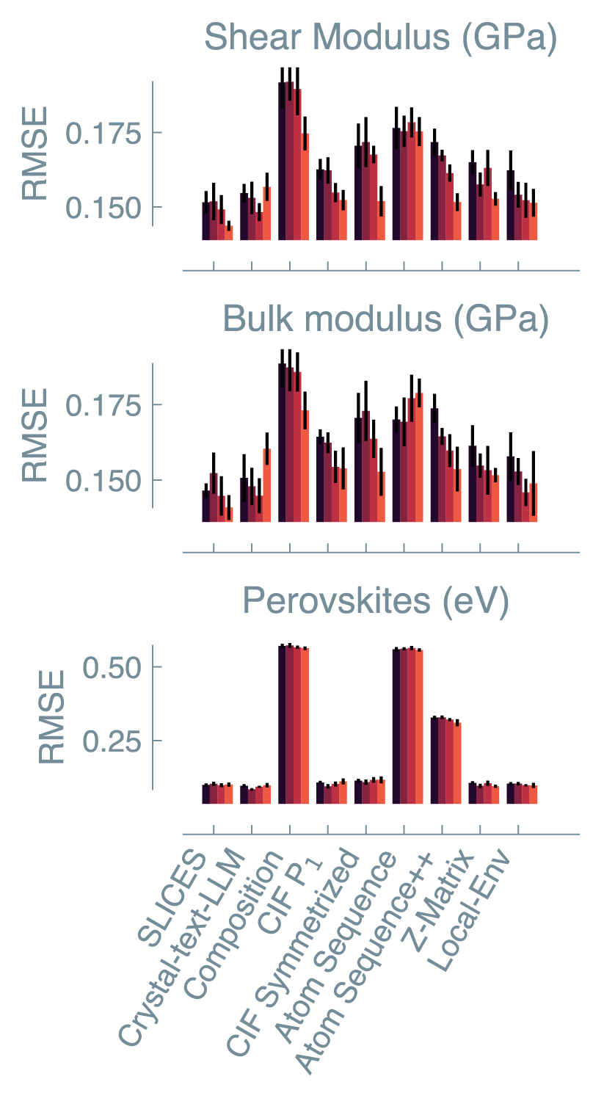
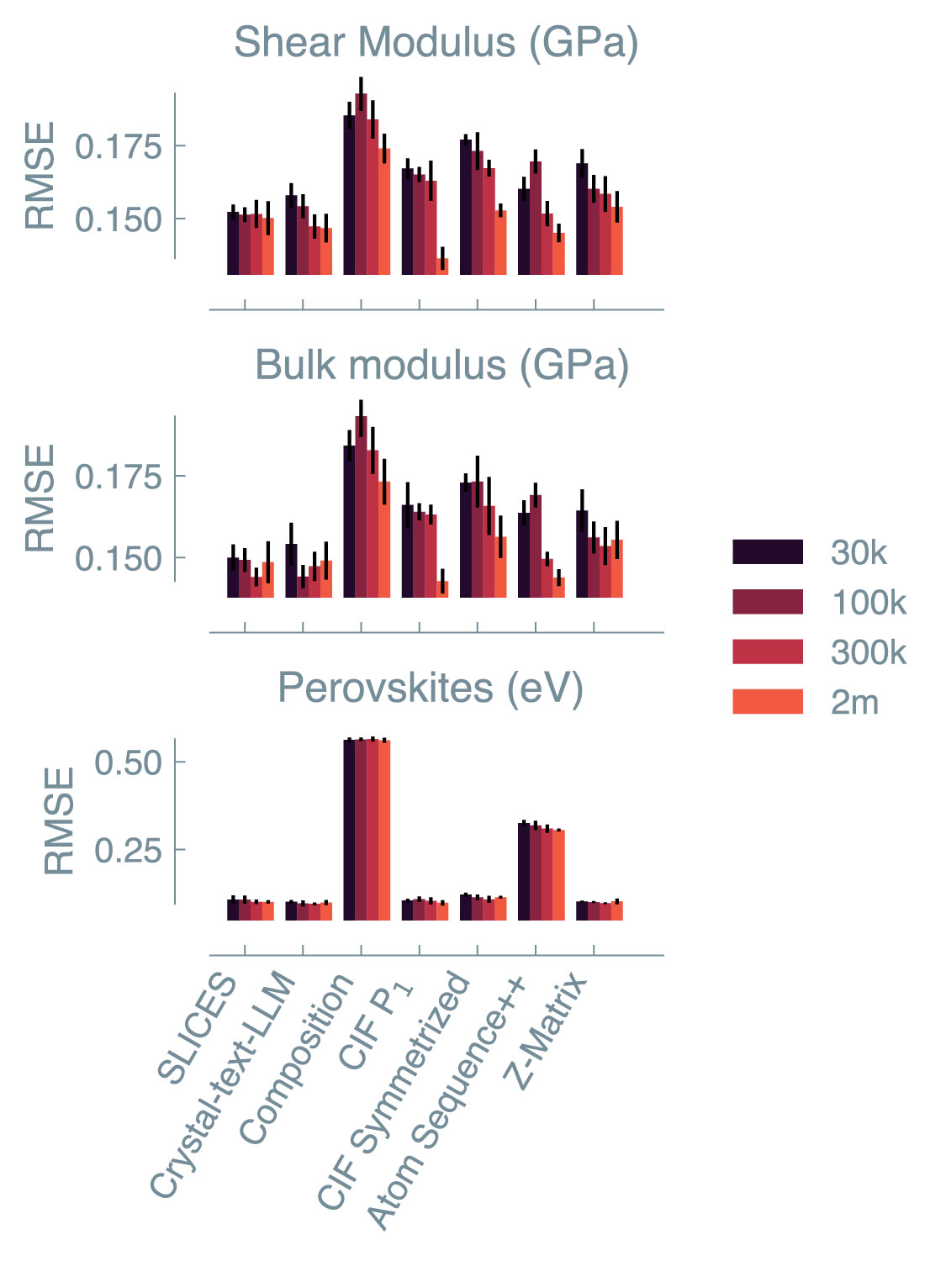
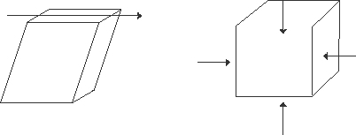
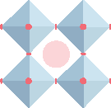
Pretrain data scaling
Property prediction
Shear modulus
Bulk modulus
Formation Energy
Language modeling
### Question: What is the {property} of the {MatText Representation}?
### Response: {}

Slide 4
Attention Analysis
Hypothetical Potential Analysis

Slide 5
Conclusion
• Information about the 3D geometry of materials not effectively leveraged in both causal and masked language modeling of materials
• Larger pretrain datasets don't help without diverse local geometries. Locality is a crucial inductive bias for material modeling.
pvt.nawaf@gmail.com | mail@kjablonka.com

Slide 6
Acknowledgement

