Slide 1
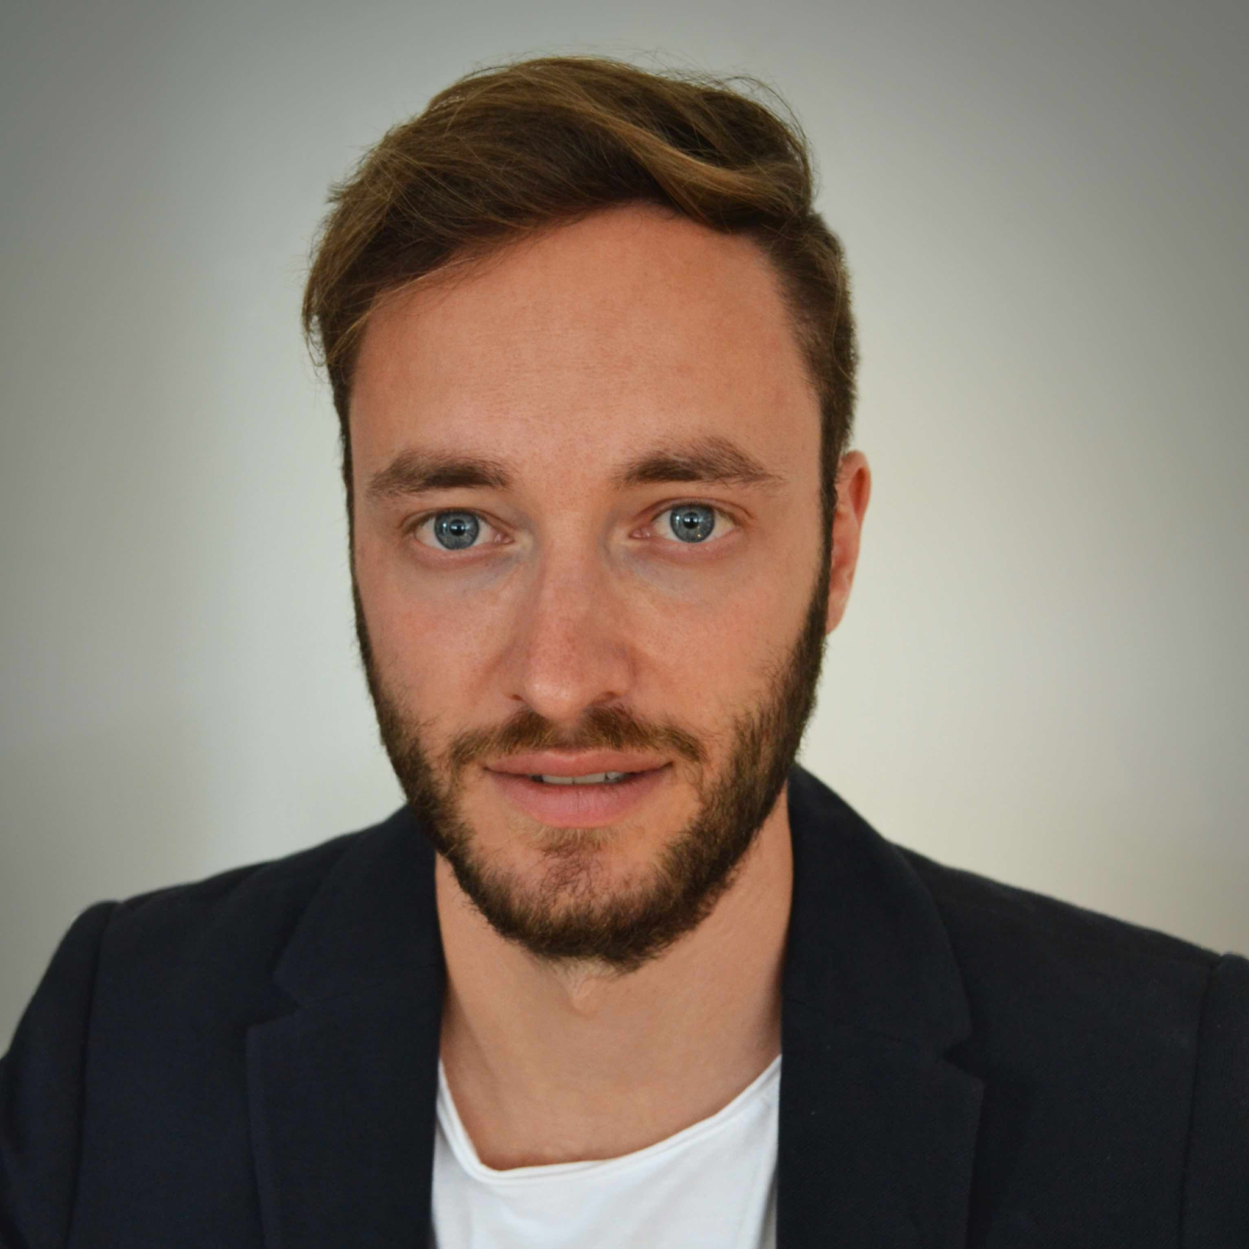
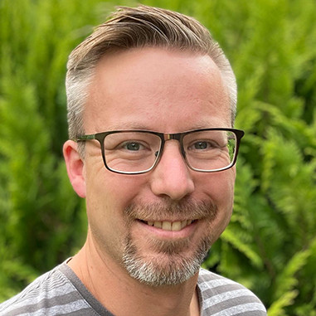
The HFMI Synergy Unit:
Towards Technological Leadership in New AI for Research Data
Paul Jäger (DKFZ)
Stefan Bauer (HM)
Stefan Kesselheim (FZJ)
Dagmar Kainmueller (MDC)
Notes:
Now you have seen six proposals for pilot projects. And all of the funded projects are expected to do great research in their domain. But now we want to zoom out a bit, take a step back. And ask the question: “How can Helmholtz become a leading organisation for developing and especially deploying foundation models beyond the duration and scope of individual projects?”. Joint with Dagmar Kainmüller, Paul Jäger and Stefan Kesselheim, we are the lead-authors of the concept behind the Helmholtz Foundation Model Initiative. And so while drafting the text and project call, we have thought a lot about how to answer this question: And the result is that, we propose a Synergy Unit for the Helmholtz Foundation Model Initiative.

Slide 2
HFMI Synergy Unit
Mission
“Amplify the impact of HFMI on domain research”
The unique structure of the Helmholtz Association enables a truly outstanding opportunity towards technological leadership by synergistic methodological innovation across Pilots & further FM projects
Notes:
Mission:
“Amplify the impact of the HFMI on domain research”
HFMI has unique potential and need to become bigger than its parts:
The unique structure of the Helmholtz Association enables a truly outstanding opportunity towards technological leadership by leveraging the set of Pilot Projects (& further FM projects) as a stage
for synergistic methodological innovation in a new wave of AI development
The Synergy Unit puts this opportunity into action

Slide 3
HFMI Synergy Unit
General Approach
The Synergy Unit works with all Pilots,
deriving best practices and generalizing principles for FM development and -application across domains
Knowledge dissemination, community building and representation complement the Synergy Unit’s approach, ensuring lasting impact of the initiative
Notes:
Individual Pilots will greatly propel research in their domains
The Synergy Unit will work with all Pilots to derive generalizing principles for FM development and -application across domains
With the dissemination of AI across all disciplines, the Learning across these pilots will amplify the impact of research across all Helmholtz areas; At the same time the broad spectrum of model development across the whole society presents a unique opportunity for generalizable insights in model training and development.
Knowledge dissemination, community building and representation complement the Synergy Unit’s approach, ensuring lasting impact of the initiative

Slide 4
HFMI Synergy Unit
General Approach
Every Pilot will need to tackle the whole Foundation Model pipeline
Notes:
– Every pilot will need to tackle the whole Foundation Model pipeline. I.e.,
– Every pilot will use some sort of base model.
– Every pilot will try to understand what their model has learned.
– Every pilot will fine-tune their foundation model to a variety of downstream tasks.
– Every pilot will assess how model performance behaves with increasing amounts of data and model size.
– And every pilot will move towards including more and more multi-modal data to extend the scope of their models.
– This sets an ideal stage for the synergy unit to perform comparative benchmarking across diverse datasets, thus deriving insights and respective recommendations for dealing with novel tasks, novel data, and novel domains.

Slide 5
HFMI Synergy Unit
Example:
Model understanding
General Approach
Pilot A: We devised a training pipeline such that Domain A prior knowledge is reflected in embedding space structure, via massive costly model tuning
Pilot C: We devised a training pipeline such that Domain C prior knowledge is reflected in embedding space structure, via massive costly model tuning
Synergy Unit: We systematically investigate across domains how known input properties are reflected in embedding space, yielding training recommendations for novel domains
Pilot B: We devised a training pipeline such that Domain B prior knowledge is reflected in embedding space structure, via massive costly model tuning
Notes:
– Let’s take as an example the task of understanding what a model has learned
– Among many diverse and exciting routes towards model understanding, one immediate approach is to investigate how known properties of the input data are reflected in embedding space.
– As a foundation model necessarily needs to tackle multiple downstream tasks, diverse kinds of annotations need to be available, (each kind at least for some small subset of the data for fine tuning and down-stream validation)
– So each good pilot will study how known properties, including available downstream annotations and possibly further meta-information, are reflected in embedding space;
– The Synergy Unit will leverage this empirical work across pilots in a comparative approach:
– We will systematically investigate across domains how known input properties are reflected in embedding space, yielding training pipeline recommendations and best practices for novel domains.

Slide 6
HFMI Synergy Unit
Example:
Model adaptation
General Approach
Pilot A: We devised fine-tuning pipelines for optimized performance on Domain A downstream tasks
Pilot C: We devised fine-tuning pipelines for optimized performance on Domain B downstream tasks
Synergy Unit: We systematically investigate data selection- and model adaptation paradigms to derive recommendations for cost-effective adaptation to new tasks and novel domains
Pilot B: We devised fine-tuning pipelines for optimized performance on Domain B downstream tasks
Notes:
Also every pilot will need to adapt their foundation model to many downstream tasks. And there ist 2 fundamental questions here:
1) How do I setup a customized adaptation pipeline for each problem, including the exact fine-tuning strategy and so on ?
And 2) Which subset of my large data pool should I select to label for the finetuning?
The Synergy Unit will address both of these questions by 1) developing systematic guidelines for model adaptation, and 2) exploring Active Learning approaches for smart data selection.

Slide 7
HFMI Synergy Unit
Example:
Scaling Laws
General Approach
Pilot A: We devised scaling laws to understand how model performance changes with data and compute for domain A.
Pilot C: We devised scaling laws to understand how model performance changes with data and compute for domain C.
Synergy Unit: We develop the methodology to predict how much better much bigger models work, and how to train them optimally.
Pilot B: We devised scaling laws to understand how model performance changes with data and compute for domain B.
Notes:
– Every project will ask the question: How much can I gain from more data and/or more compute and especially how can I utilize a budget of compute most efficiently?
– How can I even estimate the benefit of more data and/or more compute without doing the work?
– Every project will scale up in small steps, but doing this systematically is challenging.
– For example, if I make a model bigger, what are the right hyperparameters to train it?
– How can I make a fair comparison of two models, where I could spend much more time into tuning the training process of the smaller model?
– Scaling is very challenging because the training process of deep learning models is not nearly understood theoretically, and in many cases, I have only one chance to run a large training.
– The synergy unit will provide recipes and best practices tested across projects and within European efforts for new Foundation Model developments within Helmholtz

Slide 8
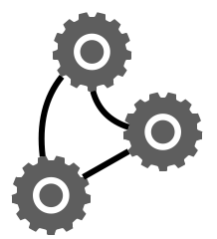
HFMI Synergy Unit
Example:
Model composition
General Approach
Pilot A: Trained a FM for domain A successfully but has a fixed inference budget in deployment.
Pilot C: Trained a FM successfully in domain C but needs retrieval with a database at test time.
Synergy Unit: You train a model once but you use it millions of times for inference. We develop the scaling laws and optimal methodology for complex inference pipelines across projects
Pilot B: Trained a FM for domain B successfully but uses it with another FM (e.g. a text model) in a pipeline where the results influence each other.
Notes:
The field is moving away from reporting the result of a single FM call, towards reporting results from increasingly complex inference strategies!
Smaller models may never reach quality levels that large models can. Yet when operating under an inference budget, points reachable by both models may be reached more efficiently w/ smaller ones
Scaling properties are crucial not just for Training but for Inference and in Inference Pipelines!
Trained FMs are not run in isolation; They will be part of complex systems at deployment and for the highest translational impact we need to ensure that these compositional systems are effective!

Slide 9
HFMI Synergy Unit
General Approach
Notes:
– In summary, the synergy unit will closely work with and leverage the pilot projects as well as other foundation model efforts in the helmholtz association to pursue a comparative benchmarking approach,
– aiming at deriving general principles for foundation model development and application,
– and yielding corresponding recommendations for domain scientists based on key properties of their data.

Slide 10
HFMI Synergy Unit
General Approach
Notes:
– We will ensure a lasting build-up of respective expertise across the Helmholtz association via a series of targeted workshops and training events,
– in collaboration with the Helmholtz Information and Data Science Academy
– as well as with key involvement of the Helmholtz AI and Helmholtz Imaging consultants

Slide 11
HFMI Synergy Unit
General Approach
Notes:
– Beyond Helmholtz, we will represent the initiative and liaise with the international AI community and sibling initiatives.
– To this end, we will leverag and expand upon existing ties, e.g., our strong connections to Swiss AI leadership and key players in core AI in UK, France, Finland and Switzerland among others.
– Initial feedback from the international AI community has already revealed high interest in our synergistic approach on top of the pilot projects;

Slide 12
HFMI Synergy Unit
Key outcomes
Streamlined Foundation Model Development and Application
More effective training- and adaptation pipelines, more cost-efficient training and inference, faster scientific progress through better model understanding
Large Curated Benchmark Datasets
Catering our cross-domain benchmarking approach to the community
Open Source, Open Science
Code, models, data

Slide 13
HFMI Synergy Unit
Collaboration and Team Science
Very close collaboration with pilots and beyond
Each synergy science topic is a large team effort w. contributions from all pilots and further FM efforts
Highly interdependent FM pipeline topics
Very close cross-topic collaborations in Synergy Unit

Slide 14
HFMI Synergy Unit
Collaboration and Team Science: Organization
Synergy Workshops
Present project- and synergy topic progress
Jointly incubate most impactful scientific next steps
Jointly plan community building- and outreach events
Twice a year – Satellite events at HAICON (Prologue Day) and Fall Incubator
HFMI Conference
Build broad FM community in Helmholtz
Recruit further FM projects into synergy topics
Once a year – aiming at 01/2025

Slide 15
HFMI Synergy Unit
Community Building and Outreach
Helmholtz
Project- and synergy presentations at HI Conf (05/2024) and HAICON (06/2024), Assembly of Members (06/2024), Annual Summit (09/2024), Incubator (11/2024)
Global Scientific Community
Workshop w. European sibling initiatives: Swiss.AI, UK, France – aiming at Spring 2025
Dagstuhl Seminar, NeurIPS / ICLR Workshops, AI for Good Global Summit
Public Outreach
Re:publica – 05/2024 Media Roundtable – 06/2024 Parlamentarisches Frühstück – 10/2024 Falling Walls Roundtable – 11/2024 (tbc)

Slide 16
HFMI Synergy Unit
Community Building and Outreach

Slide 17
HFMI Synergy Unit
Key outcomes
Streamlined Foundation Model Development and Application
More effective training- and adaptation pipelines, more cost-efficient training and inference, faster scientific progress through better model understanding
Large Curated Benchmark Datasets
Catering our cross-domain benchmarking approach to the community
Open Source, Open Science
Code, models, data
Lasting Networks and Knowledge in Helmholtz
Lasting Impact on the Global Community

Slide 18
HFMI Synergy Unit
Personnel and Topics
Coordinate Foundation Model Efforts in Helmholtz
Representation and Liaison
Strategic Alignment
Promote Integration and Cross-disciplinary Collaboration
Expanding Model Scope and Performance
Compositional Generative Models
Novel Base Models
Systematic Model Scaling
Scaling laws
Scaling hyperparameters
Systematic Model Adaptation
Systematic Selection of Adaptation Data
Fingerprinting for Adaptation Strategies
Systematic Model Understanding
Relating model knowledge to domain knowledge
Understanding multi-modal data integration
Knowledge Dissemination and Guidance
Community Building and Knowledge Dissemination
Alignment with Information and Data Science Framework
Guidance and Reporting
Notes:
– A comparative approach across pilots and further FM endeavors is a bold effort
– Implementing it will require both working very closely with all pilots on the empirical side, as well as abstract conceptual work to devise generalizing principles
– I.e., it requires empirical work engineering and HPC side as well as work on core AI method development
– Furthermore, each FM pipeline topic has a diverse range of thematic angles
– We ask for 2 FTEs per FM pipeline topic, which is what we deem a minimal setup for the initial phase of the HFMI, i.e., for a Synergy Unit “Pilot” phase suitable for a proof of concept, to be re-assessed in case the initiative will grow
– We furthermore ask for 1 FTE to work as project manager for community building including workshop- and event organization;
– We have a perfect candidate for the PM position in Berlin, namely Eirini Kouskoumvekaki who has long-term experience as a PM for a HIDA school and is very excited to take on this new responsibility
In summary, we are ready to start not only in supporting the selected projects but help drive and connect Helmholtz with the international AI Community And now look forward to your feedback.

Slide 19
The HFMI Synergy Unit:
Towards Technological Leadership in New AI for Research Data
Paul Jäger (DKFZ)
Stefan Bauer (HM)
Stefan Kesselheim (FZJ)
Dagmar Kainmueller (MDC)
Notes:
Now you have seen six proposals for pilot projects. And all of the funded projects are expected to do great research in their domain. But now we want to zoom out a bit, take a step back. And ask the question: “How can Helmholtz become a leading organisation for developing and especially deploying foundation models beyond the duration and scope of individual projects?”. Joint with Dagmar Kainmüller, Paul Jäger and Stefan Kesselheim, we are the lead-authors of the concept behind the Helmholtz Foundation Model Initiative. And so while drafting the text and project call, we have thought a lot about how to answer this question: And the result is that, we propose a Synergy Unit for the Helmholtz Foundation Model Initiative.

