Slide 1
AutoAI-Pandemics
Democratizing Machine Learning for Analysis, Study, and Control of Epidemics and Pandemics
1
Much larger team
Presenter: Dr. Ulisses Rocha (he, they)
Microbial Data Science, team leader
Helmholz Centre for Environmental Research
1

Slide 2
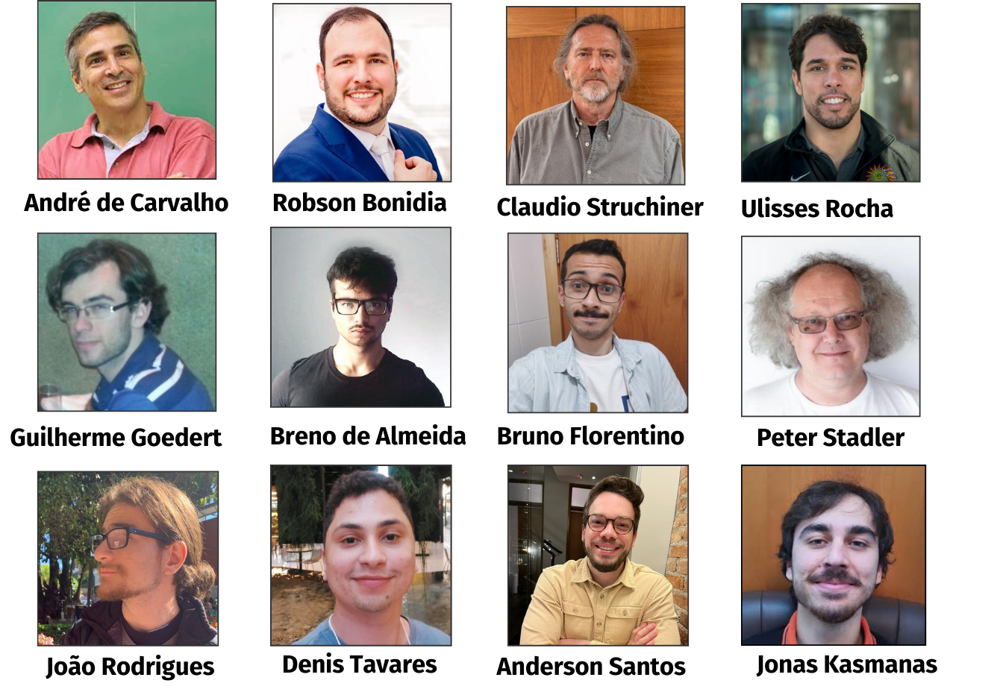
Our Team
AutoAI-Pandemics
Website
We are one of many consortia
2

Slide 3
The Global South AI4PEP Network
AI4PEP Website
3

Slide 4
AutoAI-Pandemics Motivation
Main causes
Infectious diseases
Epidemics
or even Pandemics
Detecting variants
Contact tracing
Challenges to predict
Epidemic outbreaks
Discovering new drugs
Fighting misinformation
Artificial Intelligence (AI) can provide tools to deal with these scenarios, demonstrating promising results in the fight against the COVID-19 pandemic.
4

Slide 5
Challenges
Serious inequalities
Expertise
Designing robust and reliable ML solutions
Researchers: biology and health
Accessibility inequalities
Knowledge inequality
Those with access to software and HPCs
Those in smaller institutions or regions without resources
ML algorithms development is complex
Limiting the potential for innovative research
Skills required constitute a barrier
5

Slide 6
Democratization
Democratizing AI implies granting ML accessibility to individuals who are not experts in regions with fewer resources, for example, individuals without training in data science, mathematics, or computer science.
6

Slide 7
Our Proposal
AutoAI-Pandemics offers the following solutions:
Automated epidemiological analysis
Automated bioinformatics analysis
Fighting misinformation/disinformation
7

Slide 8
Our goals
To democratize access to Machine Learning (ML) techniques, allowing non-specialists to use them without needing knowledge of programming, artificial intelligence, and other disciplines.
1.
Computational tools (AutoAI-Pandemics); (ii) data analyses and syntheses; (iii) data reconciliation or integration of public datasets
2.
OBJECTIVES
3.
To significantly reduce the experience needed to use ML pipelines
8

Slide 9
Democratizing AI Knowledge in LAC
Engagement with underrepresented communities
Special Short Courses
Public awareness campaigns in AI
Collaboration with Industry
Open-Source Initiatives
International collaboration
Community-based development
9

Slide 10
Our Solutions
10

Slide 11
Focus of Contributions
Democratizing Access to Machine Learning by:
AutoAI-Pandemics focus on accessibility to non-experts
addressing significant accessibility inequalities
knowledge gaps in the use of ML for biological research
Tasks automated include:
feature selection
algorithm recommendation
hyperparameter tuning
Automating complex tasks reducing the time to analyze biological sequences
Increased scientific efficiency
Advancements in understanding critical biological issues
Potential outcomes
Accelerated rate for discoveries
Increased scientific efficiency
11

Slide 12
Path to inclusivity and innovation
strengthens global scientific efforts
Promote broader inclusion of researchers
including researchers from diverse backgrounds and resources
enhances global health efforts
Benefitting:
Society
Economy
This can lead to breakthroughs
By making ML a shared resource
shift from exclusivity to accessibility
12

Slide 13
Our Impact
+21.000
Accesses to our solutions and articles
+10
Awards, Recognitions, and Grants
+148
citations in our articles
+123
Stars on
GitHub
+50
news published in media
+100.000
People directly and indirectly impacted
13

Slide 14
Main Recognitions
Google Latin America Research Awards (LARA):
BioAutoML was selected by LARA-Google as one of the 24 (out of 700) most promising ideas in Latin America
One of the most promising projects among a total of 221 proposals from 47 countries in a global competition organized by the AI4PEP
AutoAI-Pandemics was one of the most promising projects among a total of 221 proposals from 47 countries
Participation in Prototypes for Humanity 2023, during COP28-Dubai
AutoAI-Pandemics was chosen from 3000 entries from over 100 countries, standing out among the 100 best
1st place, "Breaking the Wall of Fake News", Falling Walls Lab Brazil 2023
Prize given by the Falling Walls Foundation, DAAD
14

Slide 15
Acknowledgments
AutoAI-Pandemics
Democratizing Machine Learning
15

Slide 16
Thank you for your attention
Do you like the idea of democratizing AI?
Ask me how!
16

