Slide 1
Graph Neural Networks for Disease Gene Identification: Discover Disease-Specific Networks through Link Prediction
Nikolay Shvetsov – Ph.D. candidate
Hübner group
Max Delbrück Center
11.06-14.06

Slide 2
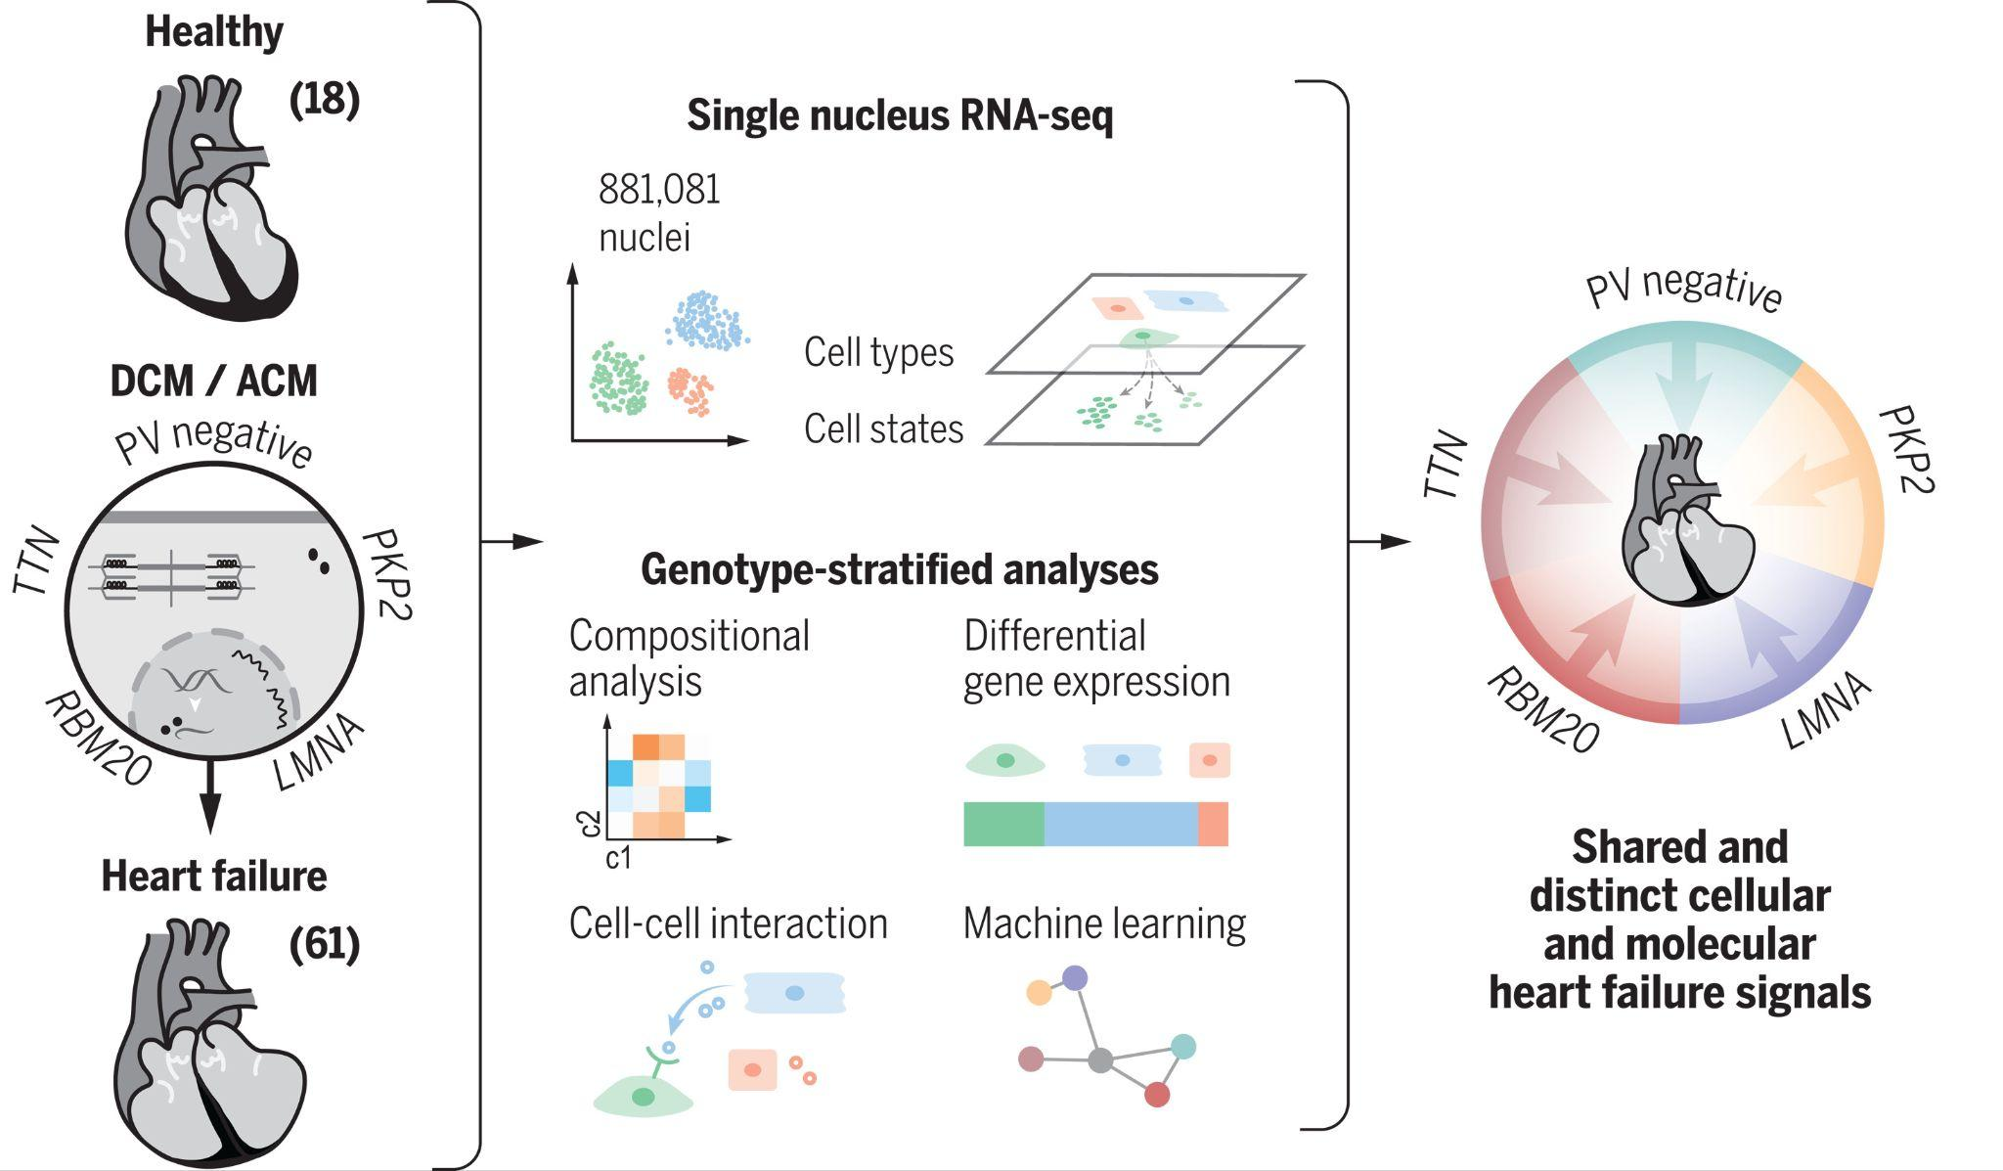
Rationale
Why are conditions different?
Can we extract disease relevant genes and connections?
Can we build disease specific networks?
Reichart,Lindberg,Maatz, et al. [Science 2022]

Slide 3
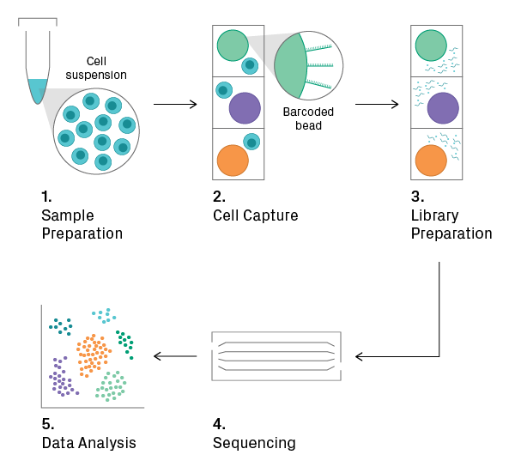
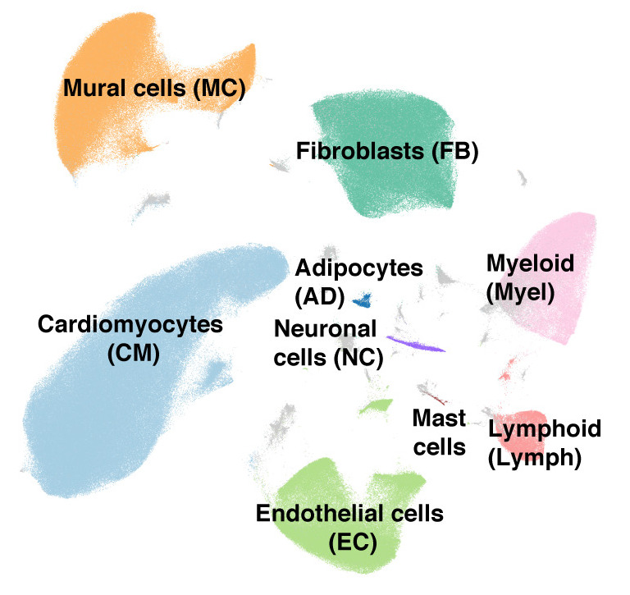
Single cell data
Revolutionary technology
High resolution
Heterogeneity detection
Reveals hidden differences in data

Slide 4
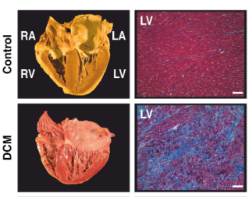
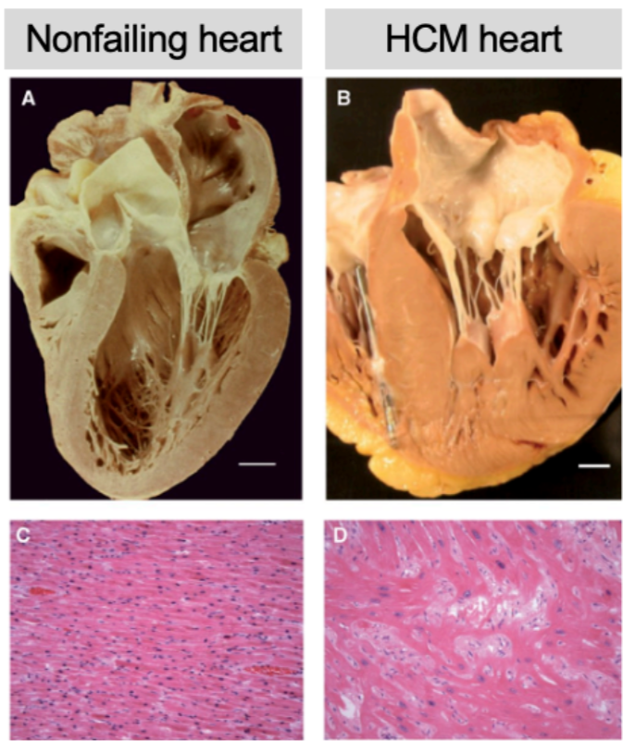
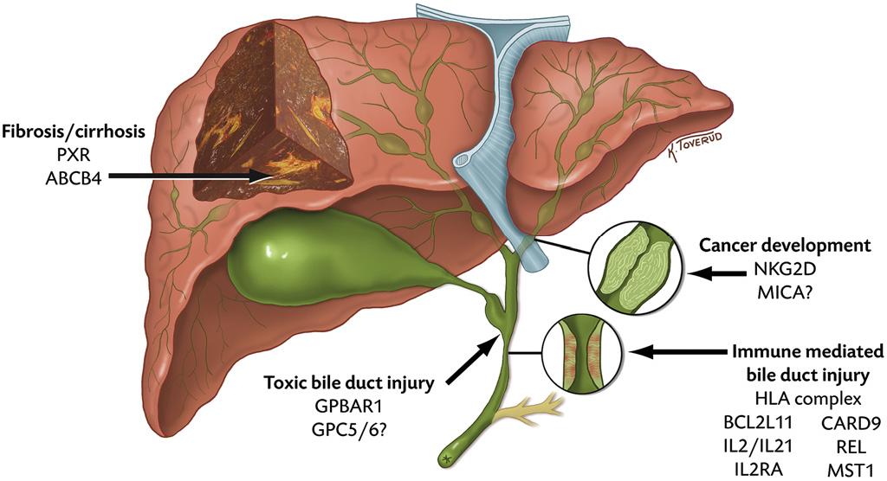
Datasets
Dataset | Number of patients | Number of cells | Number of classes
Dilated Cardiomyopathy(DCM) | 42 | 169 071 | 3
Hypertrophic cardiomyopathy(HCM) | 111 | 999 335 | 4
Primary sclerosing cholangitis(PSC) | 63 | 316 791 | 6

Slide 5
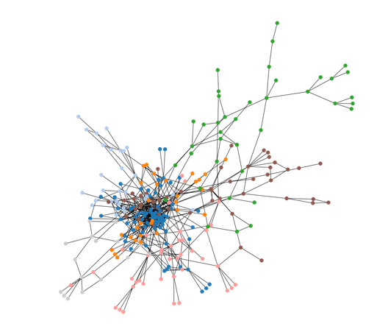
Motivation and pipeline
What?
Identification of disease regulators
Insights into connections between pathways
How?
Create baseline network based on correlation for each patient
Estimate quality of network for each patient (Graph labelling task)
Building a model to predict connection between genes
Apply the model on single cell datasets to study changes in the gene regulatory network
Find hidden connections between genes
Optimize network per patient to find “disease specific connections”

Slide 6
Proposed Pipeline: Overview

Slide 7
Proposed Pipeline: Step 1: baseline network construction
Correlation Network: Extract basic node connections specific to the patient.
Incorporate Prior Knowledge: Integrate data from databases, including transcription factors* and protein-protein interactions.
Baseline Network Establishment.
*Transcription factor is a protein that binds to specific DNA regions and regulates the turning on or off of genes, helping control which proteins are produced in the cell.

Slide 8
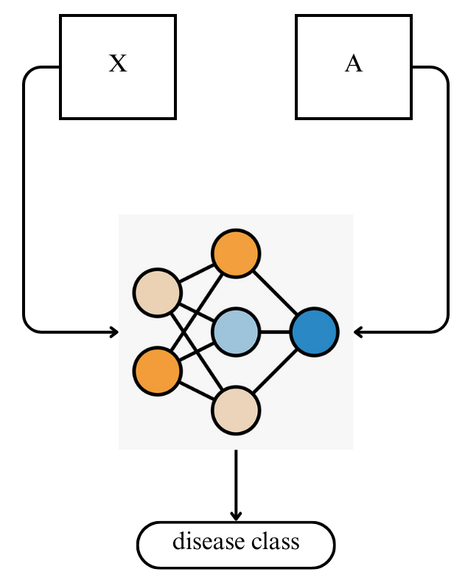
Proposed Pipeline: Step 1-baseline networks validation
Graph labeling task for network validation
Dataset | F1 score macro
DCM | 0.82
HCM | 0.75
PSC | 0.58
X - count matrix
A - adjacency matrix

Slide 9
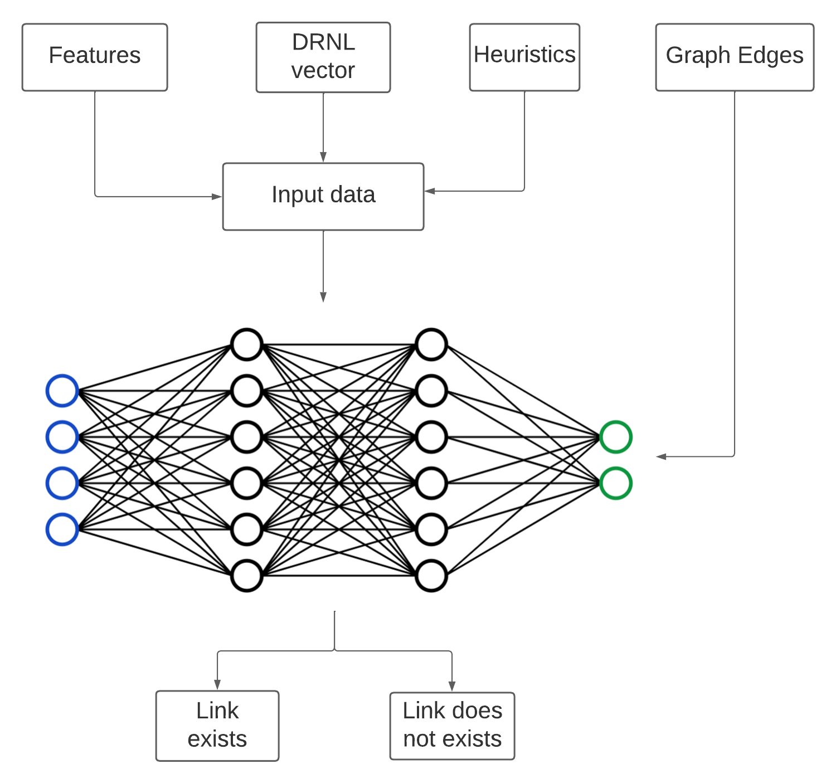
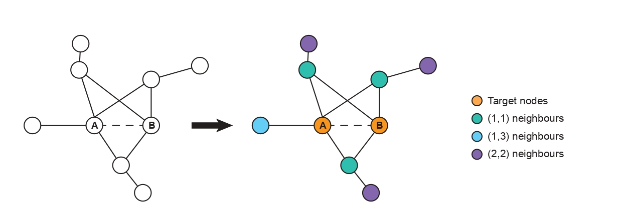
Proposed Pipeline:
Step 2 - link prediction
How to improve networks?
Catch hidden patterns in data and find obvious connection

Slide 10
Proposed Pipeline:
Step 3 - class specific network construction
Matthew correlation heatmaps between class specific networks
Networks within a class exhibit greater similarity to one another
compared to networks from distinct classes.

Slide 11
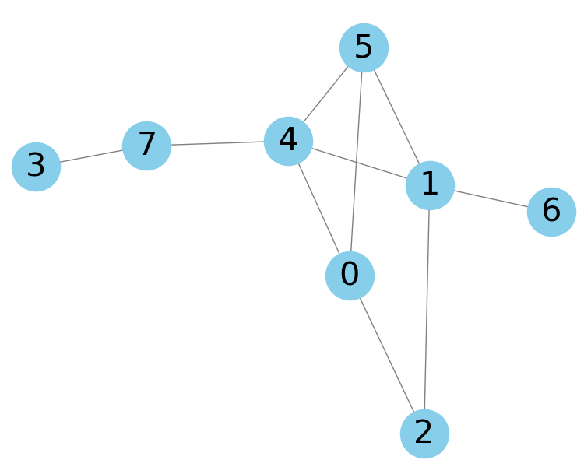
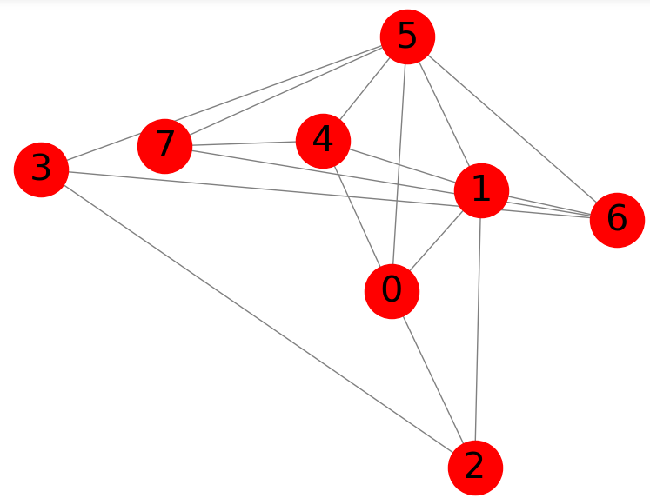
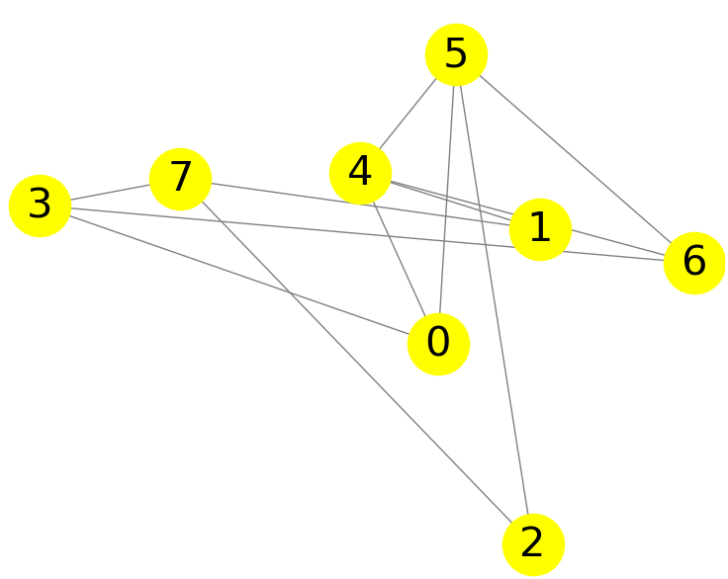
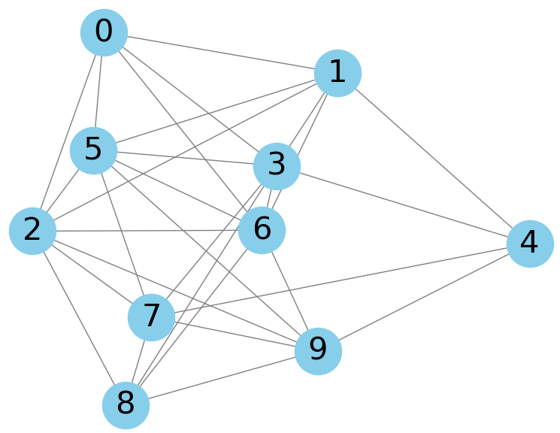
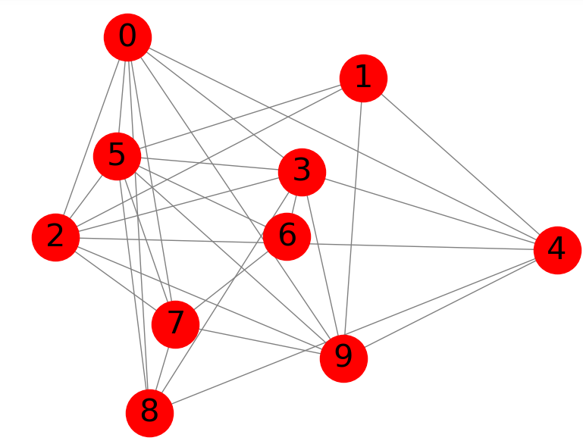
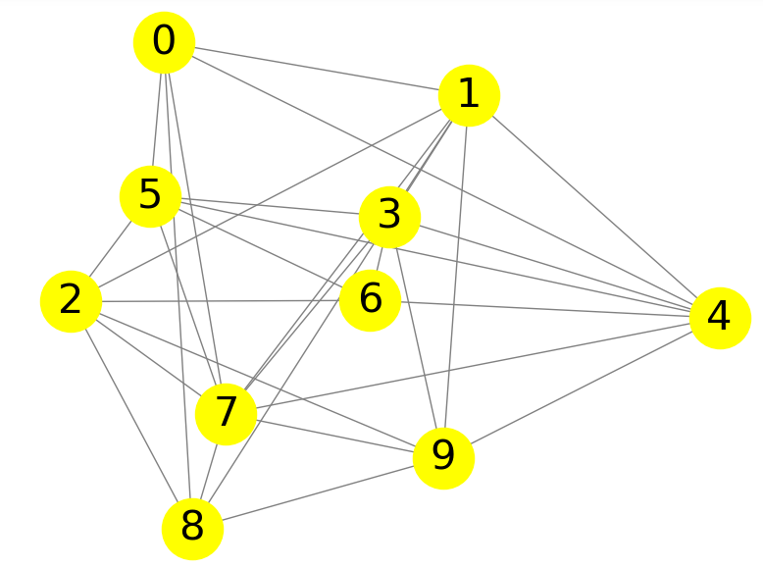
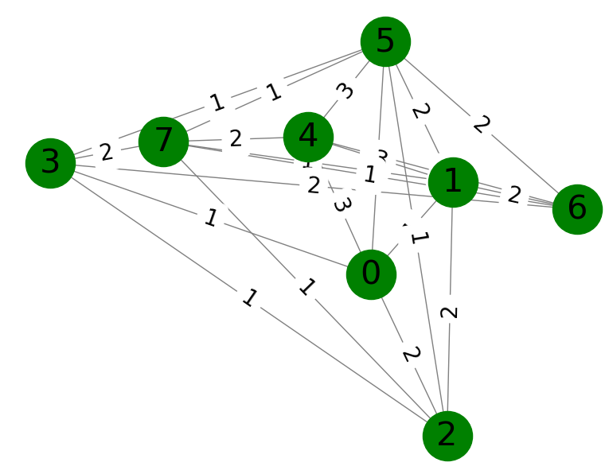
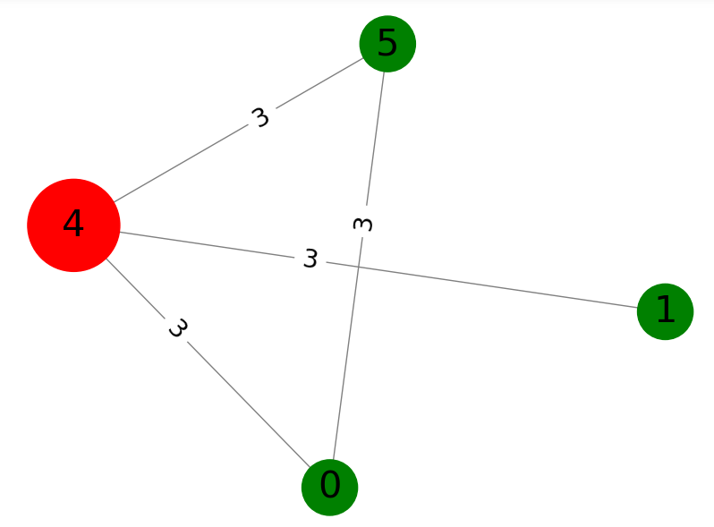
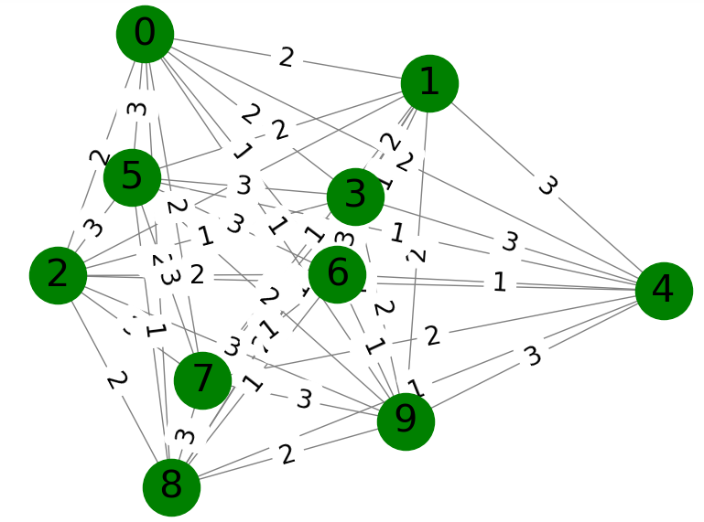
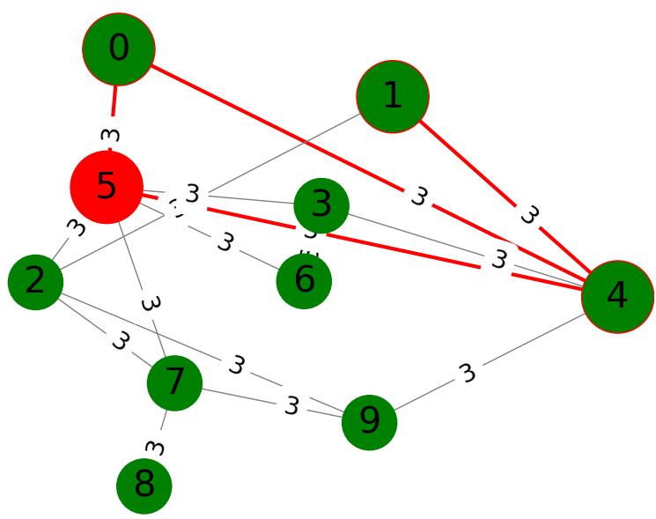
Proposed Pipeline:
Step 3 - class specific network construction
Class I
Class II
Patient 1
Patient 2
Patient 3
Patient 1
Patient 2
Patient 3
Mapping
Mapping

Slide 12
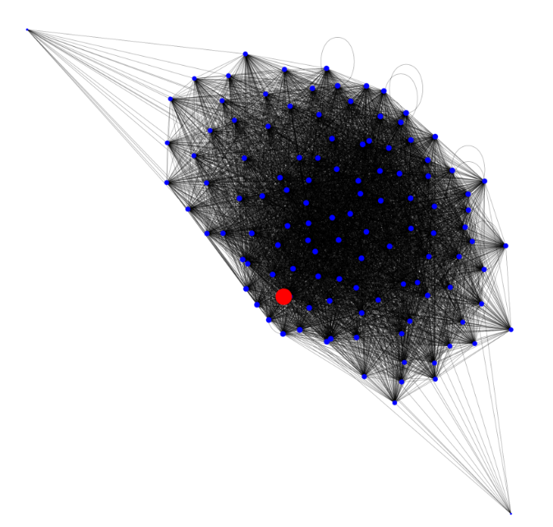
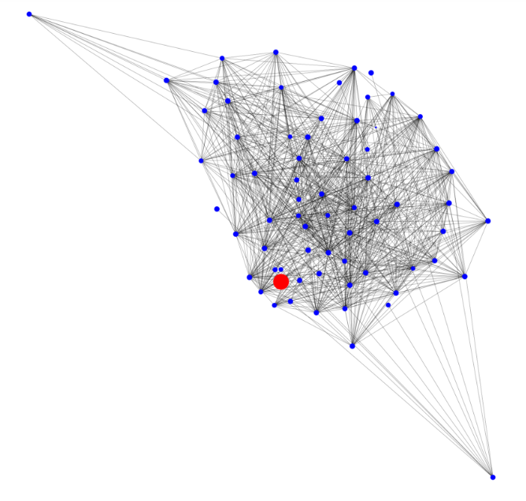
Proposed Pipeline:
Step 3 - class specific network construction
TTN
LMNA
Statistics:
Connectivity density: 76%
Target node degree: 186
Statistics:
Connectivity density: 10%
Target node degree: 45
Hub specific pathways

Slide 13
Conclusion
Dataset | Number of genes | Selected genes | F1 score on all genes | F1 score on selected genes | Avg number of hubs per class
DCM | 3000 | 457 | 0.82 | 0.98 | 6
HCM | 4609 | 478 | 0.79 | 0.97 | 7
PSC | 4720 | 246 | 0.57 | 0.96 | 12
Geometrical data representation of snRNAseq data contain additional information for high accuracy classification
DL methods identified common links across patients within class subgroups
New insights to disease nature, new potentially druggable targets

Slide 14
Acknowledgments
to AG Hübner group:
Eric L Lindberg,
Henrike Maatz,
Eleonora Adami,
Norbert Hübner
AG Heinig Helmholtz Zentrum Munich
AG Lippert HPI, Potsdam University

