Slide 1
Risk control Based trust of deep learning models for Remote sensing applications
Protim Bhattacharjee^{1*}, Shriya Bhatija² and Peter Jung¹
¹Institute of Optical Sensor Systems (OS), German Aerospace Center (DLR)
²Technical University of Munich (TUM)
*protim.bhattacharjee@dlr.de

Slide 2
Motivation
AI being integrated into safety- and welfare- critical data analysis pipelines
Promotes the need of trust on AI inference
Methods such as ensemble learning, temperature scaling only consider the training and validation
Uncertainty during inference or deployment?
Characteristics of inference time uncertainty:
Set outputs (tolerance regions) instead of pointwise outputs; cardinality reflecting uncertainty
Usage of user defined risks and tolerances
Interpretable
potentially different from training loss/metric function
Methods with provable statistical distribution free finite sample guarantee:
Conformal prediction
Risk based control

Slide 3
Risk Control
Let $\hat{f}$ be the trained estimator with non thresholded outputs
Let ${\left(X_{k}, Y_{k}\right)}_{k=1, …, N}$ be a calibration (not seen during training) data-label pairs, $N$: no. of calibration samples
Define $T_{λ}(X)$ as a parameterized set valued output function obtained by thresholding $\hat{f}\left(X\right)$ at $λ$; $λ∈Λ ⊂ℝ ∪ \left\{±∞\right\}$
Define loss, $L(T_{λ}\left(X\right), Y)$; e.g., FNR, FDR
Risk, $R\left(λ\right)= 𝔼\left[L\left(T_{λ}\left(X\right), Y\right)\right]$ =$\frac{1}{N}\sum_{k=1}^{N}{L(T_{λ}(X_{k}), Y_{k})}$
Given:
user defined risk threshold, $α$
user defined tolerance, $δ$
We want a $\hat{λ}$ such that
$ℙ\left(R\left(\hat{λ}\right)≤α\right)≥1 −δ$
Methods of controlling the risk
Upper confidence bound
Multiple hypothesis testing

Slide 4
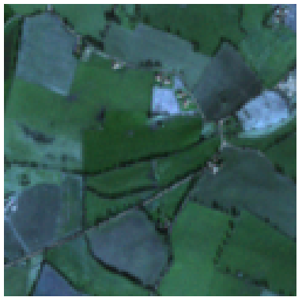
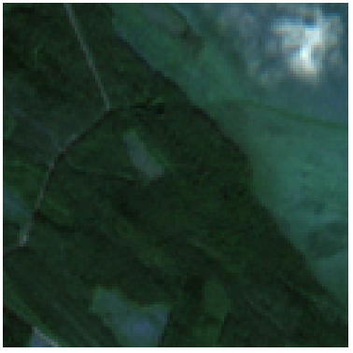
Application: Multi-label classification
BigEarthNet¹: Sentinel images with 43 classes
¹
¹
Two classes:
Non-irrigated arable land
Pasture
Four classes:
Coniferous forest
Mixed forest
Peatbogs
Transitional woodland/shrub
Possible loss functions, $L(T_{λ}\left(X\right), Y)$ :
False negative rate (FNR): minimize misses
False discovery rate (FDR): minimize false positive
¹G. Sumbul, M. Charfuelan, B. Demir, V. Markl, "BigEarthNet: A Large-Scale Benchmark Archive for Remote Sensing Image Understanding", IEEE International Geoscience and Remote Sensing Symposium, pp. 5901-5904, Yokohama, Japan, 2019, https://doi.org/10.1109/IGARSS.2019.8900532

Slide 5
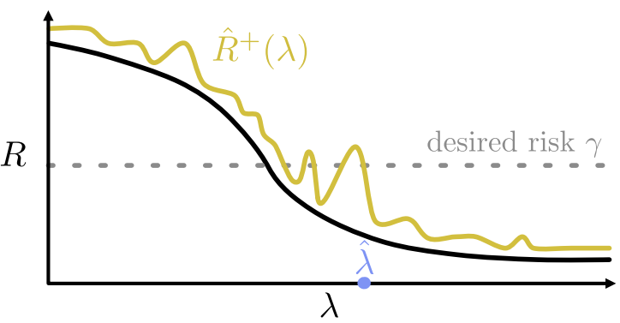
Method 1: Upper confidence bound (UCB)²
²
Derive upper bound, ${\hat{R}}^{+}\left(λ\right)$, on the empirical risk, $\hat{R}\left(λ\right)$ such that
$$ℙ\left(\hat{R}\left(λ\right)≤{\hat{R}}^{+}\left(λ\right)\right)≥1−δ$$
User defined risk $α$
Choose $\hat{λ}≜\inf{ \left\{λ∈Λ:{\hat{R}}^{+}\left(λ^{′}\right)<α, ∀λ^{′}≥λ\right\}}$
$Y_{N+1}= \left\{{c: \hat{f}}^{ }{\left(X_{N+1}\right)}_{c} ≥\hat{λ} , c∈ 𝒴\right\}$
Two requirements
$λ_{1}≤λ_{2} ⇒T_{λ_{1}}\left(X\right)⊆ T_{λ_{2}}\left(X\right)$
$S ⊆ S^{′} ⇒L\left(Y,S\right)≥L(Y,S^{′})$ (monotonicity of risk)
Many possible methods to bound
Hoeffding bound
Hoeffding–Bentkus (HB) bound
Waudby-Smith–Ramdas (WSR) bound
desired risk $α$
²S. Bates, A. N. Angelopoulos, L. Lei, J. Malik, and M. Jordan, “Distribution-free, Risk-controlling Prediction Sets,” J. ACM, vol. 6, no. 43, 2021, https://doi.org/10.1145/3478535

Slide 6
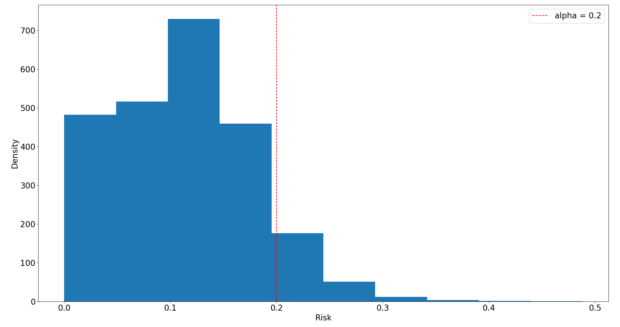
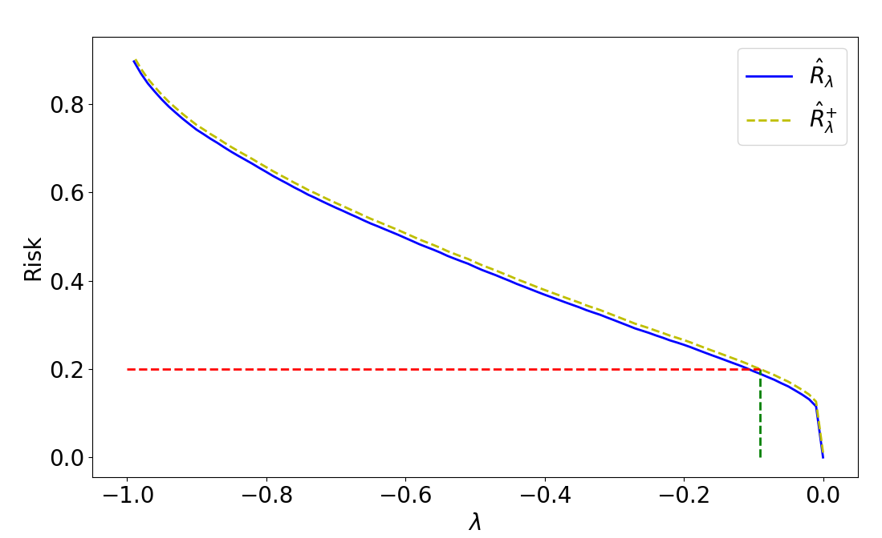
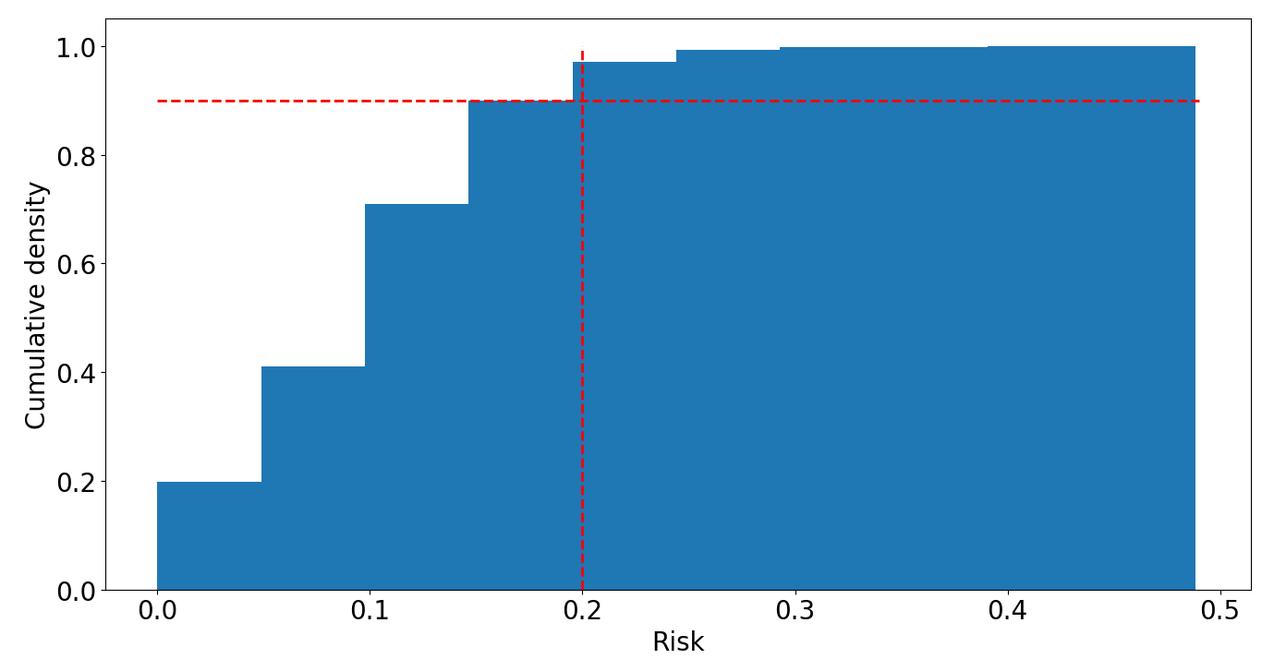
Method 1: Upper confidence bound (UCB)²
Histogram for risk calculated on validation set
Hoeffding bound: ${\hat{R}}_{Hoef }^{+}\left(λ\right)=\hat{R}\left(λ\right)+ \sqrt{\frac{1}{2N}\log{\frac{1}{δ}}}$
Risk/Loss controlled: FNR
User defined $α=0.2, δ=0.1$
$$ℙ\left(R\left(\hat{λ}\right)≤α\right)≥1 −δ$$
$$ℙ\left(R\left(\hat{λ}\right)≤0.2\right)≥0.9$$
$$N=10000$$
0.9
$$α$$
$$\hat{λ}$$

Slide 7
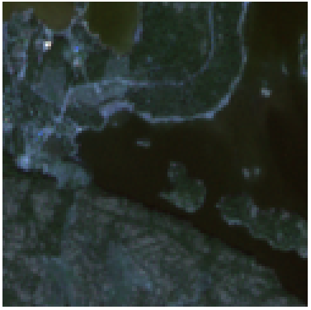
Method 1 Application: Multi-label classification with FNR control
¹
True Labels: [‘Bare rock’, ‘Mixed forest’, ‘Sea and ocean’, ‘Transitional woodland/shrub’]
Original predictions: [‘Broad-leaved forest’, ‘Coniferous forest’, ‘Mixed forest’, ‘Land principally occupied by agriculture, with significant areas of natural vegetation’] Missed predictions: ‘Bare rock’, ‘Sea and ocean’, ‘Transitional woodland/shrub’
After risk control: [‘Broad-leaved forest’, ‘Coniferous forest’, ‘Land principally occupied by agriculture, with significant areas of natural vegetation’, ‘Mixed forest’, ‘Olive groves’, ‘Sea and ocean’, ‘Transitional woodland/shrub’, ‘Water bodies’] Missed predictions: ‘Bare rock’
Metric controlled: false negative rate (FNR): ${FN}/{\left(TP+FN\right)}$
The predicted set increased the true positives, $FP,$ to reduce the FNR.

Slide 8
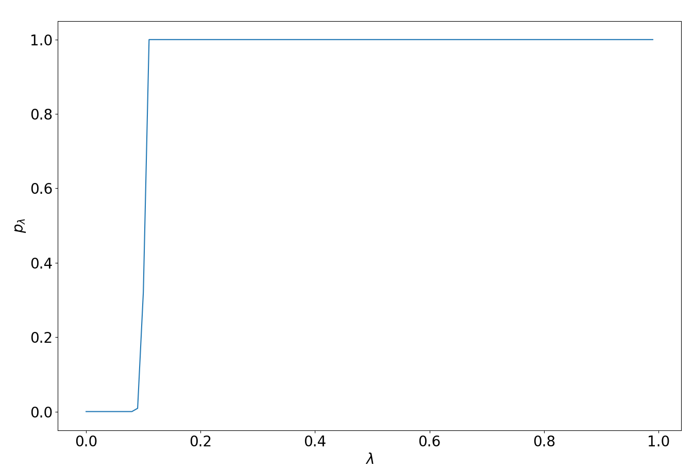
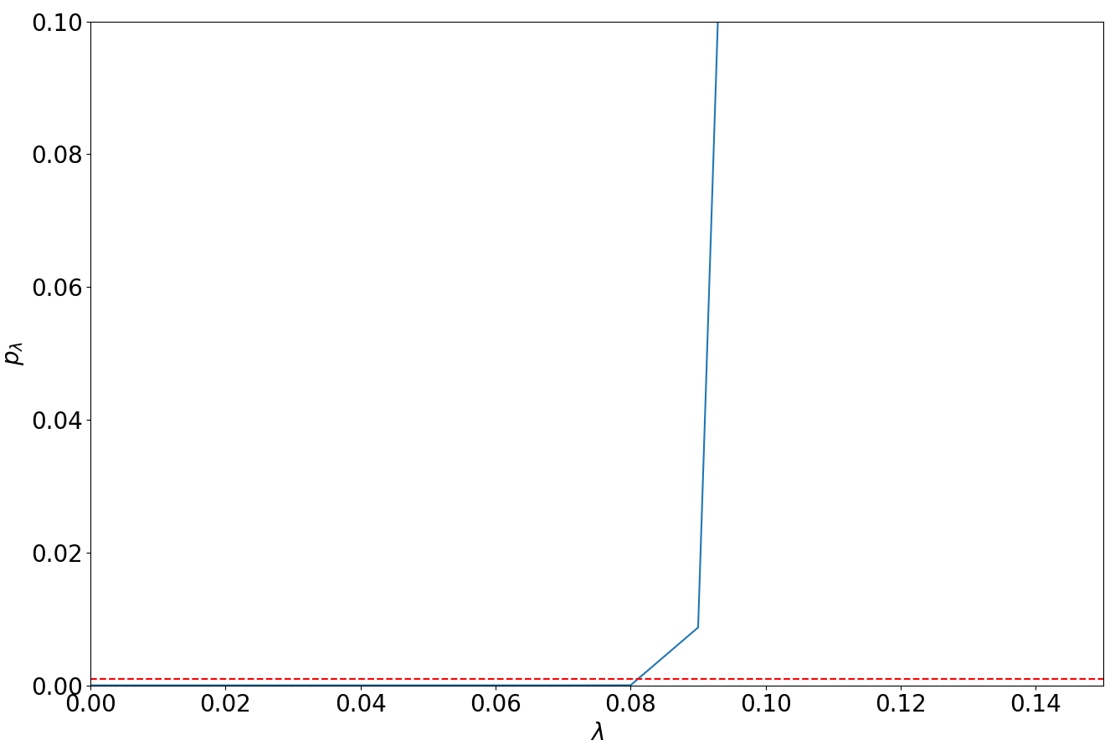
Method 2: Learn then test (LTT)³
LTT on FNR with$α=0.2, δ= 0.1, M=100$
Possible to remove restriction on risk being monotone
Fix user defined $α$
Discretize $Λ= \left[λ_{1}, λ_{2}, …, λ_{M}\right]$
Treat risk at each $λ_{m}$ as an hypothesis test, $H_{m}:R(λ_{m})>α$
p-value: $ℙ\left(R\left(λ_{m}\right)≤α\right)≤ α$
Algorithm:
Calculate p-value, $p_{λ_{m}}$ value for each $H_{m}$, $\left[p_{λ_{1},}p_{λ_{2}}, …, p_{λ_{M }}\right]$
$\hat{Λ} := \left\{λ_{m}:p_{λ_{m }}≤ \frac{δ}{M}\right\}$ and choose any ${\hat{λ}}_{∗}∈ \hat{Λ}$
$Y_{N+1}= \left\{c: \hat{f}{\left(X_{N+1}\right)}_{c} ≥{\hat{λ}}_{∗} , c∈ 𝒴 \right\}$
$ℙ\left(R\left({\hat{λ}}_{∗}\right)≤α\right)≥1 −δ$
$$\frac{δ}{M}$$
$$\hat{Λ}$$
³A. N. Angelopoulos, S. Bates, E. J. Candès, M. I. Jordan, L. Lei, “Learn then test: Calibrating predictive algorithms to achieve risk control,” 2021, arXiv:2110.01052v5

Slide 9
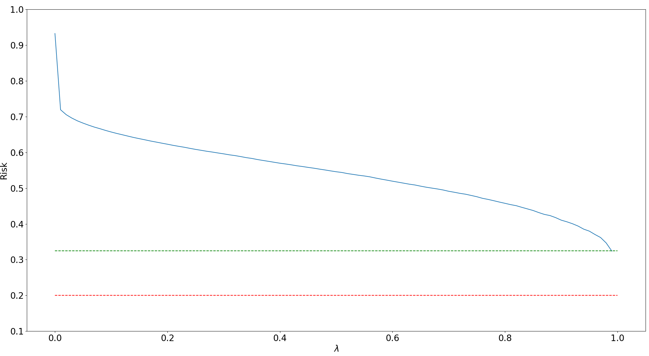
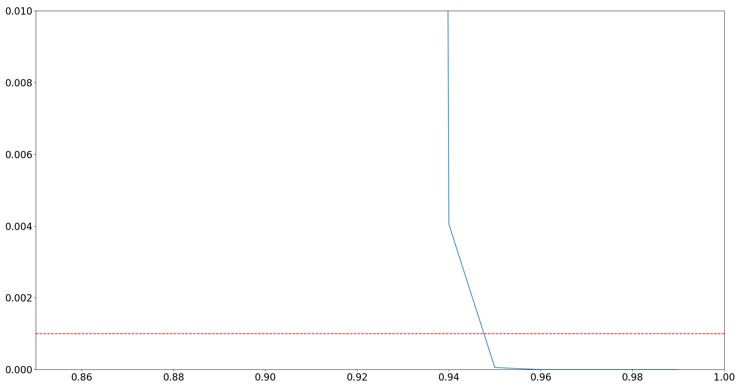
Method 2: Learn then test (LTT)³: FDR
FDR = 1 – Precision = $\frac{FP}{FP+TP}$
FDR violates $S ⊆ S^{′} ⇒L\left(Y,S\right)≥L(Y,S^{′})$
Cannot control directly with UCB
Can be controlled via LTT: Does not require nesting of loss
$α=0.$2
$α=0.$3
$α=0.$4
$$p_{λ}$$
$$λ$$
$$\frac{δ}{M}$$
$$\hat{Λ}$$

Slide 10
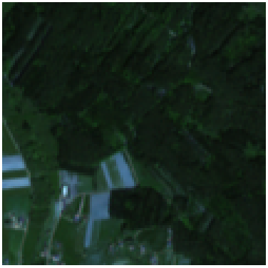
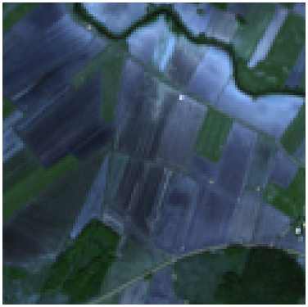
Method 2 Application: Multi-label classification with FDR control
¹
¹
¹
True labels: [‘Broad-leaved forest’, ‘Coniferous forest’, ‘Discontinuous urban fabric’, ‘Mixed forest’, 'Non-irrigated arable land’]
Original Predictions: [‘Coniferous forest’, ‘Mixed forest’,
False positives: ‘Transitional woodland/shrub’]
After risk control: [‘Coniferous forest’] False positives: []
True labels: [‘Coniferous forest’, ‘Non-irrigated arable land’]
Original Predictions: [‘Non-irrigated arable land’, False positives: ‘Broad-leaved forest’, ‘Complex cultivation patterns’, ‘Discontinuous urban fabric’, ‘Land principally occupied by agriculture, with significant areas of natural vegetation’, ‘Pastures’]
After risk control: [‘Non-irrigated arable land’], False positives: []
True Labels: [‘Bare rock’, ‘Mixed forest’, ‘Sea and ocean’, ‘Transitional woodland/shrub’]
Original predictions: [‘Mixed forest’, False positives: ‘Broad-leaved forest’, ‘Coniferous forest’, ‘Land principally occupied by agriculture, with significant areas of natural vegetation’]
After risk control: [], False positives: []

Slide 11
Conclusion
Trust in AI systems with provable distribution free finite sample statistical guarantees
Compute friendly method for controlling user defined risk and tolerance
Access to training data not required, calibration and test should be from same distribution
easy extension to covariate shift/ noisy scenarios.
Risks can be single or compound
Marginal coverage guarantees were presented, moving forward: Class-conditional guarantees
FDR risk control with LTT for ship segmentation (DLR MACS) $α=0.1, δ=0.1$

