Slide 1
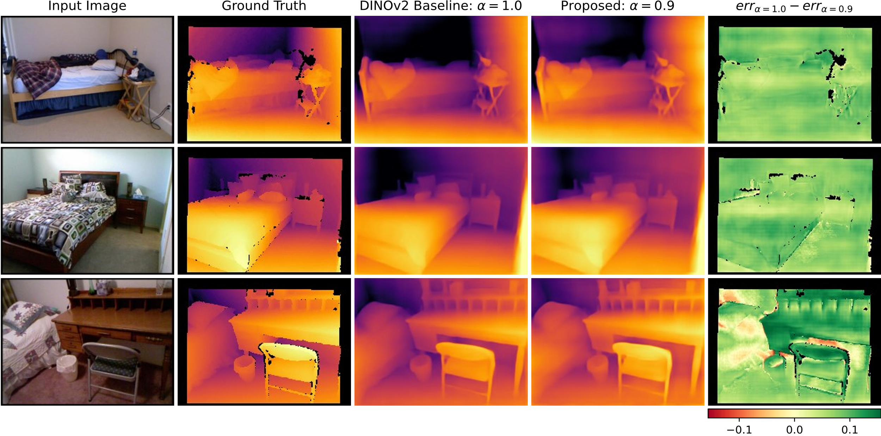
Multi-Source, Auxiliary Tasks Supported Monocular Depth Estimation
HAICON24 - 13.06.2024
Alessio Quercia^{1,2}, Erenus Yildiz¹, Zhuo Cao¹, Abigail Morrison^{1,2}, Kai Krajsek¹, Ira Assent^{1,3}, Hanno Scharr¹
¹Forschungszentrum Jülich, ²RWTH Aachen, ³Aarhus University

Slide 2
Goal & application
Given:
given a pretrained foundation model
a target Monocular Depth Estimation (MDE) dataset
Yang, Lihe, et al. "Depth anything: Unleashing the power of large-scale unlabeled data." arXiv preprint arXiv:2401.10891 (2024).

Slide 3
Goal & application
Given:
given a pretrained foundation model
a target Monocular Depth Estimation (MDE) dataset
Goal: Improve MDE quality
Yang, Lihe, et al. "Depth anything: Unleashing the power of large-scale unlabeled data." arXiv preprint arXiv:2401.10891 (2024).

Slide 4
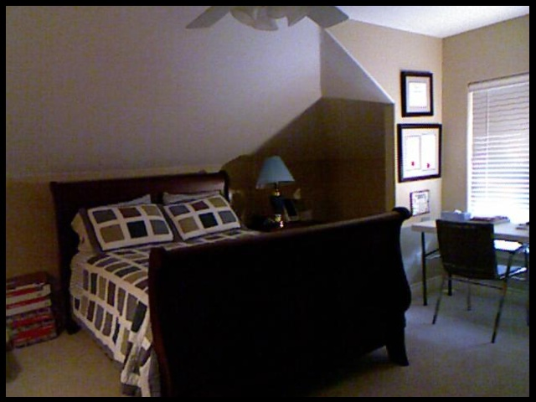
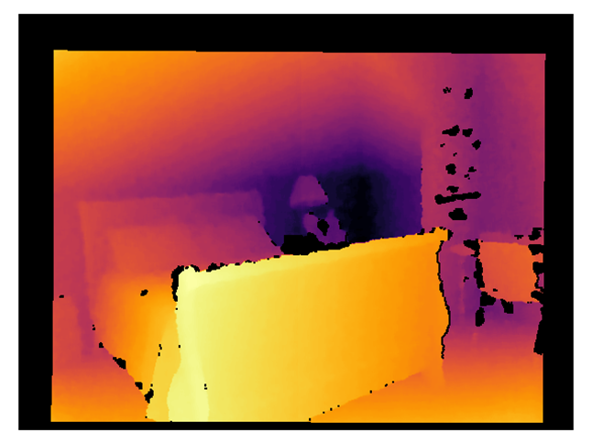
Goal & application
Different task
Given:
given a pretrained foundation model
a target Monocular Depth Estimation (MDE) dataset
Goal: Improve MDE quality
Same task
Same data
Different data
Yang, Lihe, et al. "Depth anything: Unleashing the power of large-scale unlabeled data." arXiv preprint arXiv:2401.10891 (2024).

Slide 5
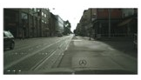
Goal & application
Different task
Given:
given a pretrained foundation model
a target Monocular Depth Estimation (MDE) dataset
Goal: Improve MDE quality
Same task
Same data
Different data
Yang, Lihe, et al. "Depth anything: Unleashing the power of large-scale unlabeled data." arXiv preprint arXiv:2401.10891 (2024).

Slide 6
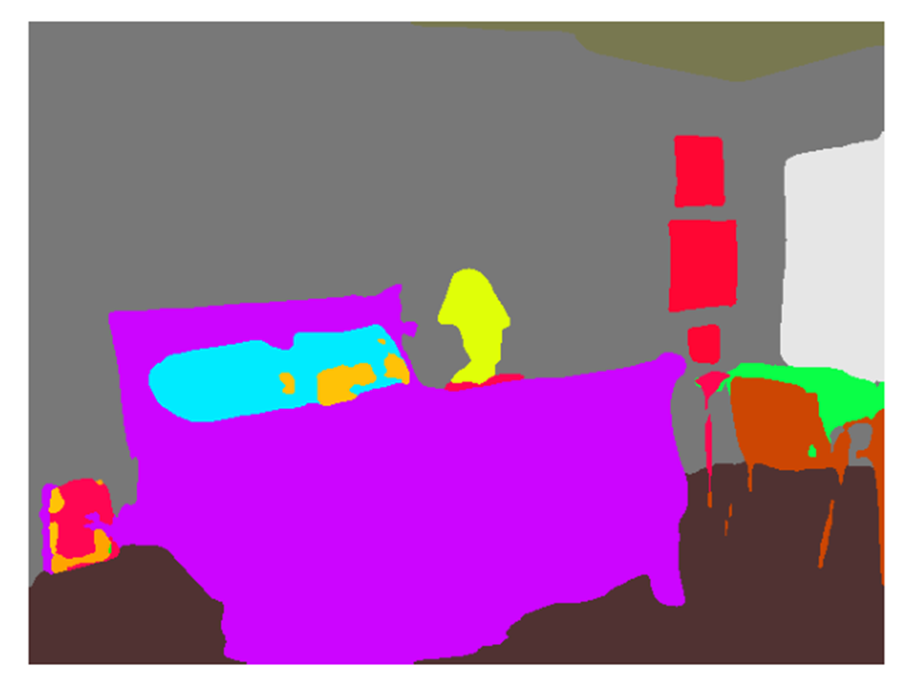
Goal & application
Different task
Given:
given a pretrained foundation model
a target Monocular Depth Estimation (MDE) dataset
Goal: Improve MDE quality
Same task
Same data
Different data
Yang, Lihe, et al. "Depth anything: Unleashing the power of large-scale unlabeled data." arXiv preprint arXiv:2401.10891 (2024).

Slide 7
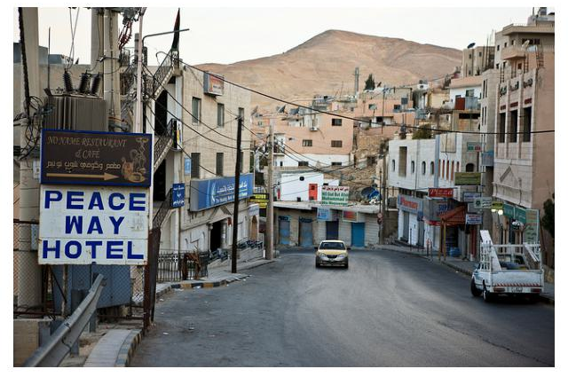
Goal & application
Different task
Given:
given a pretrained foundation model
a target Monocular Depth Estimation (MDE) dataset
Goal: Improve MDE quality using auxiliary dataset(s) from a related vision task
Same task
Same data
Different data
Yang, Lihe, et al. "Depth anything: Unleashing the power of large-scale unlabeled data." arXiv preprint arXiv:2401.10891 (2024).

Slide 8
Baseline training procedure
MDE
Dataset
DINOv2: general purpose pretrained foundation model
DPT: decoder for dense prediction for Vision Transformer
Oquab, Maxime, et al. "Dinov2: Learning robust visual features without supervision." arXiv preprint arXiv:2304.07193 (2023).
Ranftl, René, Alexey Bochkovskiy, and Vladlen Koltun. "Vision transformers for dense prediction." Proceedings of the IEEE/CVF international conference on computer vision. 2021.

Slide 9
Can we improve MDE using auxiliary data from similar tasks?
MDE
Dataset
Seg
Datasets
Cls
Datasets
?
?
Oquab, Maxime, et al. "Dinov2: Learning robust visual features without supervision." arXiv preprint arXiv:2304.07193 (2023).
Ranftl, René, Alexey Bochkovskiy, and Vladlen Koltun. "Vision transformers for dense prediction." Proceedings of the IEEE/CVF international conference on computer vision. 2021.

Slide 10
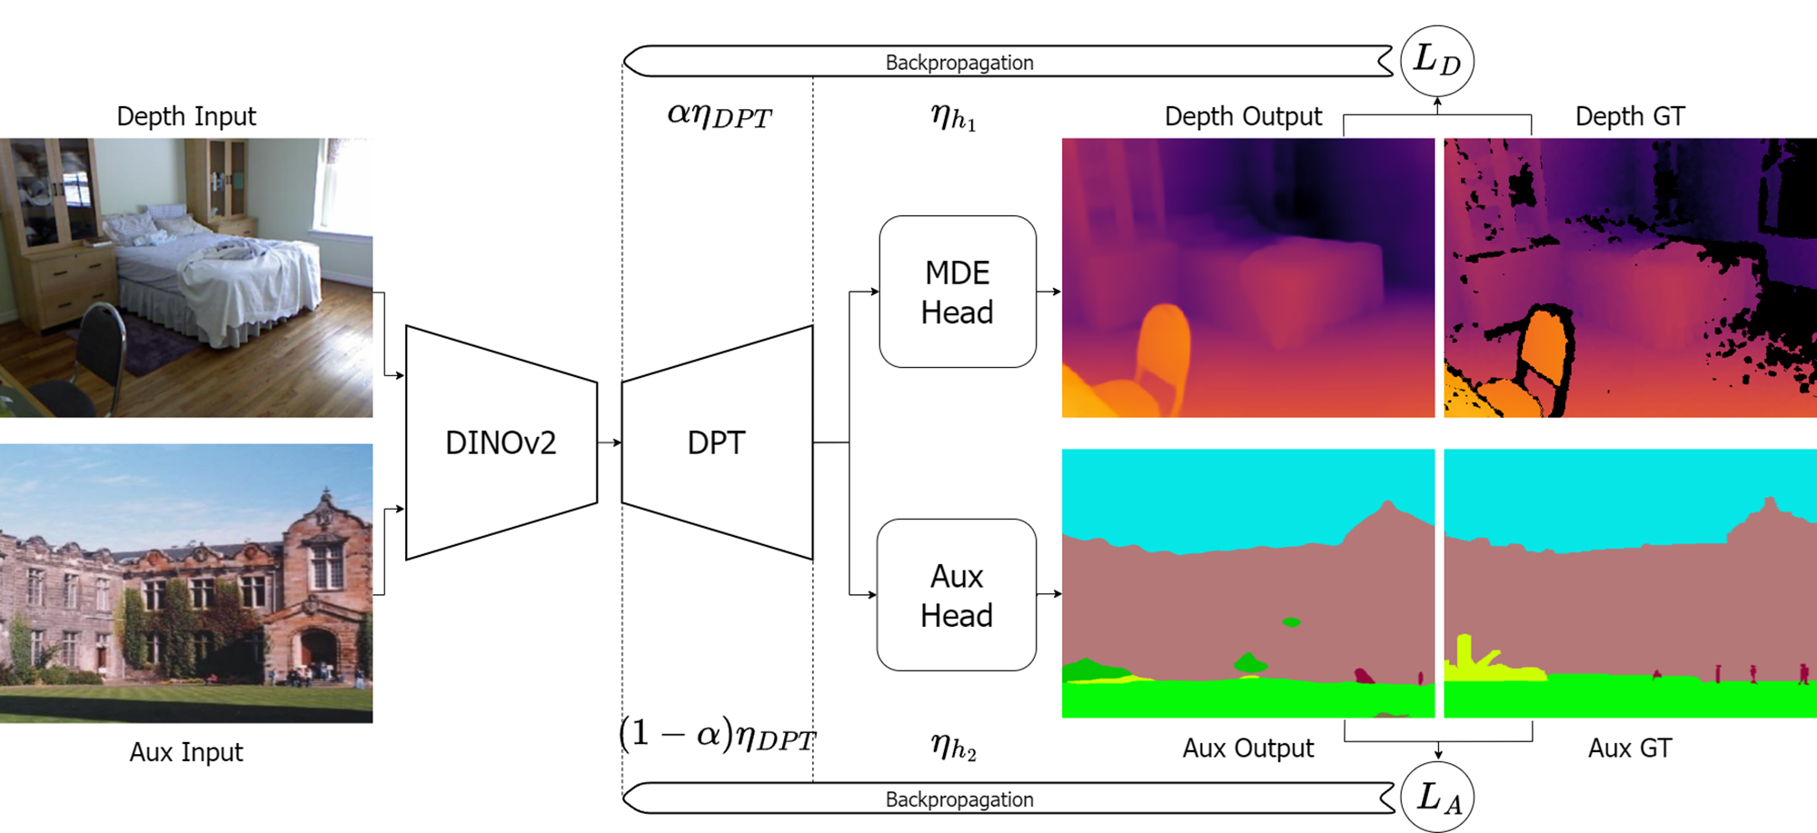
Can we improve MDE doing segmentation on external data?
Oquab, Maxime, et al. "Dinov2: Learning robust visual features without supervision." arXiv preprint arXiv:2304.07193 (2023).
Ranftl, René, Alexey Bochkovskiy, and Vladlen Koltun. "Vision transformers for dense prediction." Proceedings of the IEEE/CVF international conference on computer vision. 2021.

Slide 11
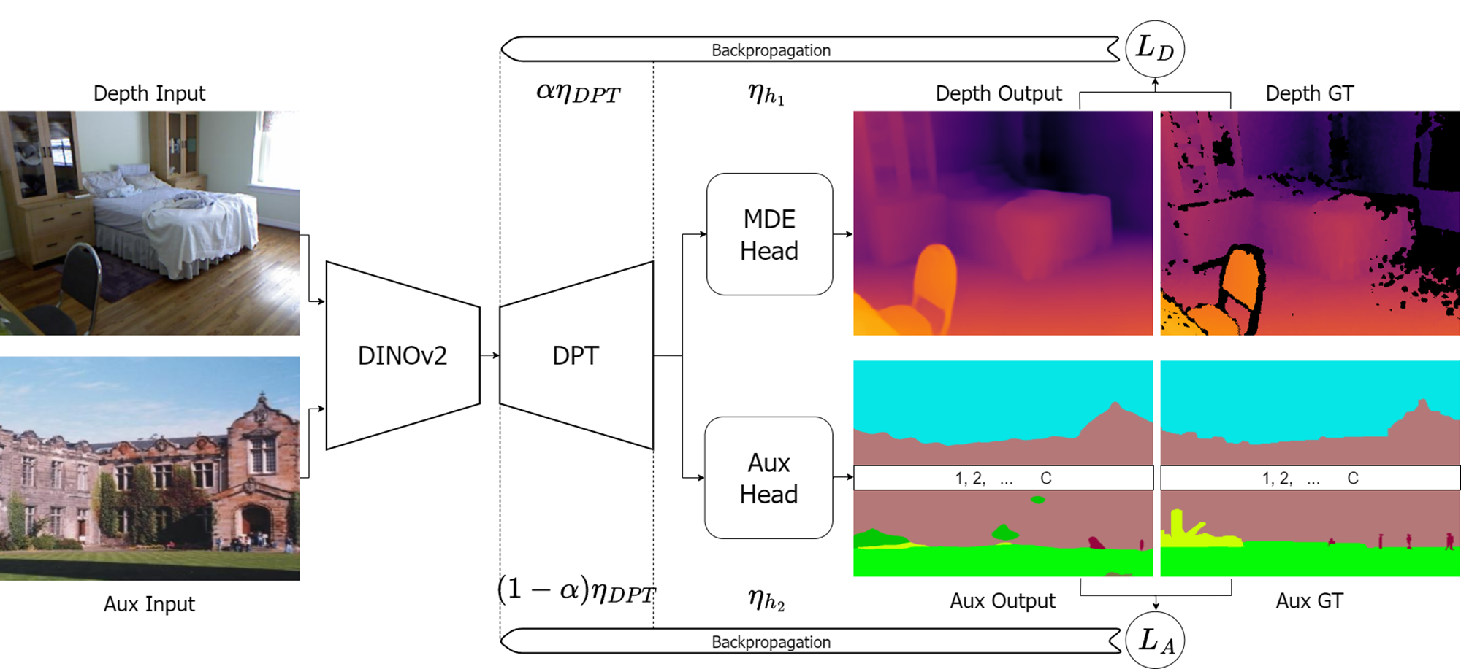
Can we improve MDE doing classification on external data?
Oquab, Maxime, et al. "Dinov2: Learning robust visual features without supervision." arXiv preprint arXiv:2304.07193 (2023).
Ranftl, René, Alexey Bochkovskiy, and Vladlen Koltun. "Vision transformers for dense prediction." Proceedings of the IEEE/CVF international conference on computer vision. 2021.

Slide 12
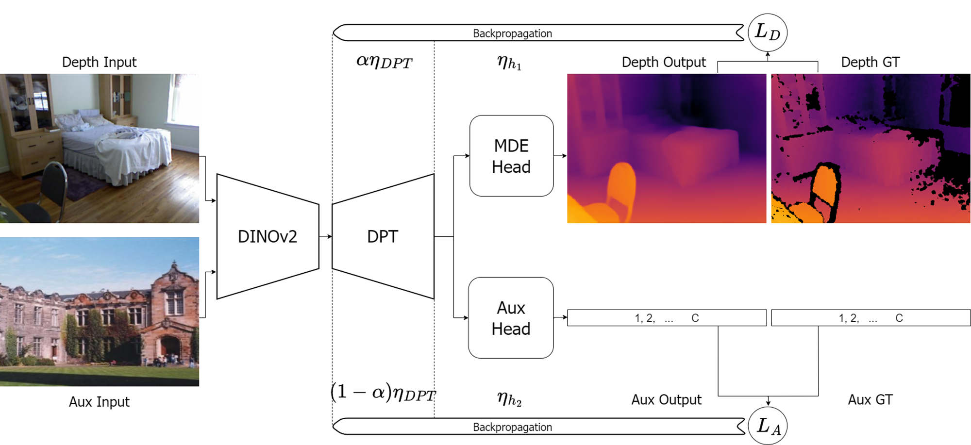
Can we improve MDE doing classification on external data?
Oquab, Maxime, et al. "Dinov2: Learning robust visual features without supervision." arXiv preprint arXiv:2304.07193 (2023).
Ranftl, René, Alexey Bochkovskiy, and Vladlen Koltun. "Vision transformers for dense prediction." Proceedings of the IEEE/CVF international conference on computer vision. 2021.

Slide 13
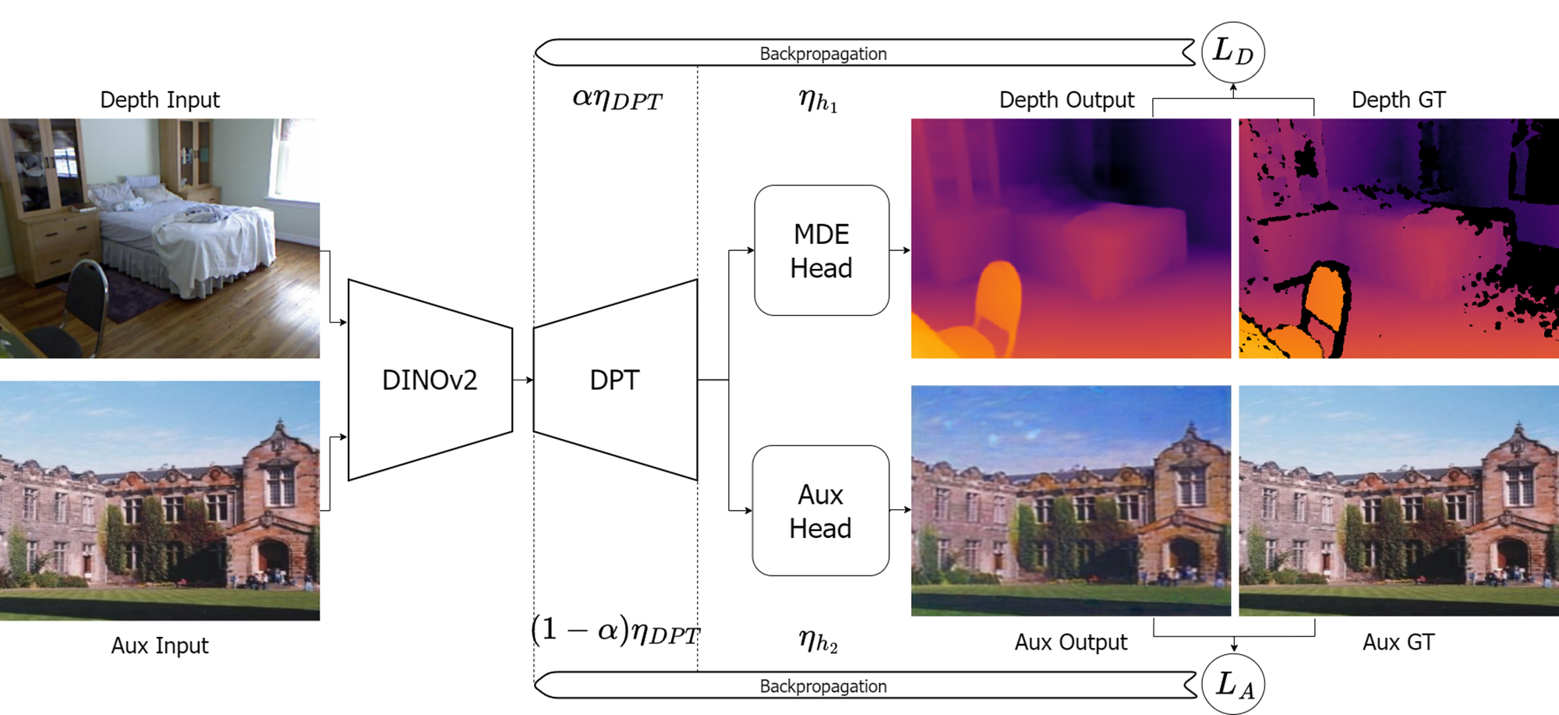
Can we improve MDE doing reconstruction on external data?
Oquab, Maxime, et al. "Dinov2: Learning robust visual features without supervision." arXiv preprint arXiv:2304.07193 (2023).
Ranftl, René, Alexey Bochkovskiy, and Vladlen Koltun. "Vision transformers for dense prediction." Proceedings of the IEEE/CVF international conference on computer vision. 2021.

Slide 14
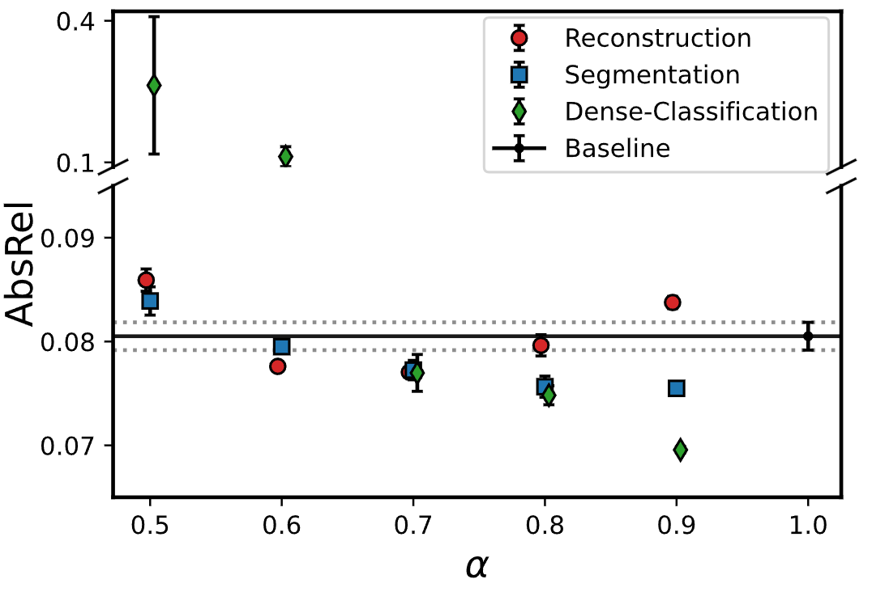
Sensitivity analysis on alpha
MIX6 Dataset
ADE20K
SUNRGBD
COCO-Stuff
Cityscapes
Pascal VOC
Pascal Context
alpha seems task-dependent
particularly sensitive to Multi-Label Dense Classification
surprisingly, Multi-Label Dense Classification helps the most

Slide 15
Auxiliary dataset independent
our scheme seems dataset-independent
it improves with any tested aux dataset on NYUv2, SUNRGBD, DIODE Outdoor
MIX6 is the best performing auxiliary dataset
Multi-Label Dense Classification is the best performing auxiliary task

Slide 16
Auxiliary dataset independent
our scheme seems dataset-independent
it improves with any tested aux dataset on NYUv2, SUNRGBD, DIODE Outdoor
MIX6 is the best performing auxiliary dataset
Multi-Label Dense Classification is the best performing auxiliary task

Slide 17
Auxiliary dataset independent
our scheme seems dataset-independent
it improves with any tested aux dataset on NYUv2, SUNRGBD, DIODE Outdoor
MIX6 is the best performing auxiliary dataset
Multi-Label Dense Classification is the best performing auxiliary task

Slide 18
Auxiliary dataset independent
our scheme seems dataset-independent
it improves with any tested aux dataset on NYUv2, SUNRGBD, DIODE Outdoor
MIX6 is the best performing auxiliary dataset
Multi-Label Dense Classification is the best performing auxiliary task

Slide 19
MDE on NYU together with Multi-Label Dense Classification

Slide 20
MDE on NYU together with Multi-Label Dense Classification

Slide 21
Conclusion
Our method allows to:

Slide 22
Conclusion
Our method allows to:
Improve quality on MDE downstream task while using external aux datasets

Slide 23
Conclusion
Our method allows to:
Improve quality on MDE downstream task while using external aux datasets
Successfully using multiple auxiliary datasets/tasks

Slide 24
Conclusion
Our method allows to:
Improve quality on MDE downstream task while using external aux datasets
Successfully using multiple auxiliary datasets/tasks
Use classification datasets as dense auxiliary tasks

Slide 25
Conclusion
Contact: a.quercia@fz-juelich.de
Acknowledgements:
This work was funded by the Helmholtz School for Data Science in Life, Earth, and Energy (HDS-LEE).
The authors gratefully acknowledge the Gauss Centre for Supercomputing e.V. (www.gauss-centre.eu) for funding this project by providing computing time through the John von Neumann Institute for Computing (NIC) on the GCS Supercomputer JUWELS¹ at Jülich Supercomputing Centre (JSC).
Our method allows to:
Improve quality on MDE downstream task while using external aux datasets
Successfully using multiple auxiliary datasets/tasks
Use classification datasets as dense auxiliary tasks
1. Jülich Supercomputing Centre. (2021). JUWELS Cluster and Booster: Exascale Pathfinder with Modular Supercomputing Architecture at Juelich Supercomputing Centre. Journal of large-scale research facilities, 7, A183.

Slide 26
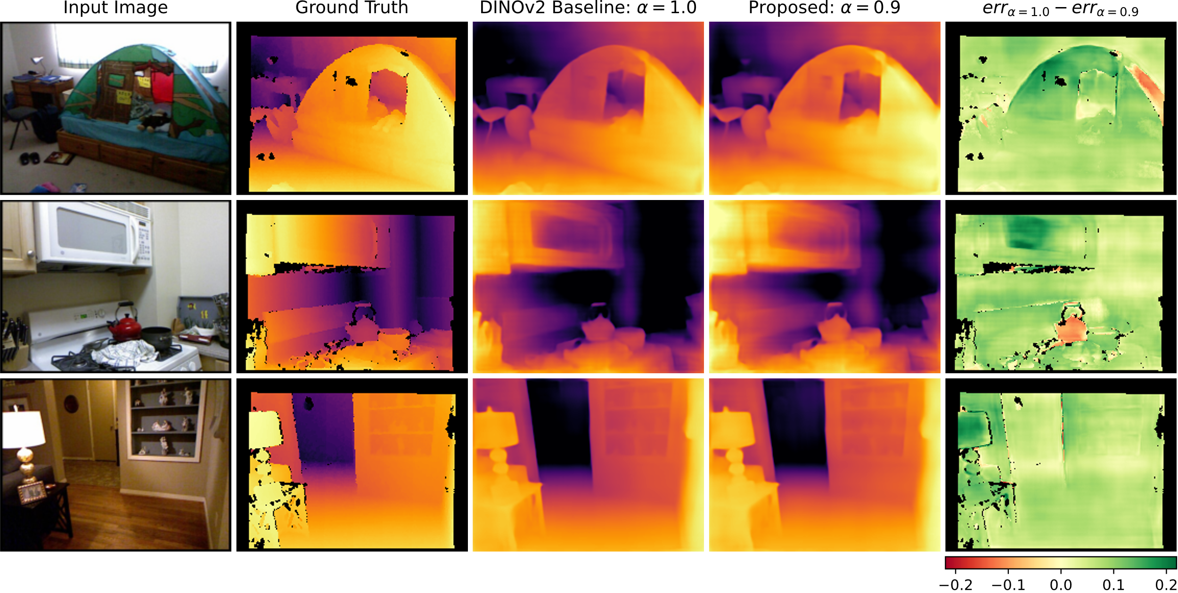
MDE on NYU together with Multi-Label Dense Classification

Slide 27
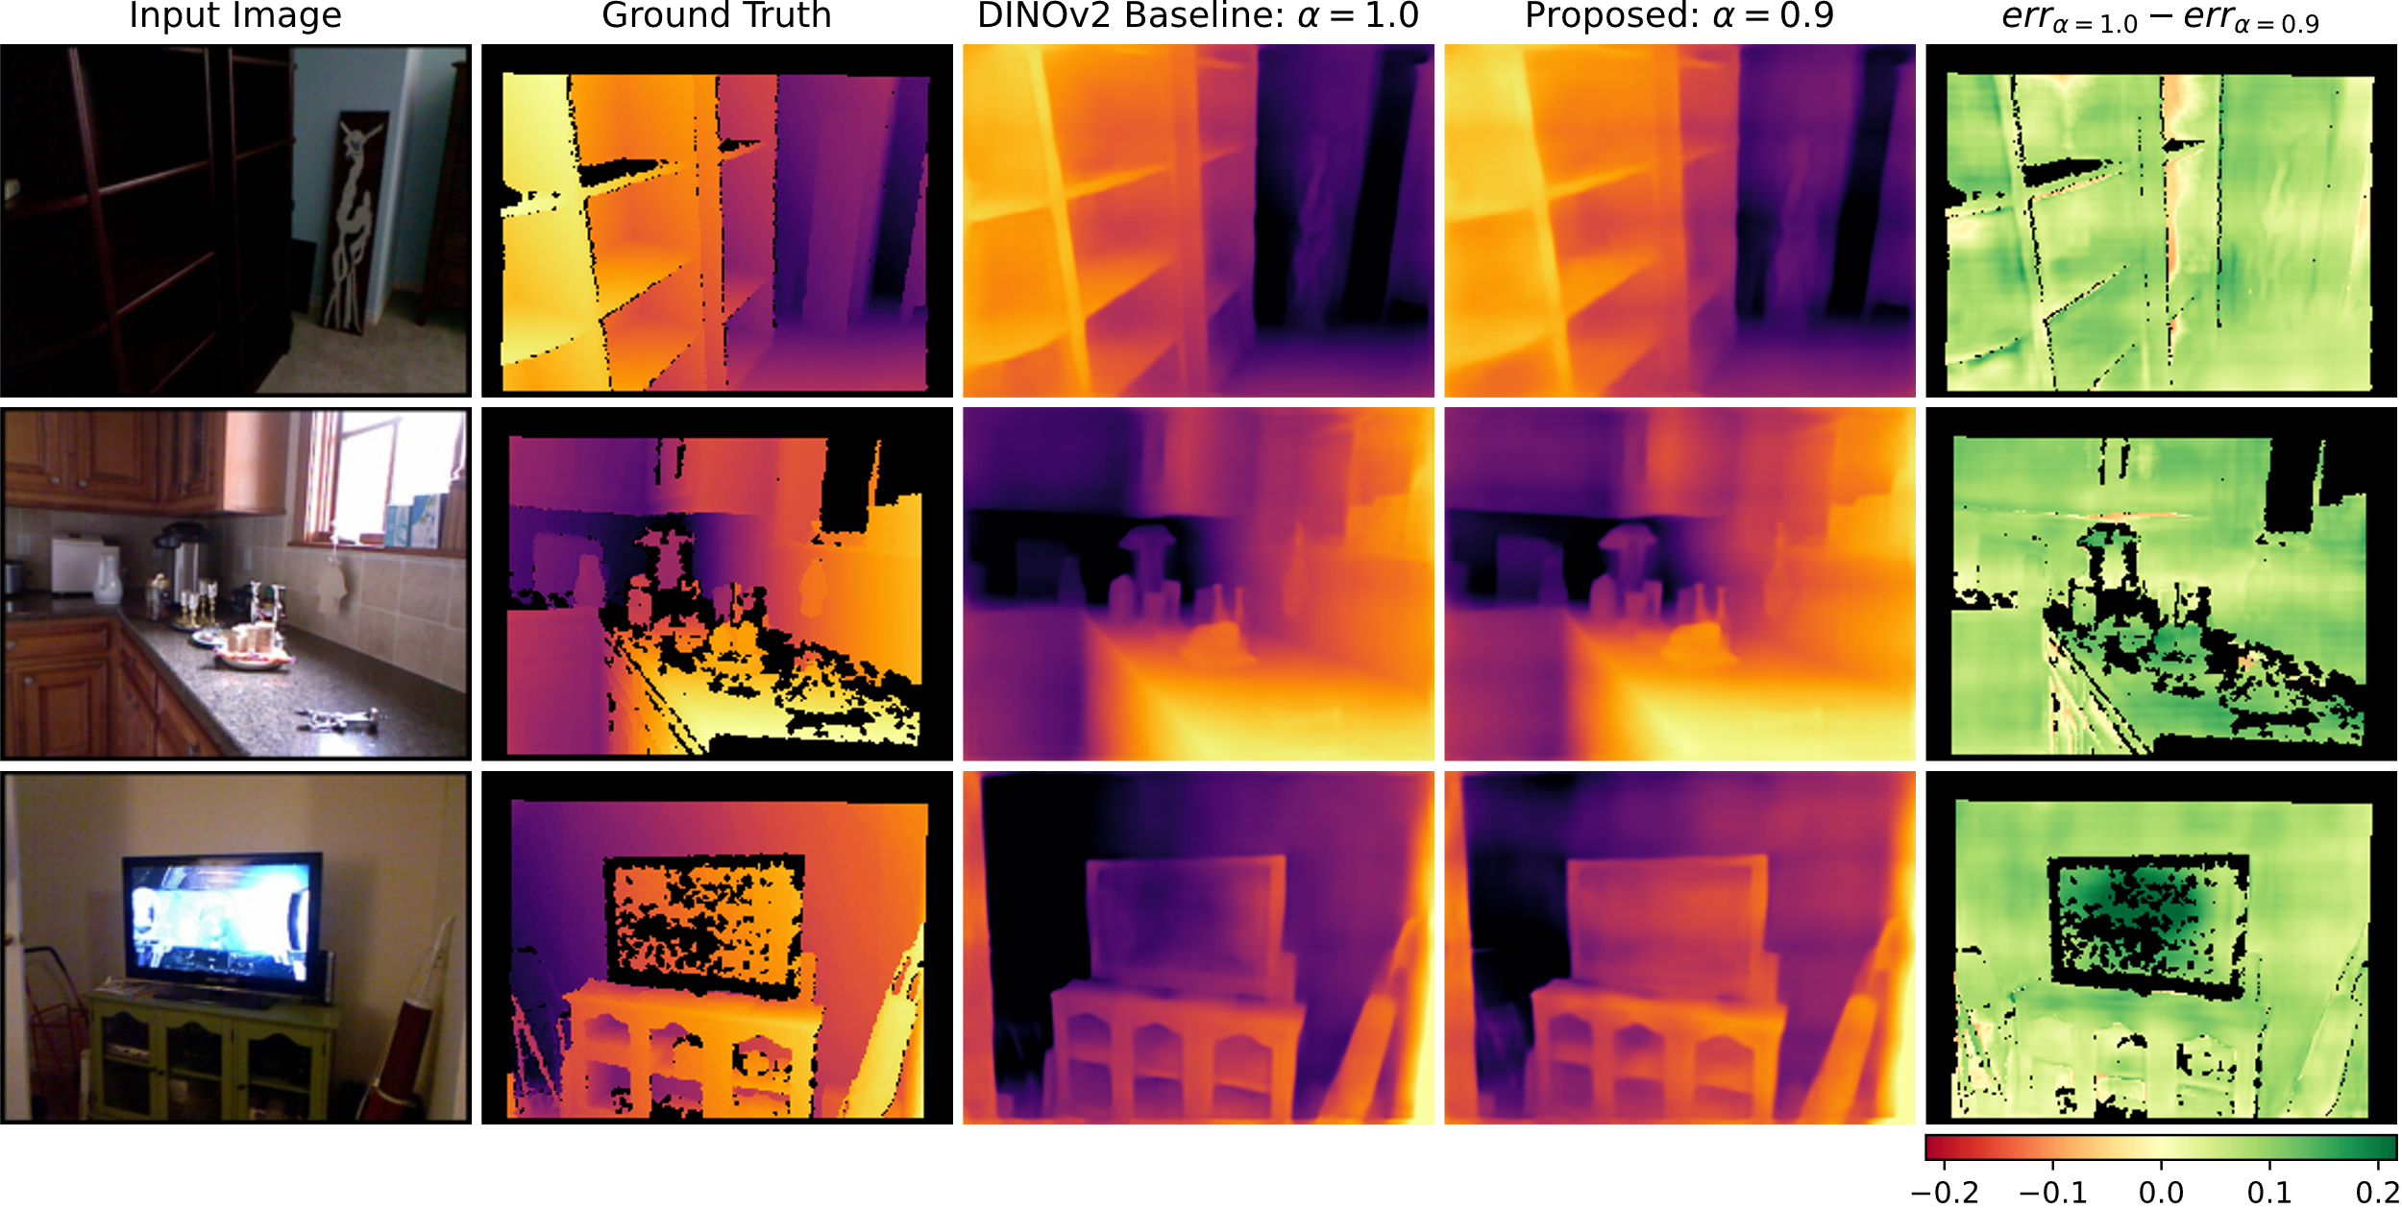
MDE on NYU together with Multi-Label Dense Classification

Slide 28
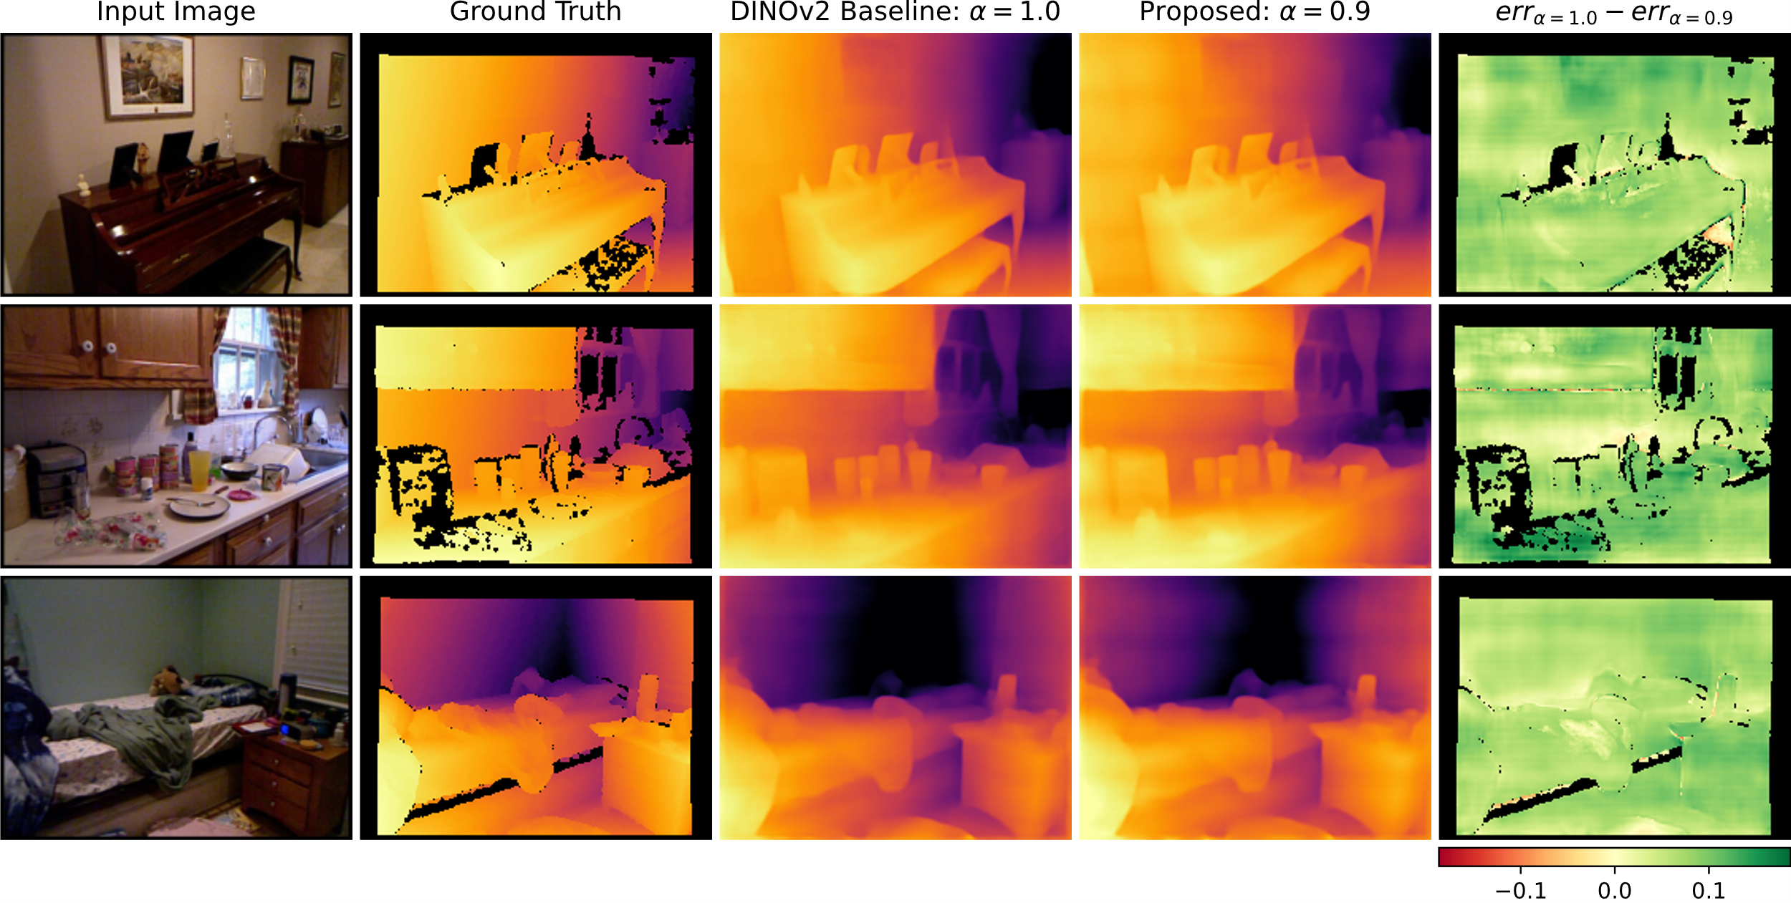
MDE on NYU together with Multi-Label Dense Classification

Slide 29
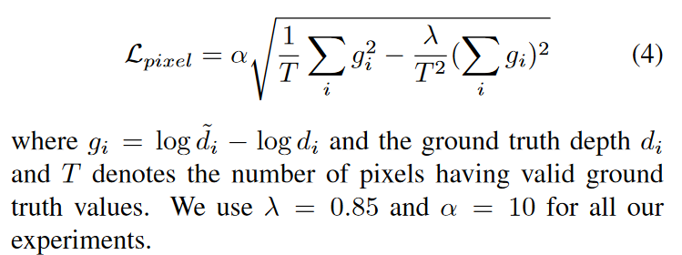
Training losses
MDE: scaled Scale-Invariant loss
Semantic Segmentation: Cross Entropy loss
Multi-Label Dense Classification: Binary Cross Entropy loss
Image Reconstruction: MSE loss
Eigen, David, Christian Puhrsch, and Rob Fergus. "Depth map prediction from a single image using a multi-scale deep network." Advances in neural information processing systems 27 (2014).
Bhat, Shariq Farooq, Ibraheem Alhashim, and Peter Wonka. "Adabins: Depth estimation using adaptive bins." Proceedings of the IEEE/CVF conference on computer vision and pattern recognition. 2021.

