Slide 1
Enhancing Quality Control in Sparsely Distributed Environmental Sensor Networks with Graph Neural Networks
Elżbieta Lasota¹, Timo Houben^{2,3}, Julius Polz¹, Lennart Schmidt^{2,3}, Luca Glawion¹, David Schäfer^{2,3}, Jan Bumberger^{2, 3}, Christian Chwala¹
¹ Karlsruhe Institute of Technology (KIT), Campus Alpin, Institute of Meteorology and Climate Research, Garmisch-Partenkirchen, Germany
² Helmholtz-Centre for Environmental Research (UFZ), Research Data Management (RDM), Leipzig, Germany
³ Helmholtz-Centre for Environmental Research (UFZ), Department of Monitoring and Exploration Technologies, Leipzig, Germany
generated by AI

Slide 2
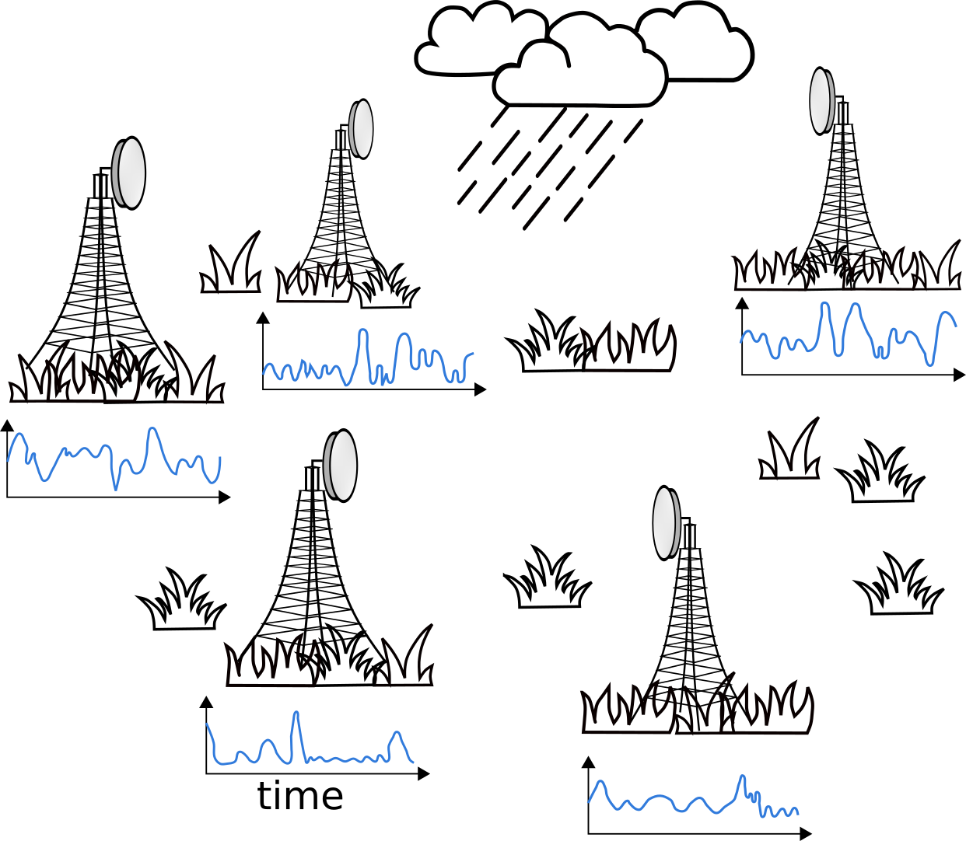
Problem and motivation
Quality control (QC) of environmental sensors is essential for producing high-quality, trustworthy data
QC of time series data from multiple scattered sensors is especially challenging due to the requirement to simultaneously integrate and analyze observations from nearby sensors and consecutive epochs,
AI-based QC frameworks are able to effectively handle large volumes of data and identify complex patterns and anomalies that may be challenging for traditional methods
Notes:
Nowadays, we have tons of the scattered environmental sensors, and the data they gather is used for lots of different things from city planning to studying climate. However, ensuring its accuracy is no easy task.
Environmental conditions can change a lot, so we need really good systems to check the data, fix any mistakes.
Unfortunately, traditional QC methods often fall short when dealing with the volume and complexity of this data. They struggle to keep up and can miss important anomalies.
Additionally, they often overlook the relationships between different sensors, which are crucial for detecting irregularities. That's why we're turning to innovative approaches like GNN. These networks excel at handling scattered data and capturing connections between sensors, providing us with a more comprehensive view of data quality.

Slide 3
Data
Commercial Microwave Links (CML)
data from 20 sensors in March, May, July 2019 flagged by 4 experts,
patches 20 km around flagged CML
edges between CMLs within 10 km,
no labels available for the neighboring sensors!
1 minute resolution,
2 557 578 samples in total,

Slide 4
Data
SoilNet
data from 204 sensors within 34 boxes in 2014, flagged by 1 expert changing over time,
all the sensors were quality checked,
15 minutes resolution,
edges between sensors within 30 m distance at the same depth or at the same location and within a vertical distance of up to 0.1 m,
2 588 730 samples in total,

Slide 5
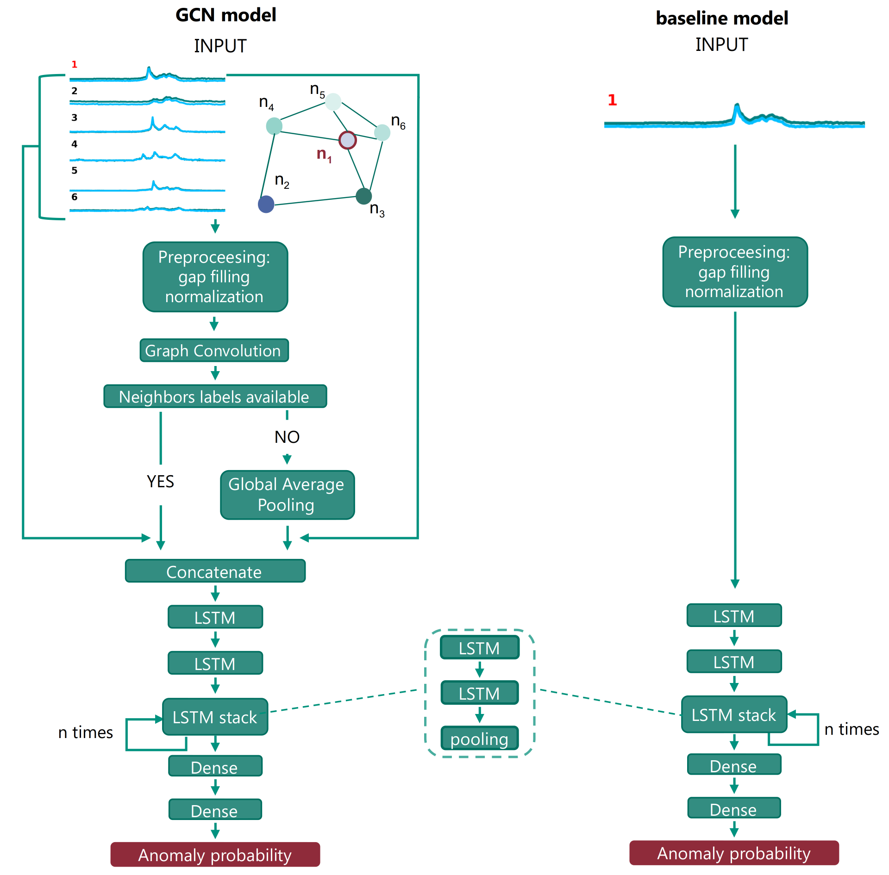
Methods
Graph Convolution
n₁
n₅
n₄
n₆
$$n_{1}^{′}=n_{1}∙w+\frac{n_{5}+n_{4}+n_{6}}{3}∙w+b$$
n₅'
n₅
n₂'
n₁
n₂
n₁'
n₅
n₂
n₄'
n₄
n₄
n₆
n₃
n₃
n₆'
n₃'
$$n_{2}^{′}=n_{2}∙w+\frac{n_{5}+n_{4}+n_{3}}{3}∙w+b$$
n₁
$$⋮$$
$$n_{6}^{′}=n_{6}∙w+\frac{n_{1}+n_{3}}{2}∙w+b$$
n₆
n₃

Slide 6
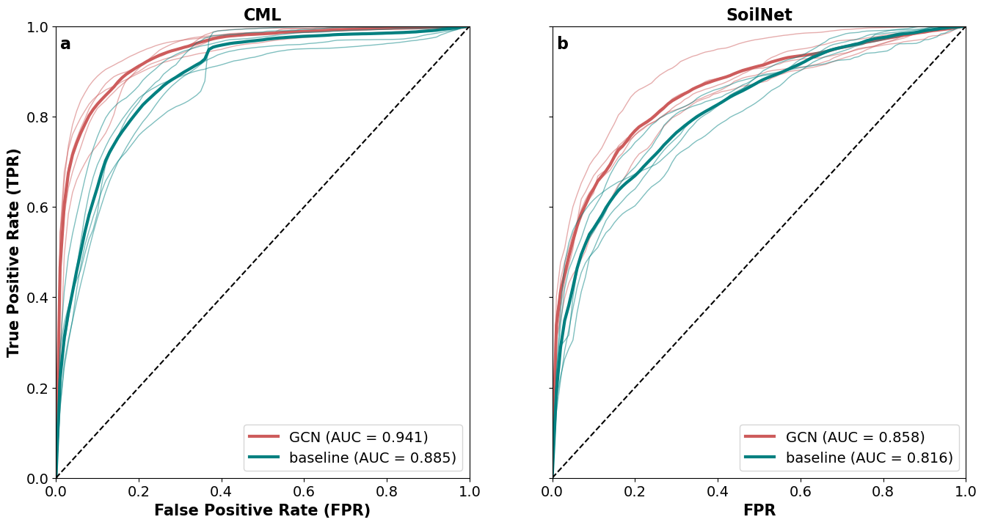
5-fold CV results
$$TPR =\frac{TP}{TP+FN}$$
$$FPR =\frac{FP}{FP+TN}$$

Slide 7
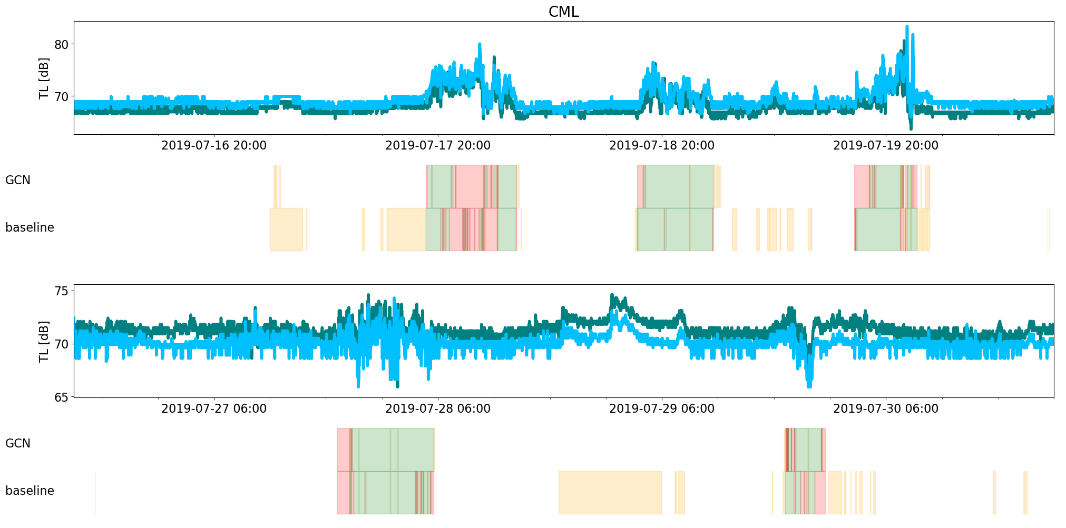
Classification of selected time series - CML

Slide 8
Classification of selected time series - SoilNet

Slide 9
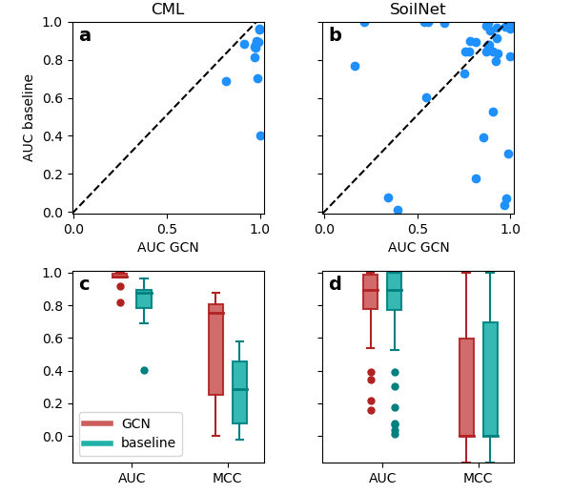
Classification performance for individual sensors

Slide 10
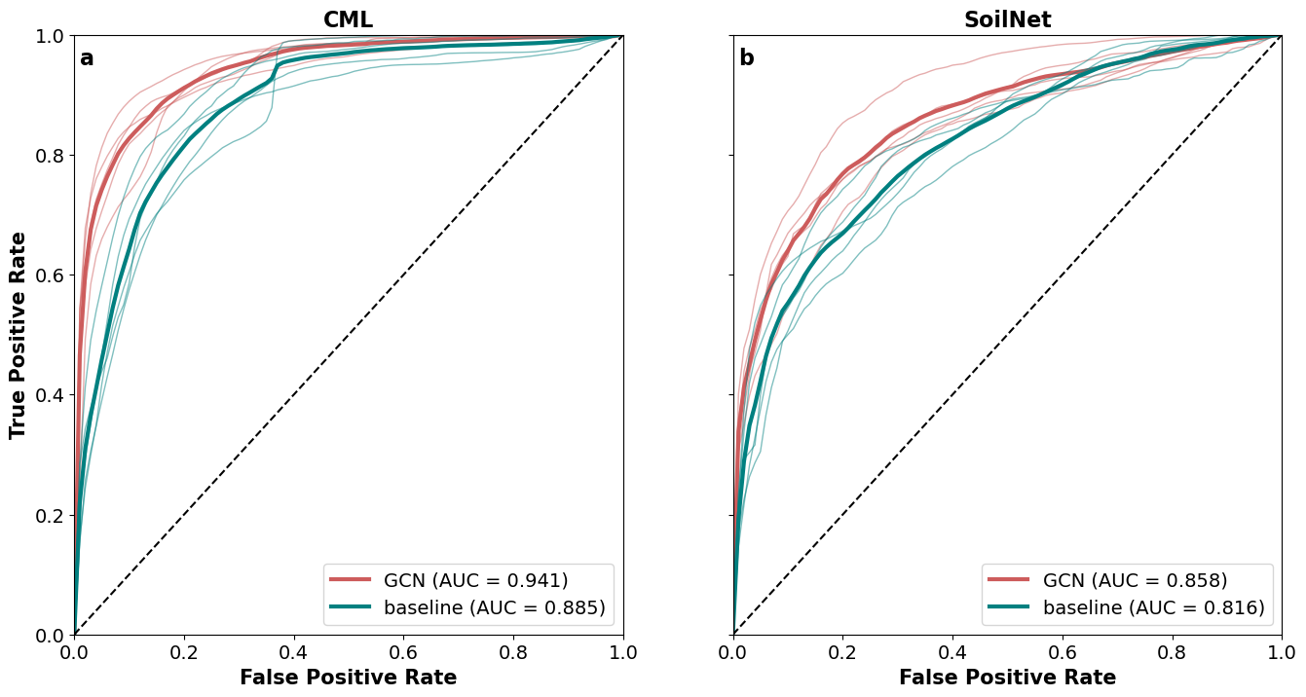
Summary & conclusions
robust evaluation using 5-fold CV consistently demonstrates superior performance of GCN over baseline models with a mean AUC of 0.941 compared to 0.885 for CML and 0.858 compared to 0.816 for SoilNet, demonstrating the significance of using neighbors information
inconsistent labeling and data quality issues in SoilNet underscore the need for rigorous data verification and QC protocols
application of GCN for anomaly detection in multiple, irregularly distributed environmental sensor, using CML and SoilNet datasets

Slide 11
Do you want to know more? Preprint available on EarthArXiv!
Lasota, E., Houben, T., Polz, J., Schmidt, L., Glawion, L., Schäfer, D., Bumberger, J., Chwala, C. (2024). Interpretable Quality Control of Sparsely Distributed Environmental Sensor Networks Using Graph Neural Networks.
https://doi.org/10.31223/X5WT3W

Slide 12
THANK YOU FOR YOUR ATTENTION!
Comments and questions are most welcome!
elzbieta.lasota@kit.edu

