Slide 1
Is there an end to deep learning for weather and climate?
The HClimRep project
Martin Schultz, JSC Forschungszentrum Jülich and University of Cologne
HAICON, Düsseldorf, 12 June 2024

Slide 2
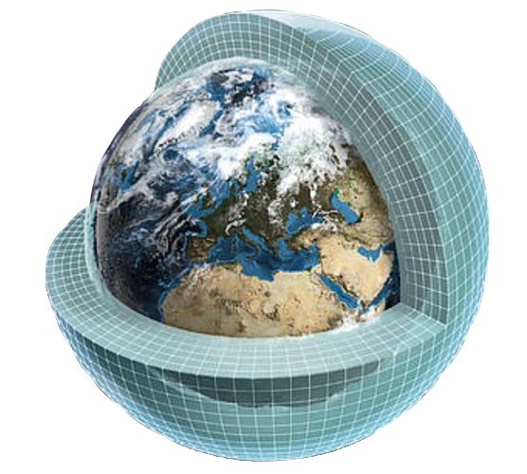
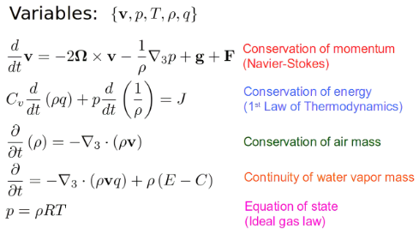
Traditional Earth System Modelling
Bildquelle

Slide 3
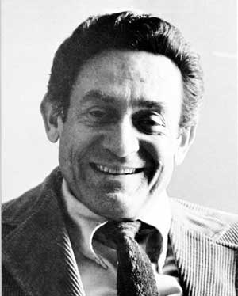
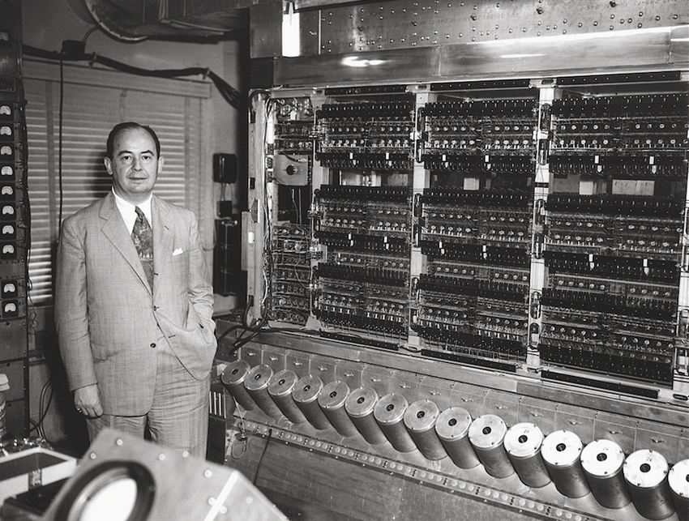
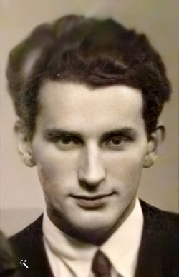
First successful numerical weather forecast
Jule Gregory Charney
Bild: WMO
Bild nach: https://de.slideshare.net/AbdulKarim141/01-introduction-to-meterology-and-weather-forecasting
John von Neumann
Ragnar Fjørtoft

Slide 4
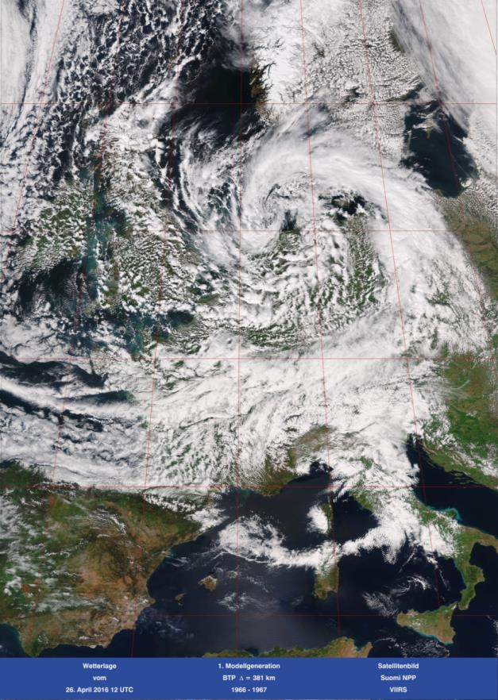
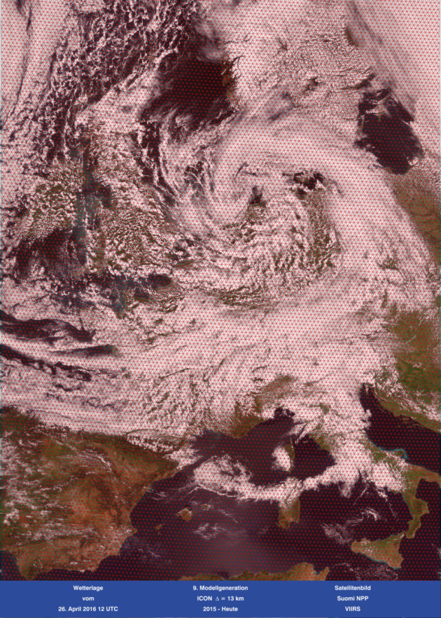
Progress in numerical weather forecasts
3 - 4 grid cells over Germany, 1 vertical layer
~ 2000 grid cells iver Germany, 90 vertical layers
Zuwachs an Rechenleistung:
1967 : 0,7 Mflops
1976 : 130 Mflops (Cray-1)
1990 : 23 Gflops (NEC)
2002 : 36 Tflops (NEC)
2009 : 1 Pflops (JUGENE)
2021*: 73 Pflops (JUWELS Booster)
2025*: > 1 Eflops (JUPITER)
* Accelerator technology (GPUs)
Bremen
Bremen
1966
2016
Jülich
Jülich
Current resolution of the DWD weather models: global = 13 km, regional = 2,1 km

Slide 5
Revolutions in weather forecasting
First successful numerical weather prediction
1950
1960-2010
2005-2025

Slide 6
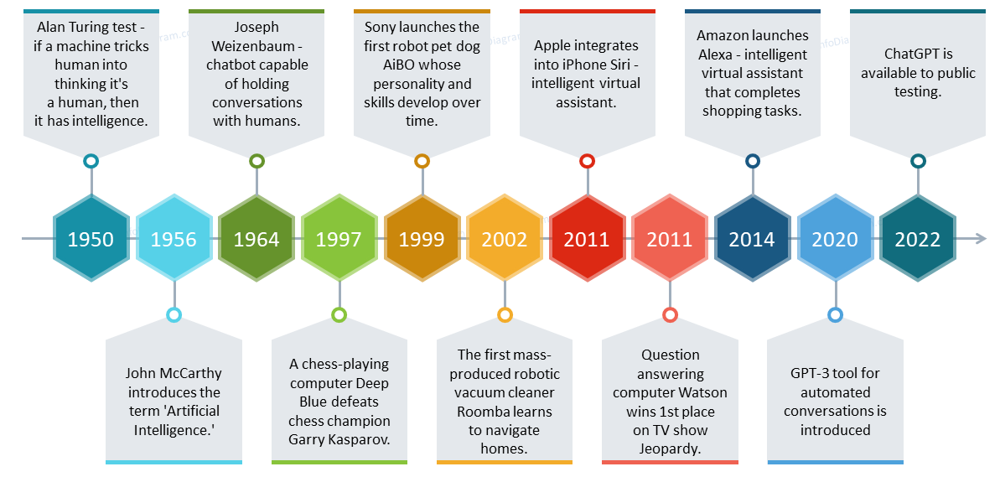
A brief history of AI
First attempt of a neural network weather model (2018)
First successful numerical weather forecast
NVIDIA V100 GPU (2017)
First AI weather forecast surpasses operational model
First gigascale computer (1972)
First terascale computer (1992)
First petascale computer (2008)
1943
2023
McCulloch and Pitts describe artificial neuron
ECMWF runs AI weather forecasts operationally
Adapted from https://www.infodiagram.com

Slide 7
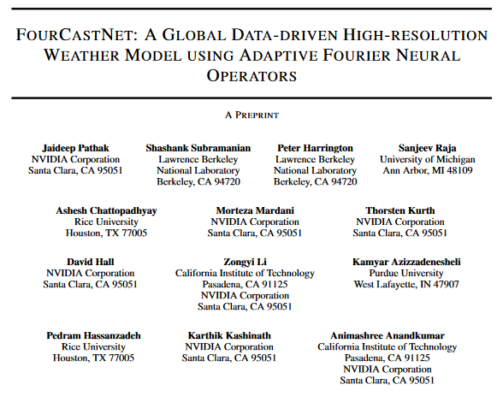
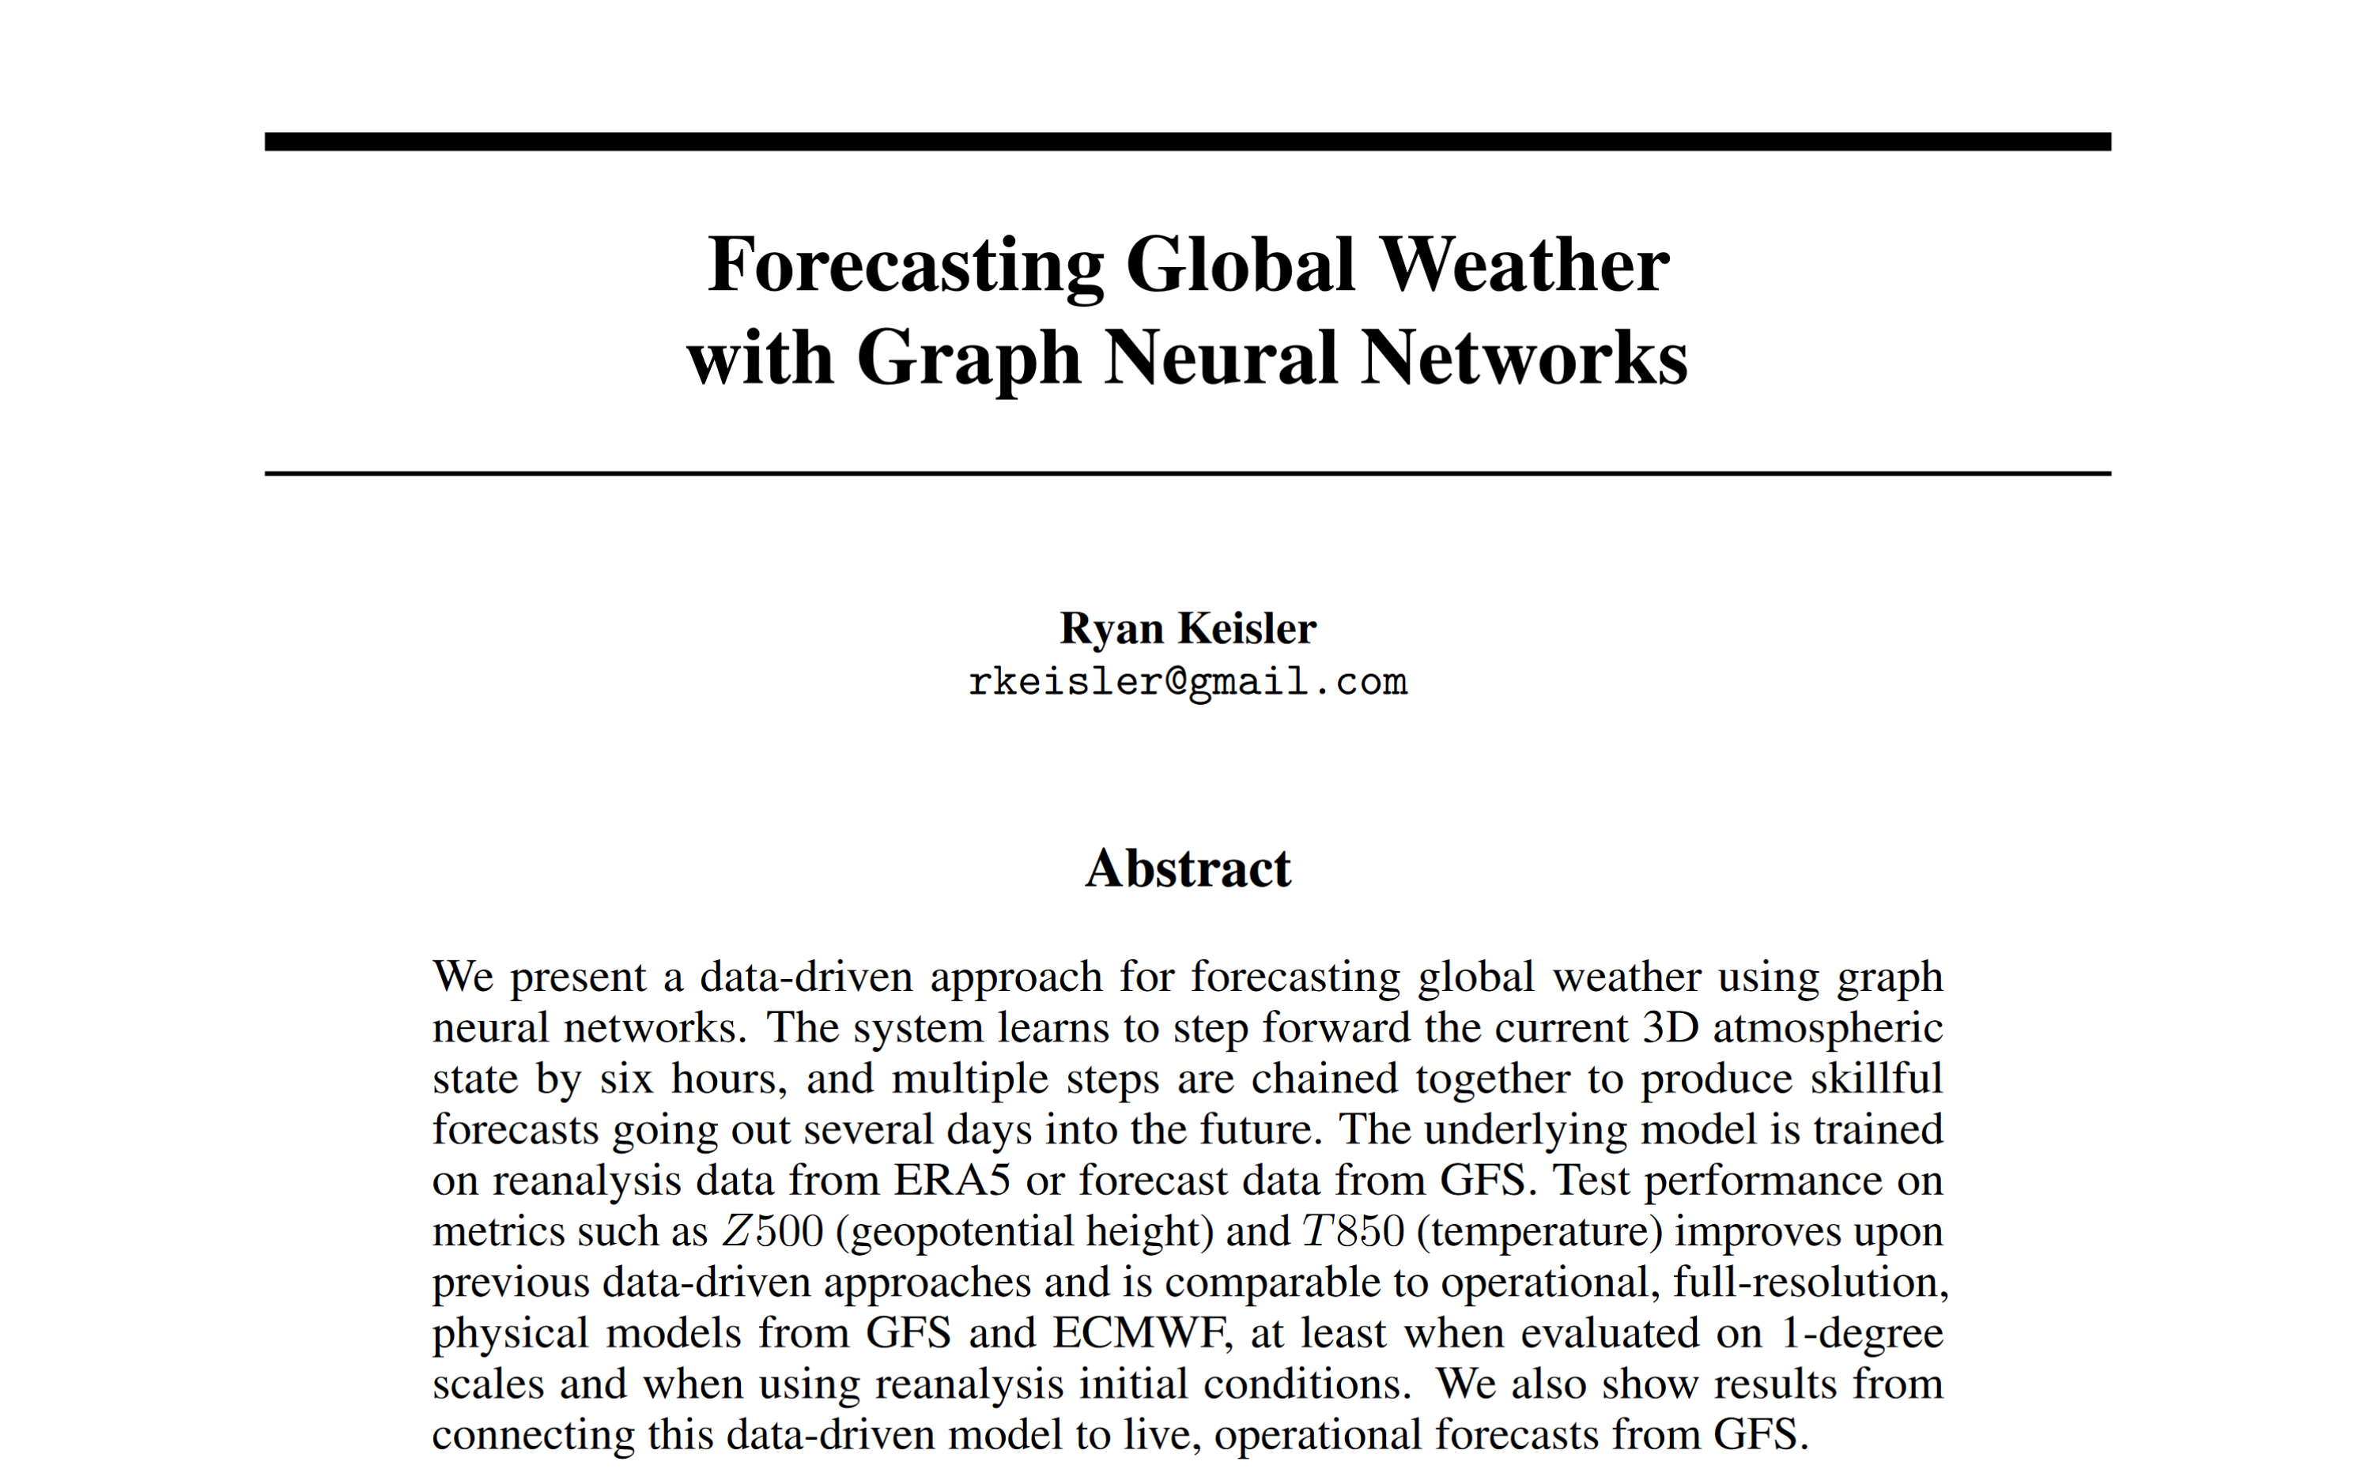
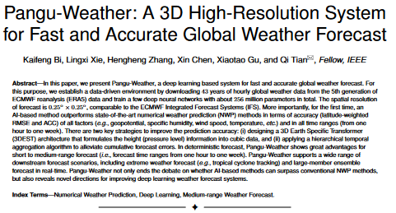
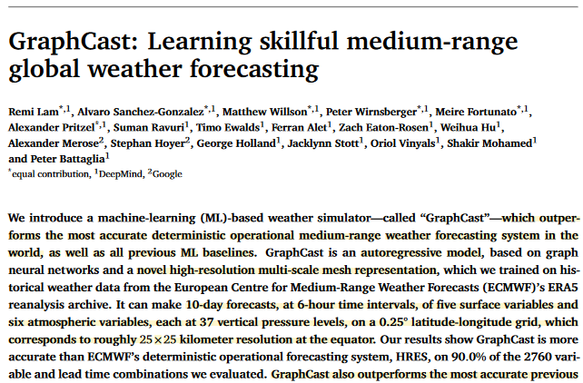
Revolutions in weather forecasting
First successful numerical weather prediction
1950
1960-2010
2005-2025
The AI revolution in weather and climate modeling
…
2022-

Slide 8
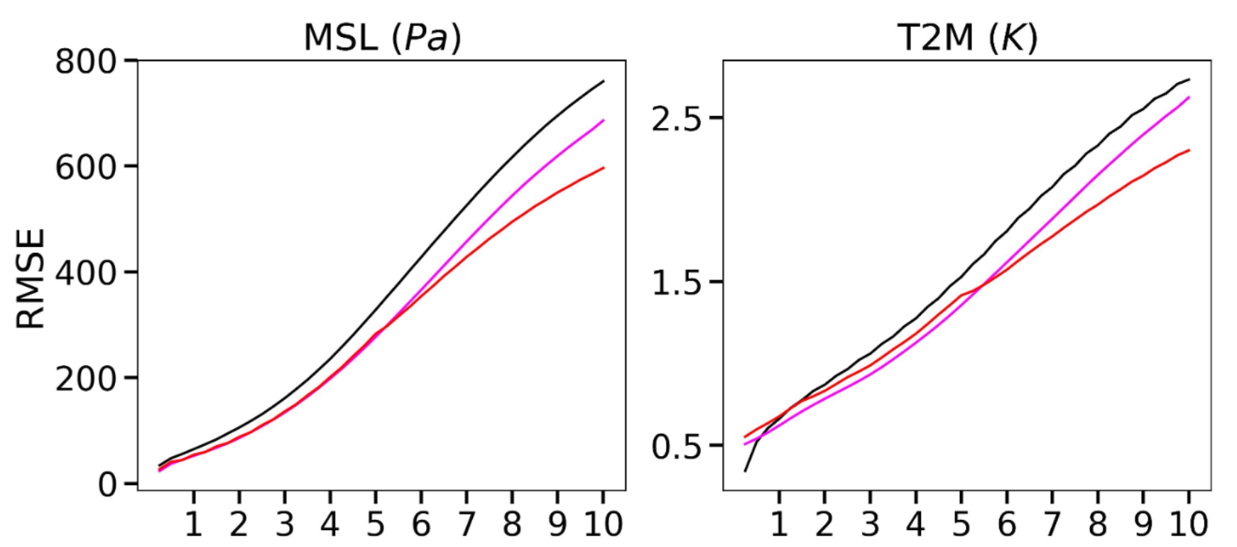
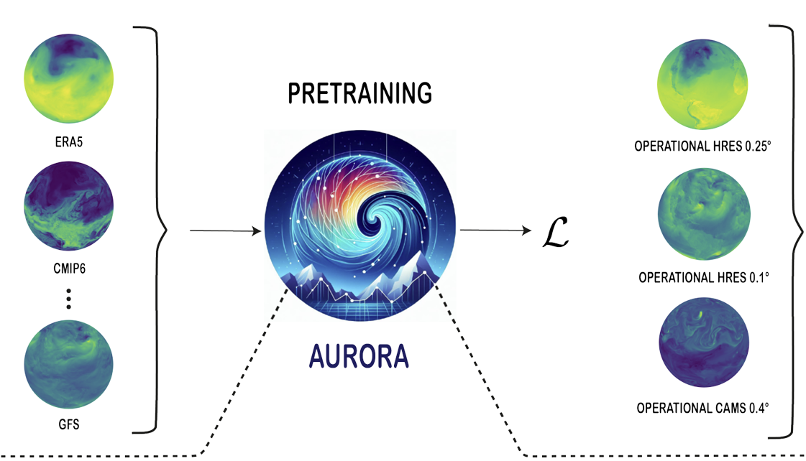
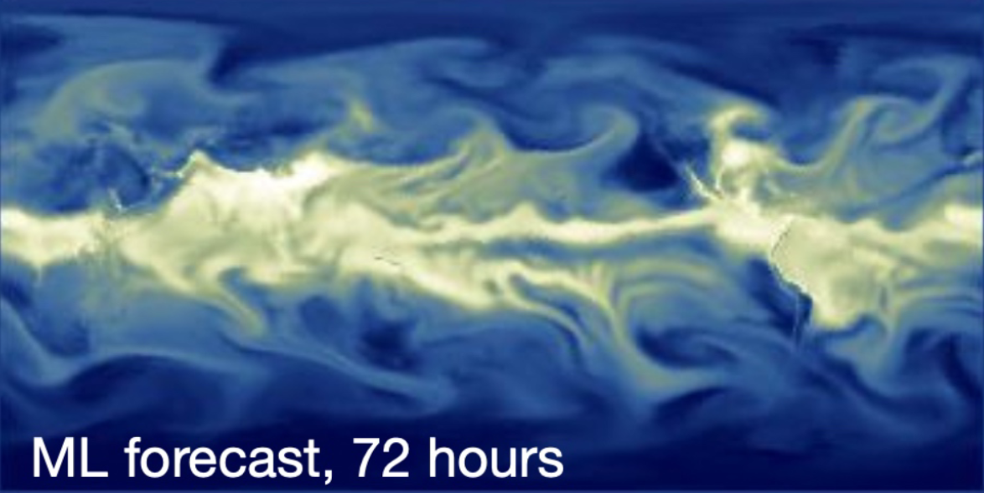
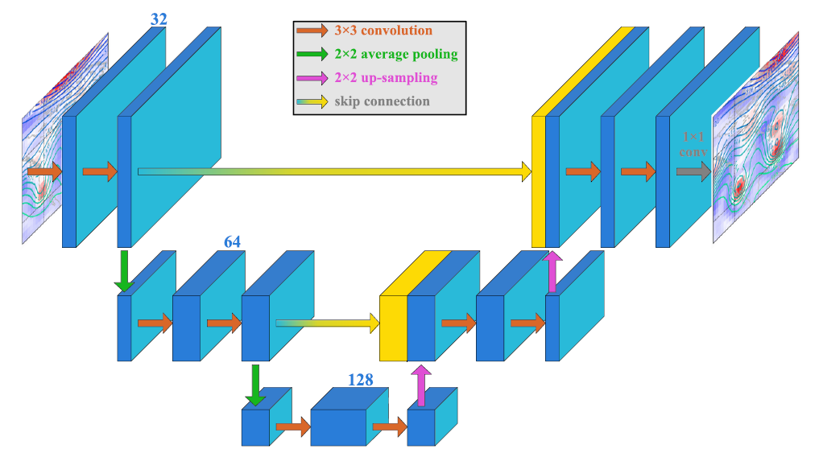
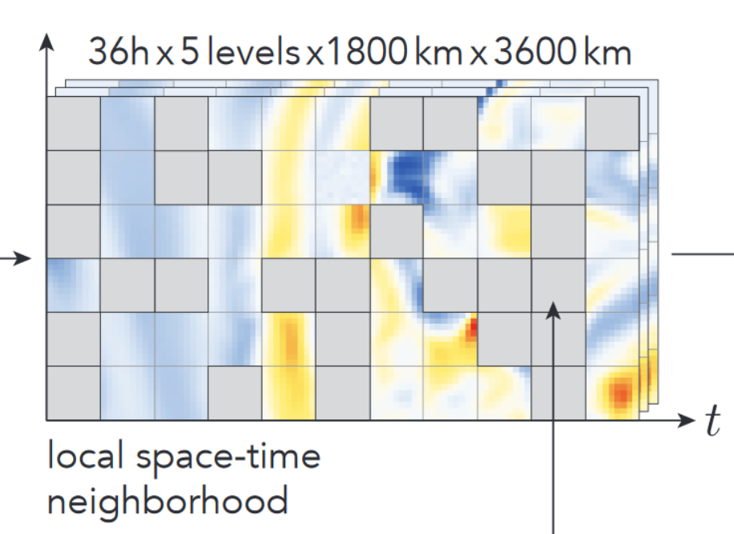
The AI revolution for weather and climate
Forecast time (days)
Chen et al.: FuXi
Keisler: Graph neural network
Pathak et al.: Fourcastnet
Bi et al.: Pangu Weather
Lam et al.: Graphcast
Bodnar et al.: Aurora
Düben and Bauer: first successful pure ML weather forecast; one field, simple FFN with 4 layers
Weyn et al.: U-net, global forecast at 2° resolution, long rollout
Lessig et al.: AtmoRep
Nguyen et al.: ClimaX
2018
2019
2020
2021
2022
2023
2024
only end-to-end models

Slide 9
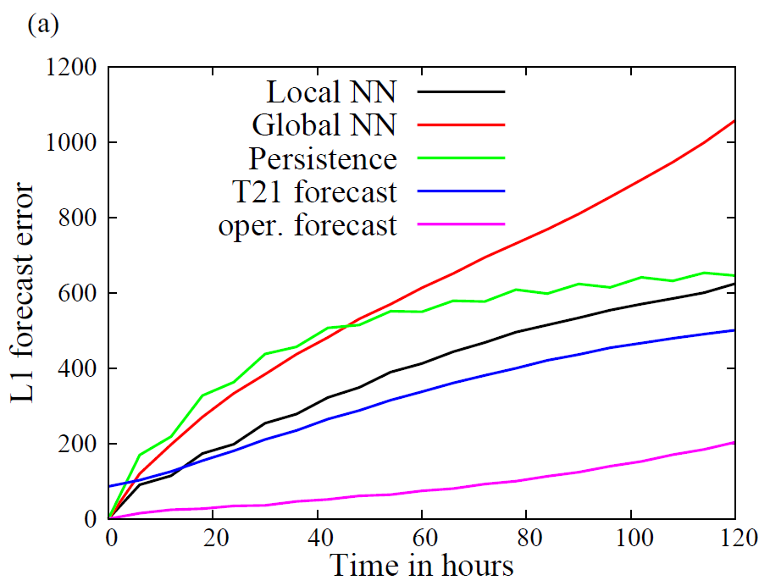
A few milestones on the path to AI weather forecasts
2018: First trial of a pure ML model: FNN with 4 layers
Input: hourly Z500, 1 pressure level, 1860 grid points (6° resolution), 67200 snap shots 2010—2017
Output: Z500 up to 120 hours ahead (autoregressive rollout)
Model error
Düben and Bauer (GMD, 2018)

Slide 10
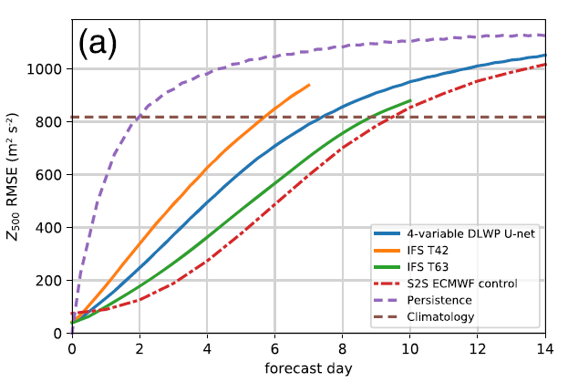
A few milestones on the path to AI weather forecasts
2020: global forecasts up to 14 days with a U-net, 11 Conv2D layers
Input: 4 variables: Z₅₀₀, Z₁₀₀₀, τ₃₀₀₋₇₀₀, T_{2m}, 6-hourly data, 1917-2012 (100,000 samples), 2° horizontal resolution
Output: 4 variables, 6-hourly for t+6 and t+12
Model error (RMSE)
Weyn et al. (JAMES, 2020)

Slide 11
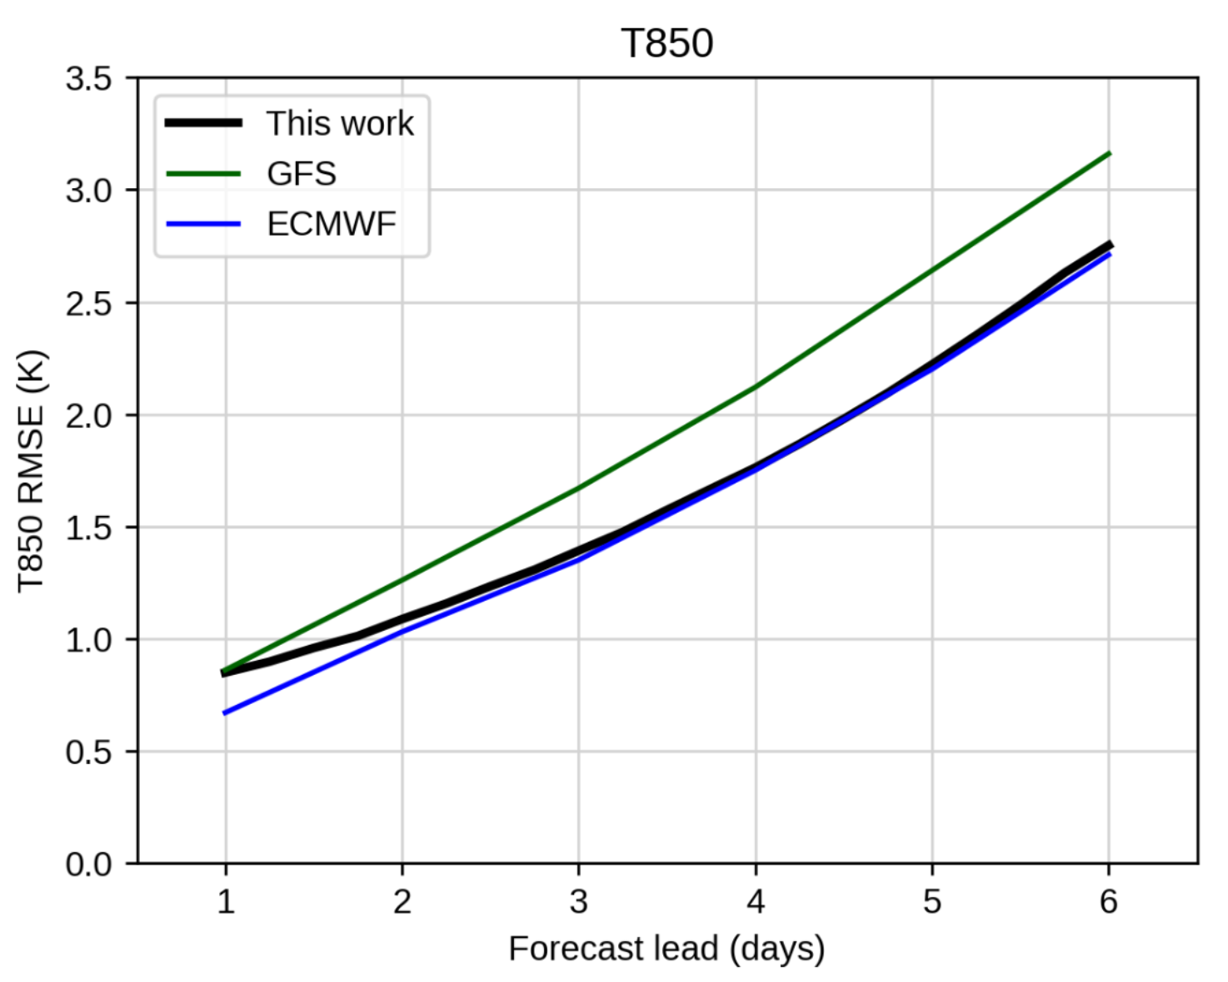
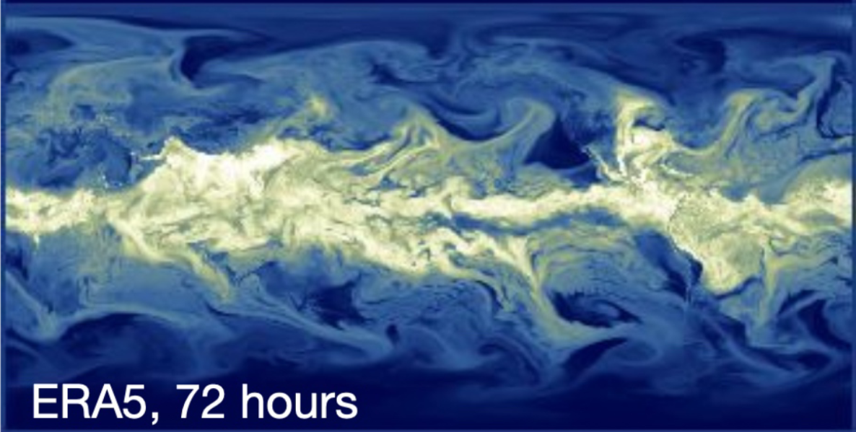
A few milestones on the path to AI weather forecasts
2022: Global forecasts at 1° resolution, 6 variables at 13 pressure levels, Graph Neural Network on icosahedric grid
Model error
Keisler (Arxiv, 2022)

Slide 12
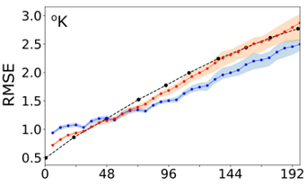
A few milestones on the path to AI weather forecasts
2022: Global forecasts at 0.25 ° resolution, 20 variables at 5 pressure levels, Transformer + Fourier Neural Operators
Model error
T2m
Pathak et al. (2022): Fourcastnet

Slide 13
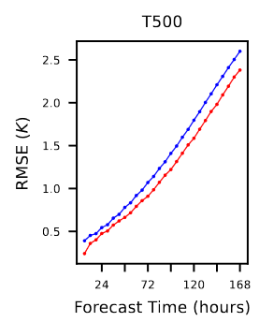
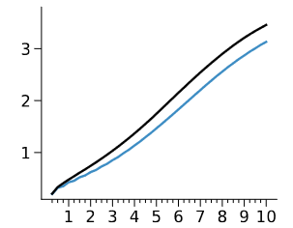
A few milestones on the path to AI weather forecasts
2022/23: The breakthrough – DL models outperform IFS HRES
Model error
RMSE (K)
Forecast time (days)
Forecast time (days)
Bi et al. (2022): Pangu-Weather
Lam et al. (2022): GraphCast
Chen et al. (2023): FuXi

Slide 14
Foundation model(s) for weather and climate
https://www.atmorep.org

Slide 16
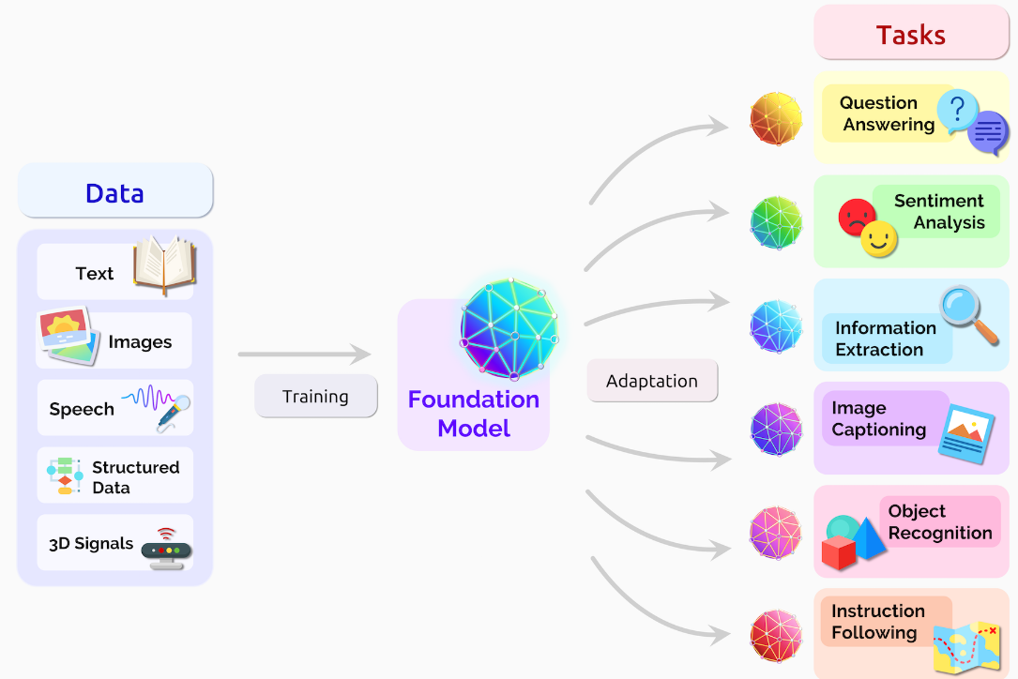
What is a foundation model?
Bommasani et al. (2021)

Slide 17
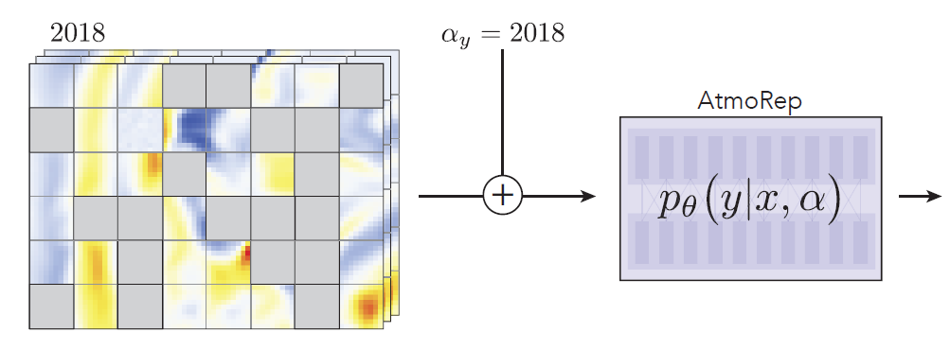
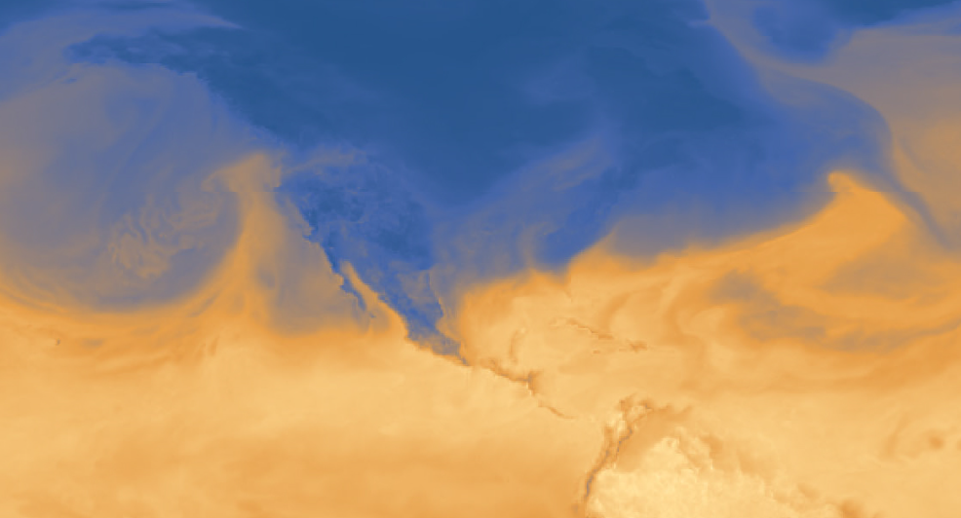
The AtmoRep concept
masked input
boundary conditions
„forecast“

Slide 19
This is a standard formulation for generative models (large language models, Dall-E, diffusion models)

Slide 20
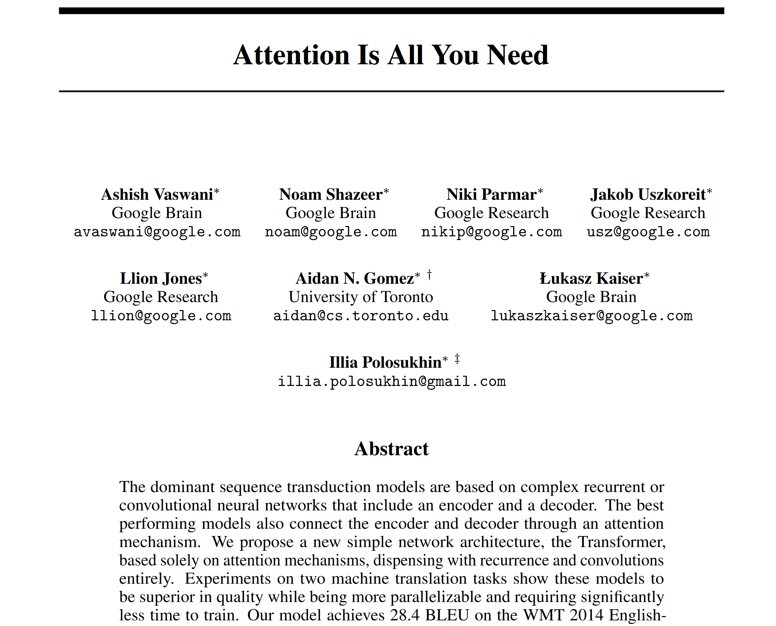
Vaswani et al., 2017

Slide 21
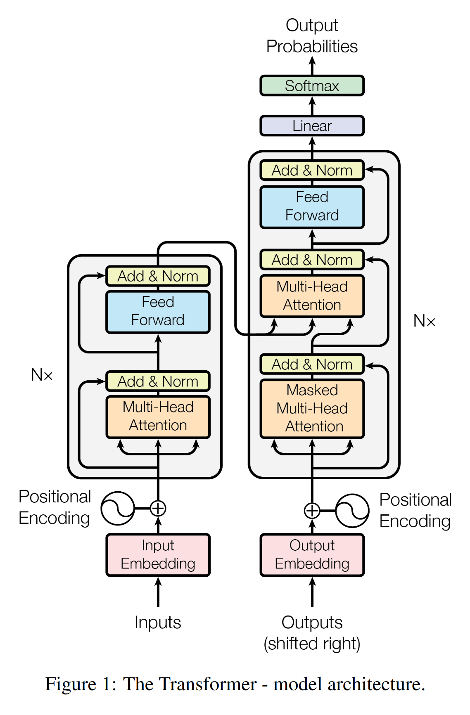
Vaswani et al., 2017

Slide 22
Embedding explained
Transformers: step 1
bicycle
train
Embedding translates information (words/tokens) into (unit) vectors in a high-dimensional space.
Goal: minimize distance between similar tokens and maximize distance between different tokens.
mountainbike
high-dimensional vector space (for example, N = 768)
chocolate
From and after https://jalammar.github.io/illustrated-bert/

Slide 23
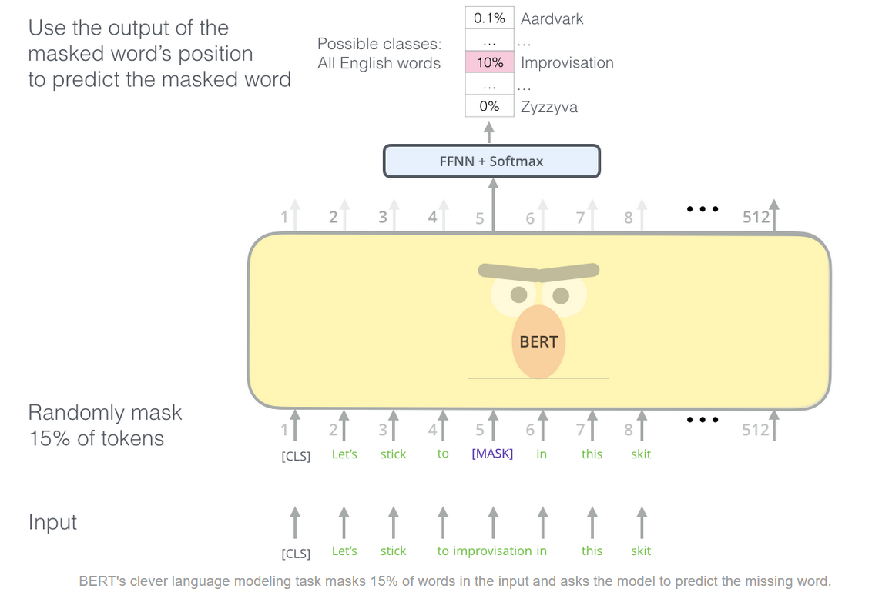
BERT masking
Transformers: step 2
Masking alone not sufficient:
Also use random words and re-insert the original tokens occasionally
From and after https://jalammar.github.io/illustrated-bert/

Slide 24
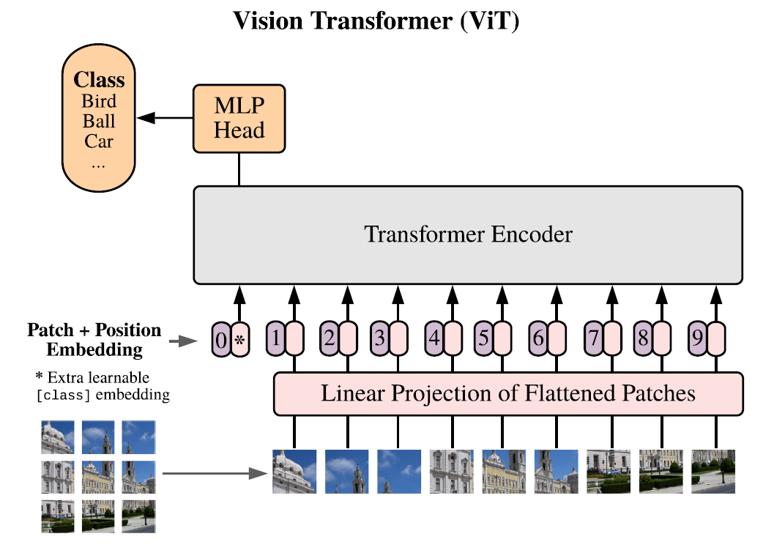
The vision transformer
Dosovitskiy et al., 2021 arXiv:2010.11929v2

Slide 25
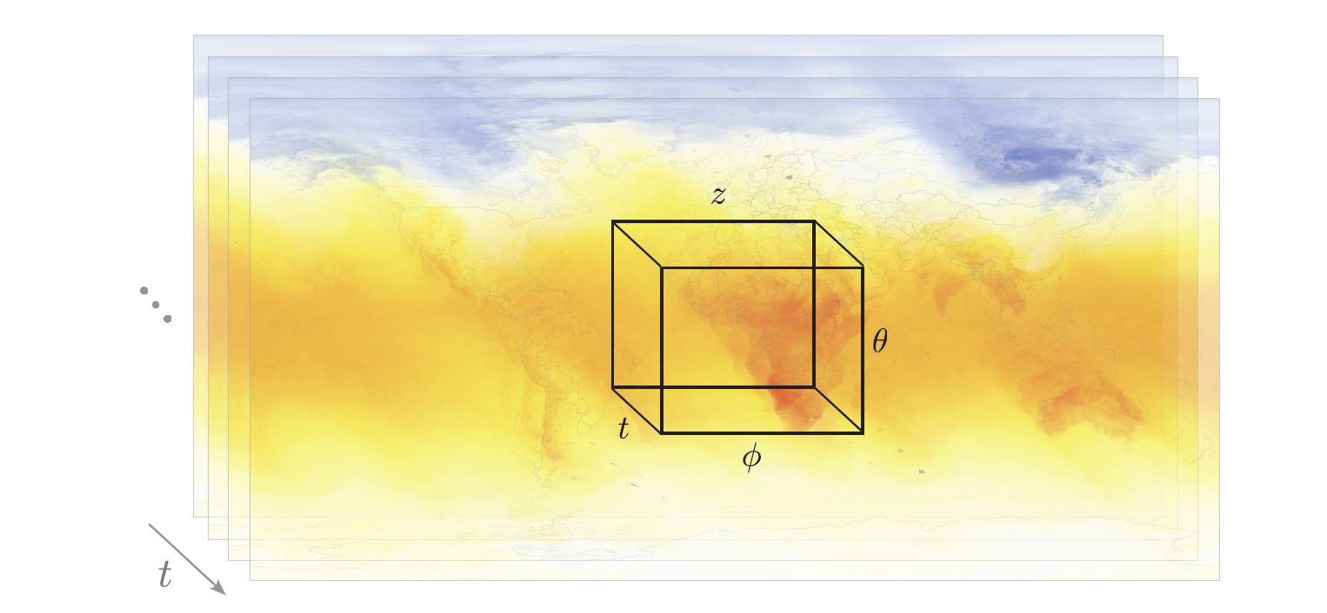
AtmoRep tokenisation
Unique concept: network is local in space and time, i.e. position and time are encoded as positional embeddings (→ memory efficient)
Figure C. Lessig

Slide 26
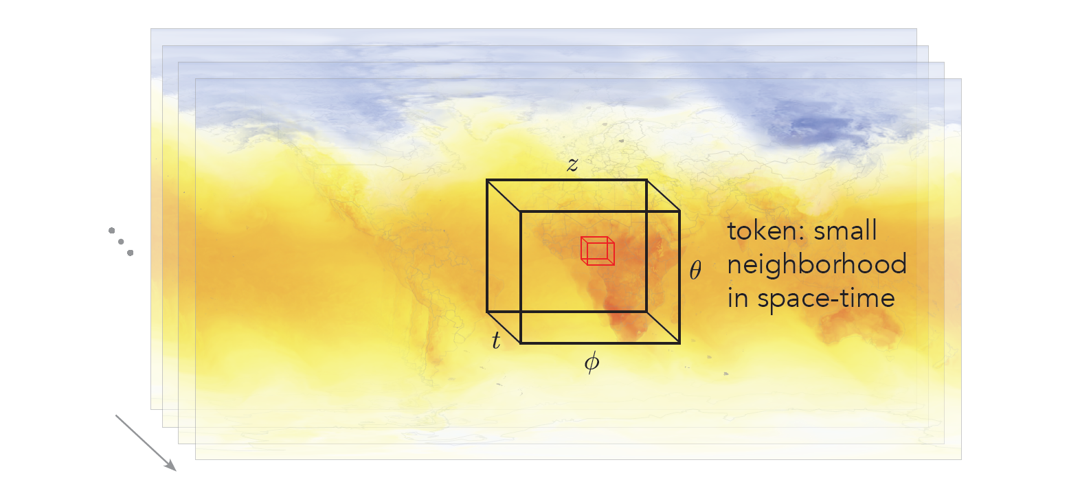
AtmoRep tokenisation
Unique concept: network is local in space and time, i.e. position and time are encoded as positional embeddings (→ memory efficient)
Figure C. Lessig

Slide 27
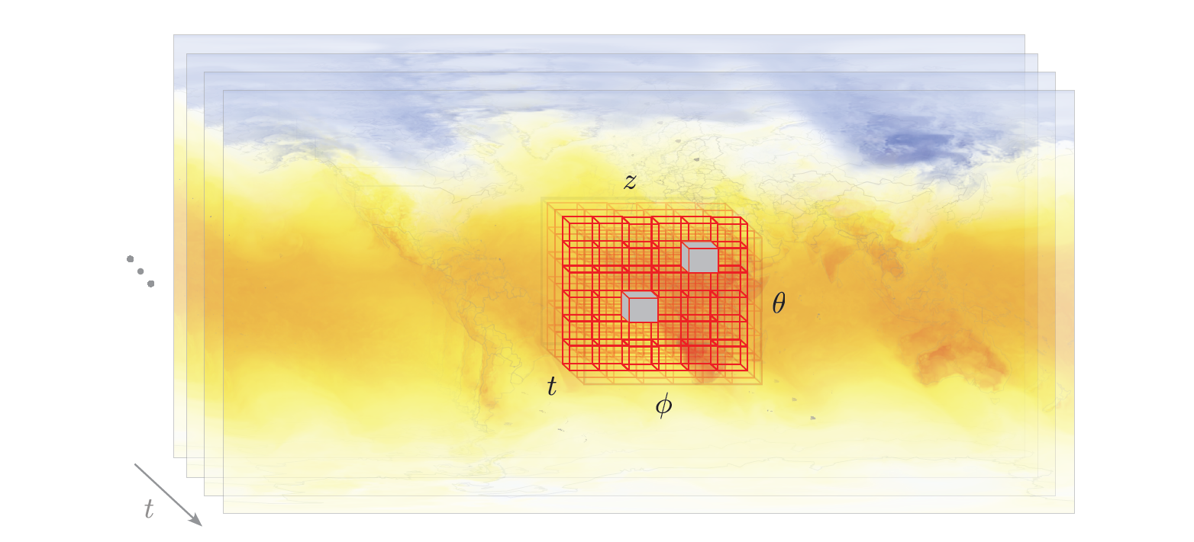
AtmoRep tokenisation
BERT-style masking
Unique concept: network is local in space and time, i.e. position and time are encoded as positional embeddings (→ memory efficient)
Figure C. Lessig

Slide 28
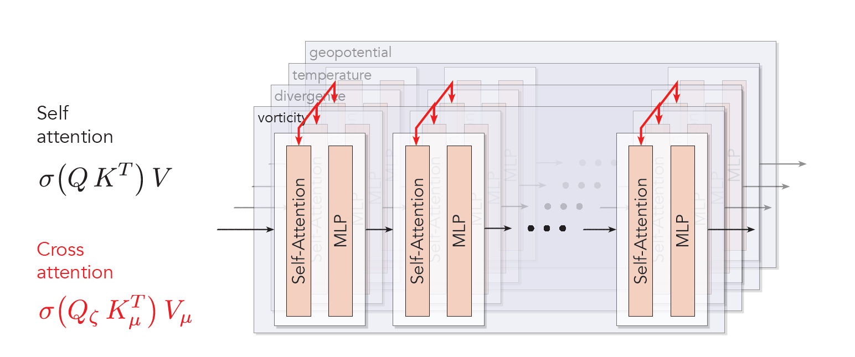
AtmoRep: the multiformer concept (coupling of variables)
Unique concept: multiformer architecture allows for flexible coupling/decoupling of variables
Figure C. Lessig

Slide 29
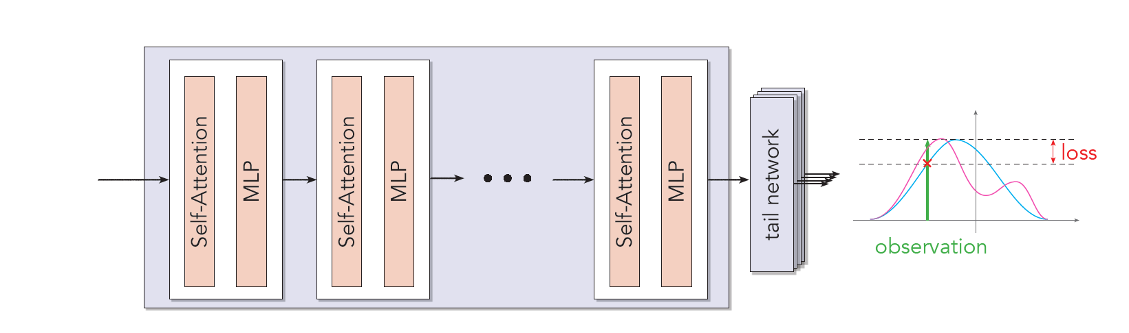
AtmoRep: statistical loss function
predicted distribution
Gaussian fit of distribution
Unique concept: statistical ensemble as intrinsic feature of the network
Figure C. Lessig

Slide 30
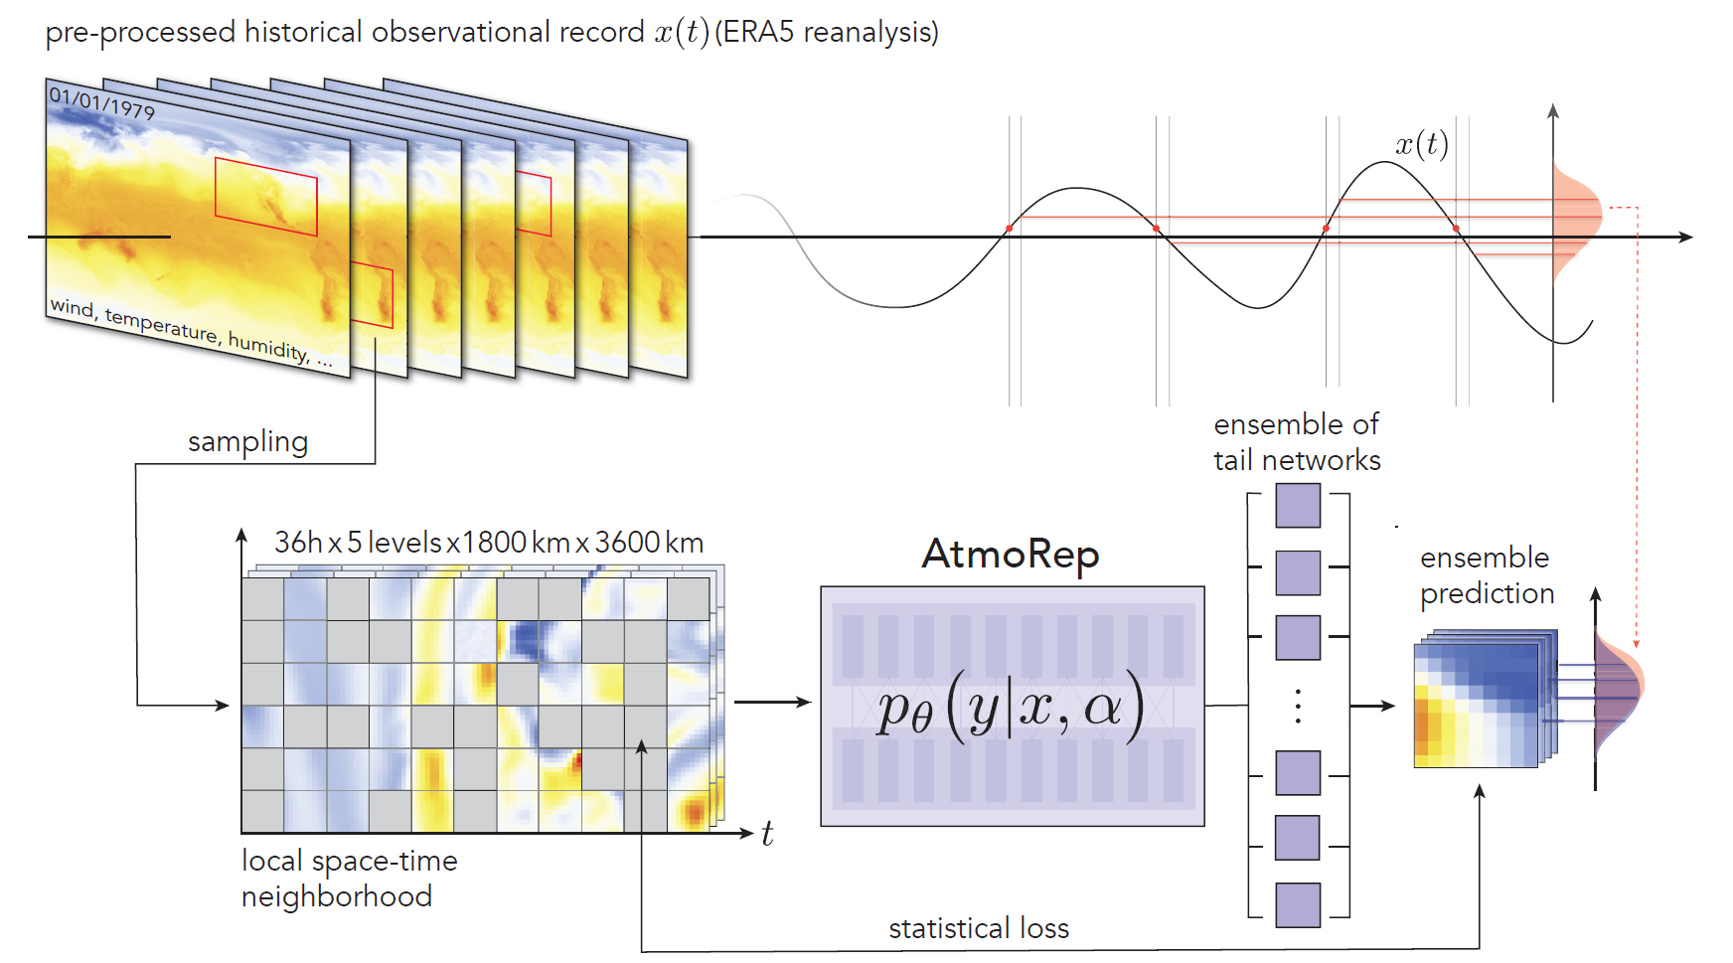
AtmoRep: summary of concept
Lessig et al., 2023

Slide 31
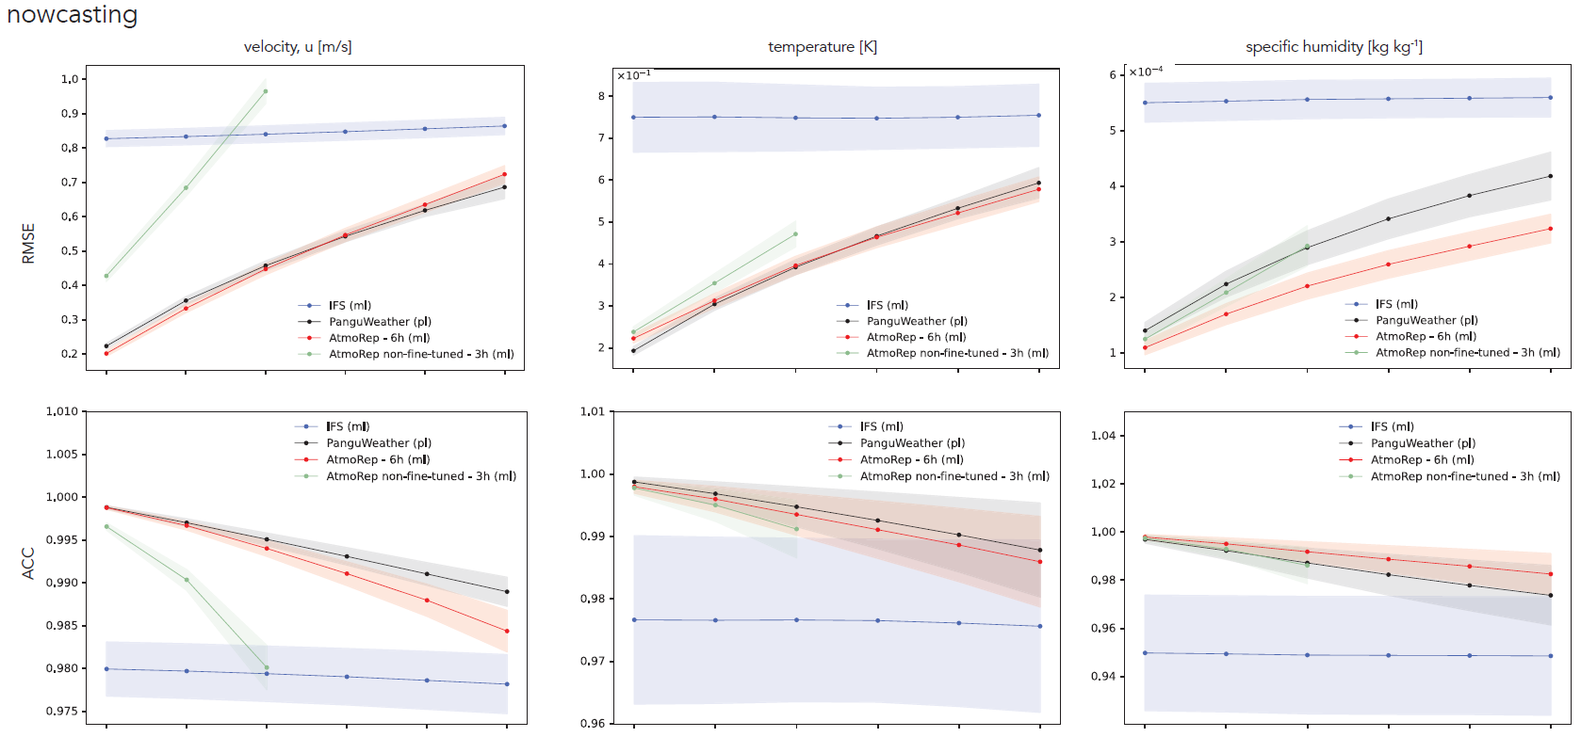
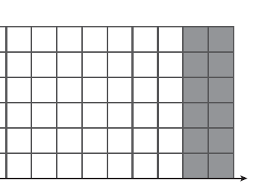
AtmoRep: zero-shot capabilities for nowcasting
past
future
x
t
Lessig et al., 2023

Slide 32
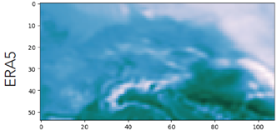
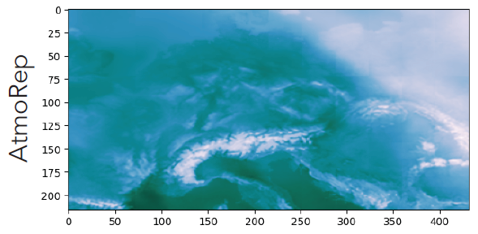
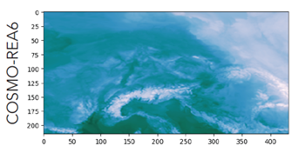
AtmoRep: applications
Statistical downscaling example
Input: low res.
(Short-term) forecasting
Statistical downscaling
Model bias correction
Model output compression
Data assimilation
Gap filling
Ensemble generation
Process emulation
…
Output: high res.
Target: high res.
Lessig et al., 2023

Slide 33
AtmoRep: Fine-tuning: downscaling of 2-metre temperature (~25 km → 6 km)
Input: low res.
Output: high res.
Target: high res.
Dynamical downscaling = super resolution + bias correction
AtmoRep better than Stengl et al., 2022 (SOTA)

Slide 34
HClimRep Helmholtz Representation Model for Climate Science
Forschungszentrum Jülich, Martin Schultz*
Alfred-Wegener-Institut, Thomas Jung
KIT, Peter Braesicke
Hereon, David Greenberg
* Presenting PI

Slide 35
HClimRep: Helmholtz Foundation Model for Climate Science
Project description
First Earth system foundation model, including the lower atmosphere, stratosphere, ocean, sea ice and hydrology.
Reliable (fast and energy-efficient) seasonal-to-decadal AI-based simulations
First climate-capable foundation model, incorporating multiple grids and resolutions, atmosphere-ocean-sea ice coupling, and a wide range of available data
Generalization across tasks as a fundamental design principle, with support for prediction, data assimilation, uncertainty quantification and counterfactual scenarios
Extrapolation capabilities will be investigated by examining correlations between coarse-scale weather variables and fine-scale variables in the present day and simulated future climates (focus on hydrology)
3 targeted downstream applications to demonstrate the capabilities and potential of HClimRep for future climate research and services, in addition to selected applications from Lessig et al. (2023).

Slide 36
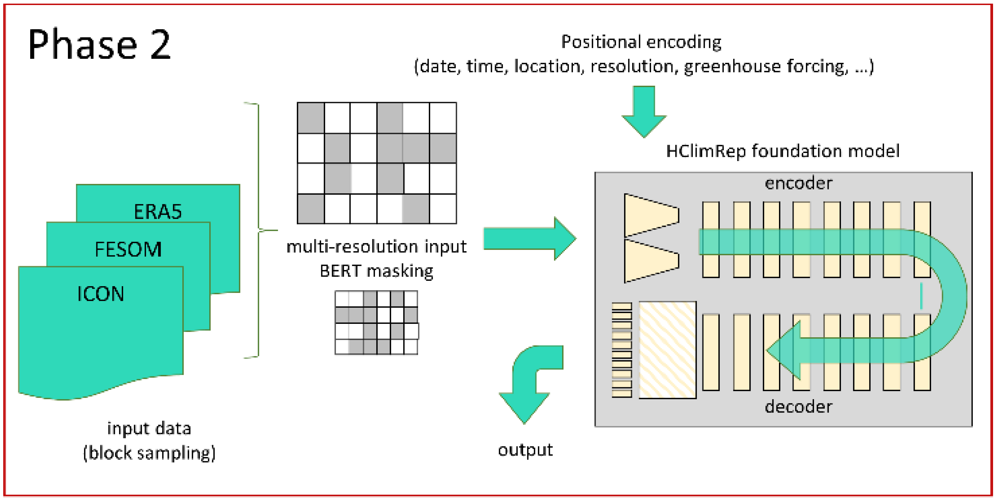
HClimRep: Helmholtz Representation Model for Climate Science
Model architecture and algorithms
HClimRep builds on existing foundation model AtmoRep (Lessig et al., 2023)
It will allow for multi-model and multi-resolution inputs
Basic architecture is a transformer encoder-decoder stack with 4D tokens
Linear tail networks allow sampling of distributions + novel stochastic loss → uncertainty quantification
Training strategy derived from BERT; training with autoregressive rollouts, conservation laws and symmetries for long-term stability
Phase 1: extend existing AtmoRep
Phase 2: build new HClimRep model

Slide 37
HClimRep in the European context
WestAI, BMBF: 2023--2026
Warmworld (Easier and Smarter), BMBF: 2024—2027
RAINA, BMBF: 2024—2027 (?)
WeatherGenerator, EU: 2025—2028 (??)

Slide 38
AtmoRep: Current developments
Extend from nowcasting to medium range weather forecasts (Christian and Ilaria)
Test direct use of observations (includes flexible tokens; Christian and Ilaria)
Further develop/improve downscaling (Michael, Ankit, and Erik)
AtmoRep as model output compressor (Asma)
First steps towards a foundation climate model (HFMI)

Slide 39
Discussion

Slide 40
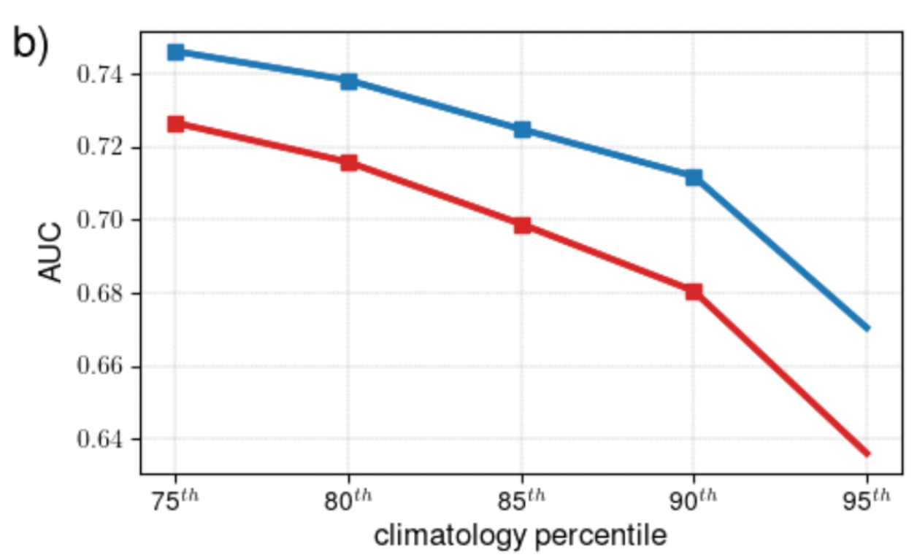
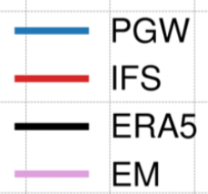
Limitations of DL weather models
2022/23: The breakthrough – DL models outperform IFS HRES; but are they really better?
T2m extremes Europe, summer 2022
Ben-Bouallegue et al. (Arxiv, 2023)

Slide 41
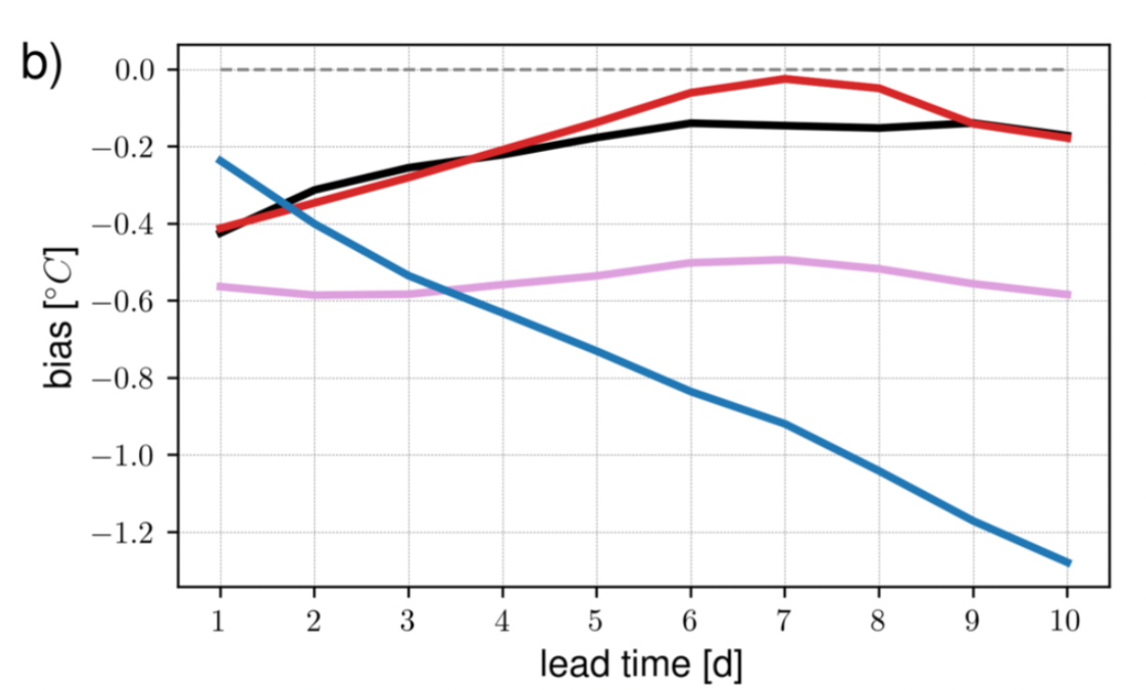
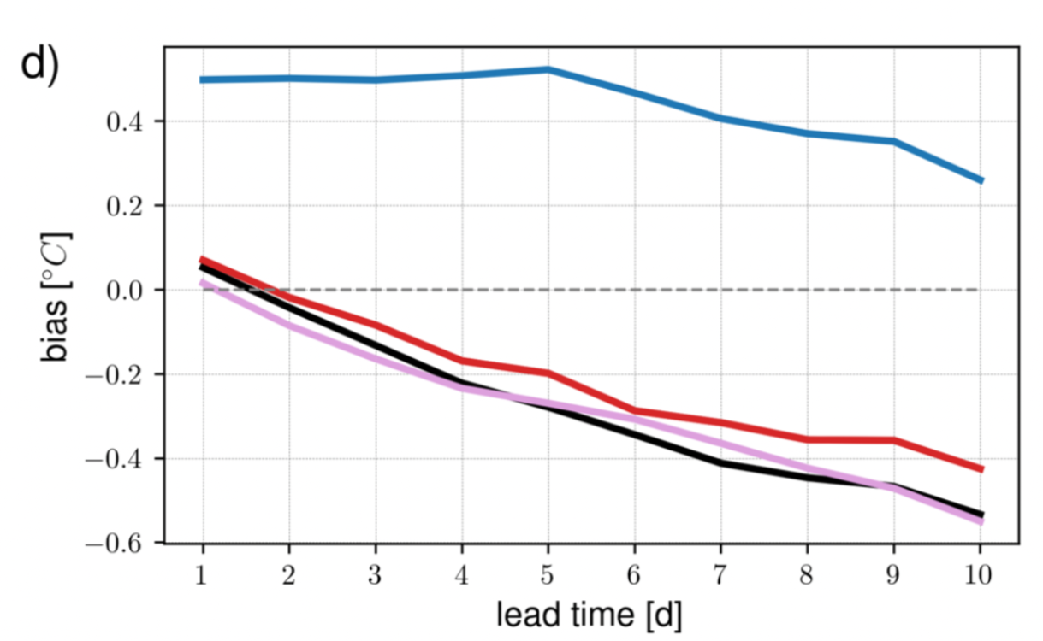
Limitations of DL weather models
2022/23: The breakthrough – DL models outperform IFS HRES; but are they really better?
T2m Europe, summer 2022
T2m Europe, winter 2022/23
Ben-Bouallegue et al. (Arxiv, 2023)

Slide 42
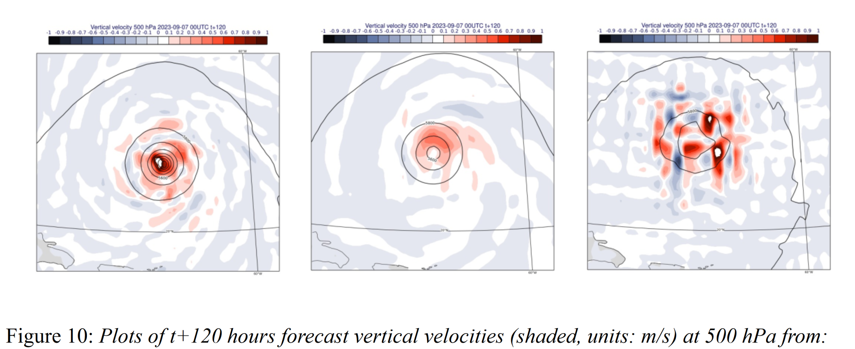
Limitations of DL weather models
IFS-HRES
ERA5
PanguWeather
Bonavita, 2024

Slide 43
DNN stability and robustness
„However, for the local networks that use the special treatment of the area around the pole, as discussed in the previous section, the forecast error diverges for the 7×7 and the 9×9 configuration. […likely that this can be fixed…]“ (Düben and Bauer, 2018)
„Every one of the 4-week forecasts initialized twice weekly in the 2-year test set (210 total forecasts) was free from instabilities and the amplification of spurious perturbations.“ (Weyn et al., 2020)
„Moreover, the similarities in error growth of a data-driven forecast and a standard NWP forecast indicate similar sensitivities to chaos between ML-based and physically-based models.“ (Ben Bouallegue et al., 2023)
„More generally, the discussion above and the results presented here highlight one of the main challenges for the next generation of data-driven ML prediction models, namely, how to produce forecasts that are skilful and at the same time dynamically and physically consistent at all relevant spatial scales.“ (Bonavita, 2024)

Slide 44
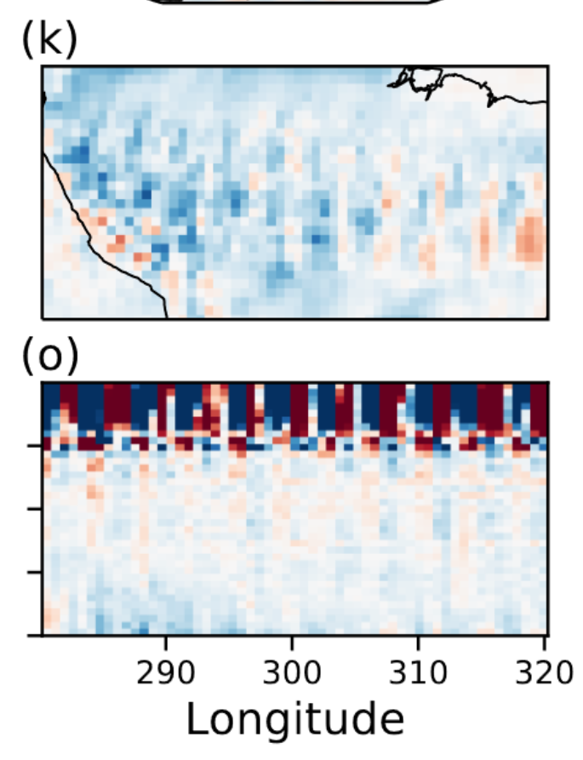
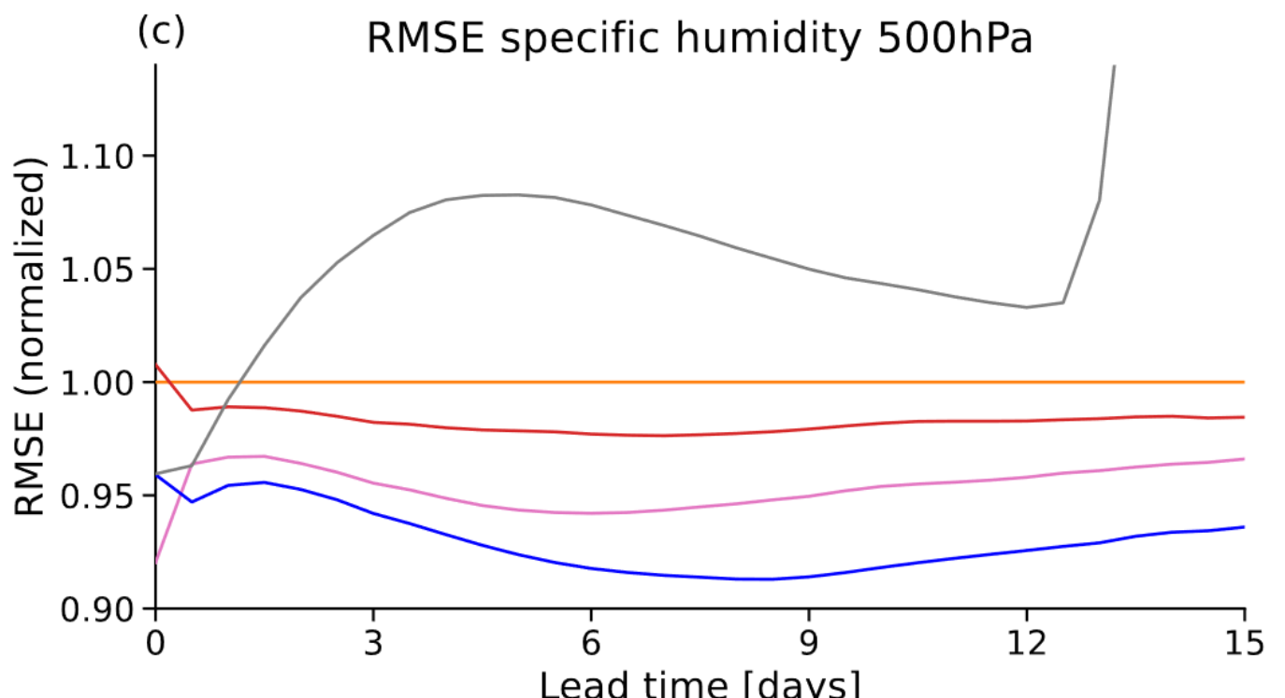
Long-term rollout
Weyn et al. (2020): up to 1 year
Watt-Meyer et al. (2023) [ACE]: up to 100 years
Kochkov et al. (2024) [NeuralGCM]: up to 40 years (22 out of 37 runs stable)
Case study on temperature instability NeuralGCM;
after 139 days
Training: 12-hour rollout
Training: 5-days rollout
Kochkov et al. (Arxiv, 2024)
Kochkov et al. (Arxiv, 2024)

Slide 45
Climate time scales; NeuralGCM
High quality deterministic forecasts up to 10 days, probabilistic forecasts up to 15 days, and stable „weather“ on century time scales
Kochkov et al. (Arxiv, 2024)

Slide 46
Climate time scales: Neural GCM achieves reduced bias in climate predictions
850 hPa temperature bias averaged 1981-2014
Worst of 22 Neural GCM simulations
Best of 22 CMIP6 GCM simulations
Kochkov et al. (Arxiv, 2024)

Slide 47
Bluriness
„The data-driven forecast appears smoother than the operational IFS forecast but the level of smoothness does not seem to increase with the forecast lead time, as we might expect when training toward RMSE.“ (Ben Bouallegue et al., 2023)
Specific humidity, 700 hPa, t+10 days
IFS HRES (0.1°)
NeuralGCM (0.7°)
Graphcast (0.25°)
Kochkov et al. (Arxiv, 2024)

Slide 48
Ensemble modelling
Classical approach: perturb initial conditions and parametrisations (also adopted by FuXi)
Deep learning: Use generative models
Example: AtmoRep (Lessig et al., 2023) → talk by Ilaria Luise tomorrow
Inherent probabilistic formulation (and probabilistic loss)

Slide 49
Ensemble modelling
Google‘s Scalable Ensemble Envelope Diffusion Sampler (SEEDS)
GEFS-2
See also:
GEFS full
SEEDS GEE
SEEDS GPP
Carver et al. (Science, 2024)

Slide 50
Upper atmosphere more difficult? Or simply overlooked?
0.64 hPa
1000 hPa
Watt-Meyer et al. (Arxiv, 2023)

Slide 51
Challenges ahead
Direct use of observations (work in progress)
Climate scenarios (→ HFMI)
Multi-scale models (has been demonstrated → SEEDS)
Upper atmosphere and tracer transport (work initiated)
Earth system modeling: ocean, sea ice, land, biogeochemical cycles, atmospheric chemistry

Slide 52
Computational costs
„The computational cost of the model is negligible; it has a throughput of 256 ensemble members (at 2° resolution) per 3 min on Google Cloud TPUv3-32 instances and can easily scale to higher throughput by deploying more accelerators. […] Training [of the 114 mio parameter model] takes slightly less than 18 hours on a 2 × 2 × 4 TPUv4 cluster. “ (Carver et al., 2024)

Slide 53
Scaling laws?
FLOPS
… but: additional training improves performance! (Llama3; Karpathy posts on X)
„Chinchilla“ optimal training; Hoffmann et al. (Arxiv, 2021)

Slide 54
Training strategies (here: large language models)
From https://github.com/huggingface/large_language_model_training_playbook

Slide 55
Conclusions
AI models will become the standard tools for weather forecasting at all scales
AI models can produce excellent deterministic forecasts and quantify uncertainties well
Some models (all?) exhibit some physical inconsistencies; these can likely be healed
Larger models exhibit good robustness and (limited?) capabilities for extrapolation
Tendency towards very large foundation models less clear than in language area (scaling laws?)
Incorporating Earth system feedbacks on all time scales is probably the largest challenge ahead

Slide 56
Bonn, Germany, 29 – 30 August 2024
Registration open until 31 July (student rate until 15 June)

